Slide 1
Resolution
Notes:
1. Scale worksheet – small groups
2. Resolution introduced
3. Battleship Part 1 – 10 groups of 3; 1-4, 2-5, 3-6 Groups of 4 students too Large
4. Bread - How do we see inside
5. Battleship 2 – 3 dimensional slices
6. MIT article
Bread – How do we see inside

Slide 2
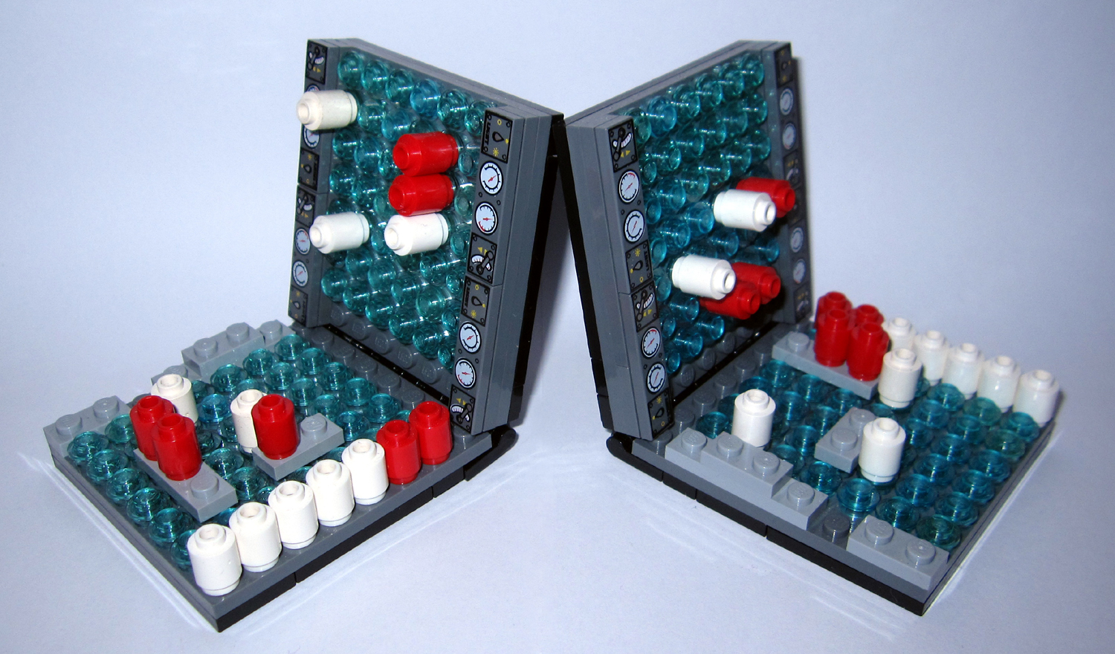

Slide 3
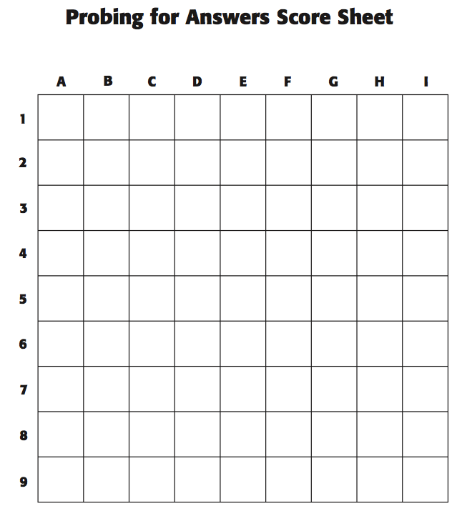

Slide 5
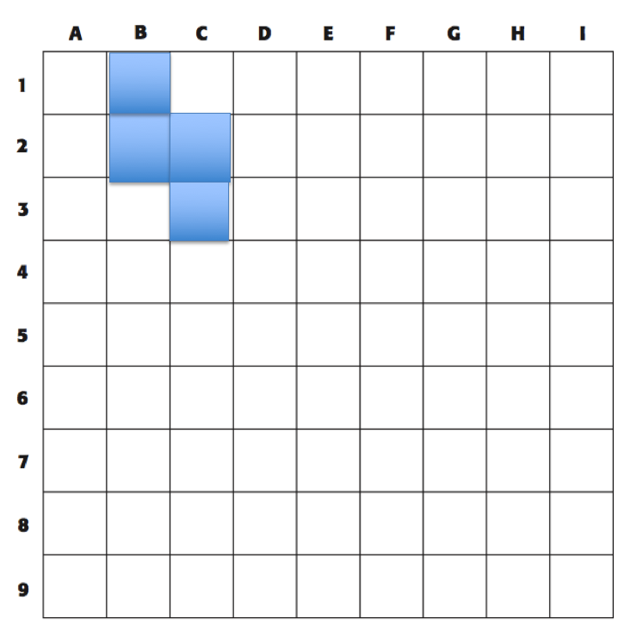
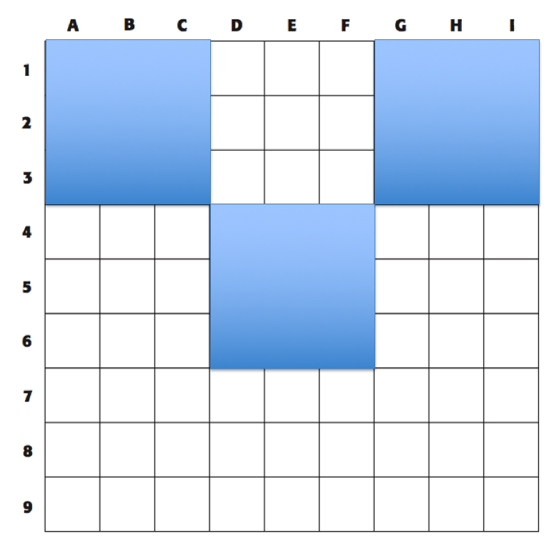
What is the difference in using different probes?

Slide 6
Resolution
A measure of the sharpness of an image or of the fineness with which a device (as a video display, printer or scanner) can produce or record such an image usually expressed as the total number or density of pixels in the image (example – a resolution of 1200 dots per inch)
The process or capability of making distinguishable the individual parts of an object

Slide 7
Different probes for different resolution
Visible light 4 to 7 x 10⁻⁷ m
Cell, bacterium, miitochondrion, virus
Electrons 2.7 to 0.9 x 10 ⁻¹⁰ m
Protein, large molecule (Glucose)
X-rays 1 x 10 ⁻⁸ to 1 x 10 ⁻¹¹ m
H₂O molecule

