Slide 1
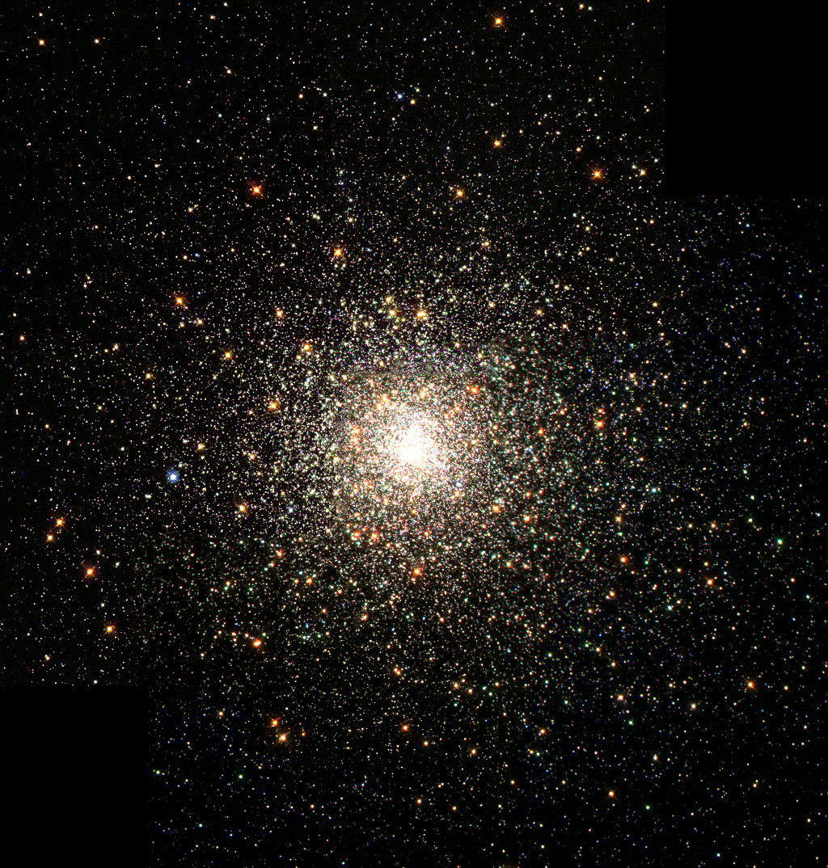
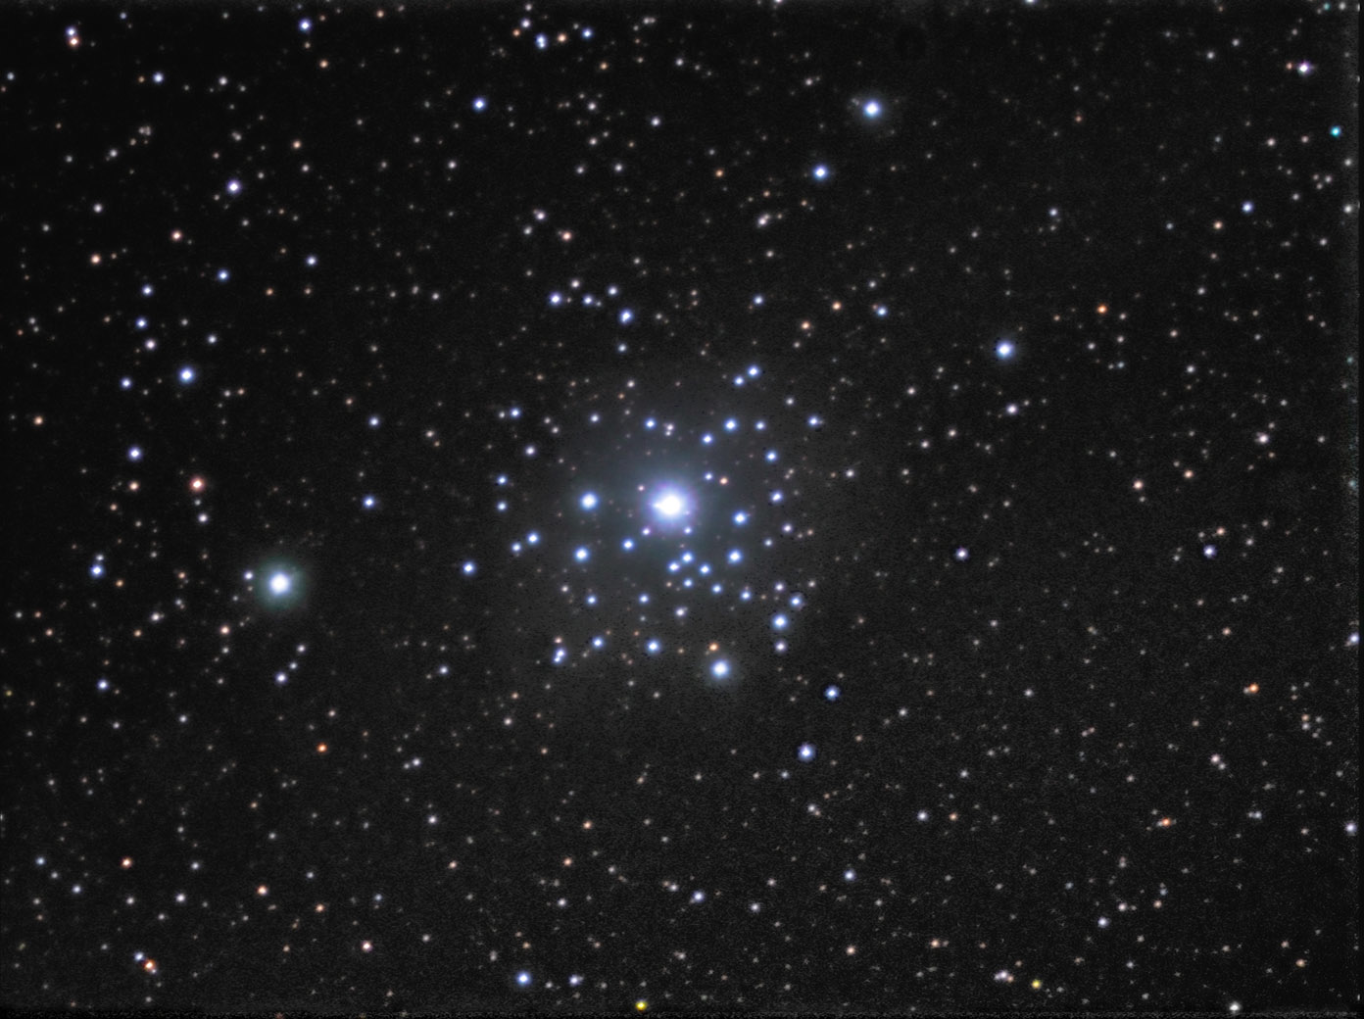
Notes:
NC 6093 (m80) – older, yellower, cooler 15 billion years old - infrared images show blue stragglers in core – unusually young & massive globular cluster
Ngc 2362 – younger, bluer, hotter 4-5 million years old - open cluster

Slide 2
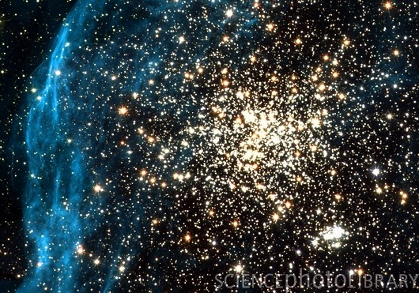
Notes:
Caption: Double star cluster. Optical image of the double star cluster NGC 1850 in the Large Magellanic Cloud. The main cluster is at centre right, and is about 40 million years old. A younger cluster (lower right) is only 4 million years old. The blue region is gas in supernova remnant N57D. Photographed by NASA's Hubble Space Telescope in 2001.

Slide 3
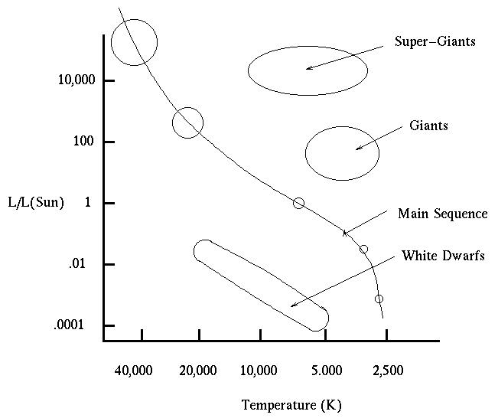
Notes:
Stars at different ages show up on HR diagram, also known as CMD

Slide 4
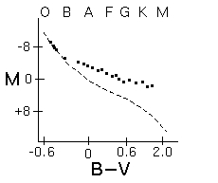
Notes:
Massive stars form first.
A very young cluster has just the massive stars on the main sequence and lighter stars are still collapsing toward main sequence.

Slide 5
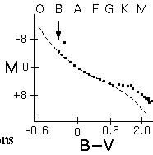
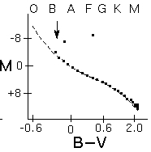
Notes:
Massive stars evolve quickly. Any O-type stars have lived and died by 12 million year stage. Some B-type stars start to leave main sequence stage while K and M-type stars are still collapsing.

Slide 6
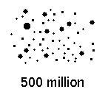
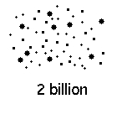
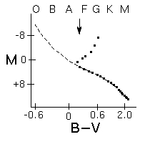
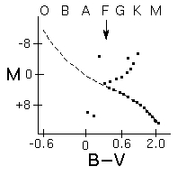
Notes:
As cluster ages, the massive stars die leaving the less massive stars on the main sequence. Arrow marks the Main Sequence Turnoff, which gives the age of the cluster. The cluster has to be as old as the most massive star that is still on the main sequence. That point on the main sequence is called the main sequence turnoff. Stars more massive than the turnoff point have already evolved “away” from the main sequence.

Slide 7
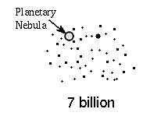
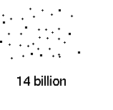
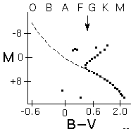
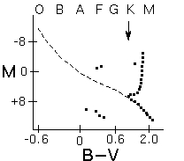
Notes:
Use the main sequence turnoff to find the age of the star cluster. Stellar evolution models confirmed by observations of real clusters.

Slide 8
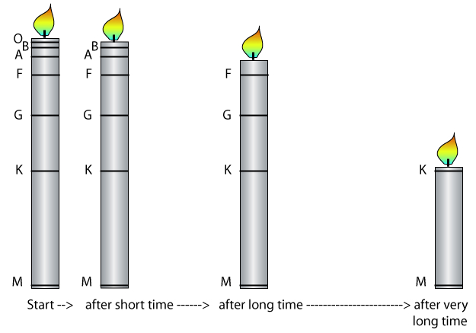
Notes:
The main sequence turnoff is analogous to a candle burning—a candle that has been lit longer will be shorter than an identical candle lit more recently.
Candle analogy for main sequence turnoff; as candle burns (=cluster ages), the candle gets shorter (=cluster main sequence remaining gets less)

Slide 9
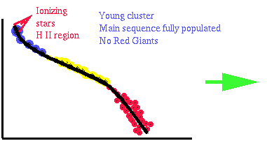
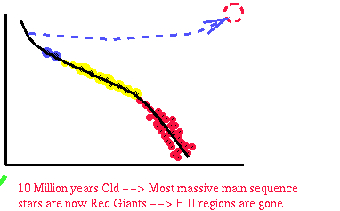
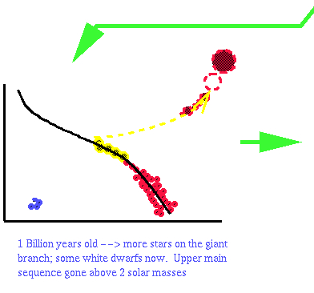
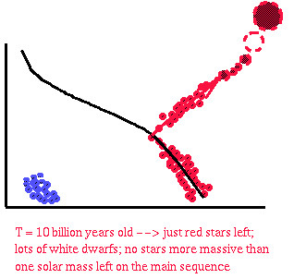
Notes:
H II regions = HII - ionized form of hydrogen;
HII regions exist most commonly in the disk of a spiral galaxy. For an HII region to exist, there must be a source to proved the ionizing heat required to strip the electron, so HII regions are common near very hot stars. As a result, HII regions can be very hot, around ~10,000K. Such areas are emission nebula. These areas of starbirth are strong in UV radiation.
Newly formed stars within the spiral of galaxy are literally blown away from its association with other stars formed in the same "nursury." A great example of this is the Orion Nebula.

Slide 10
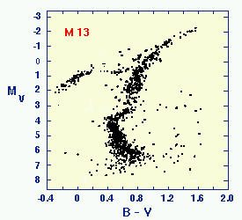
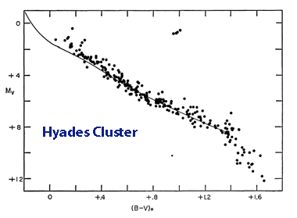
What can you say about these clusters?
Hyades star cluster M13
Notes:
Hyades star cluster – y axis
M13 – y axis 10 top 26 bottom brightness

Slide 11
Copyrighted, 1998 - 2010 by Nick Strobel
www.astronomynotes.com

