Slide 1
Parallax

Slide 2
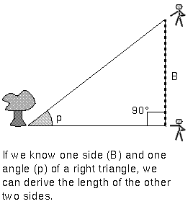

Slide 3
This triangle should be 4,500 times longer!

Slide 4
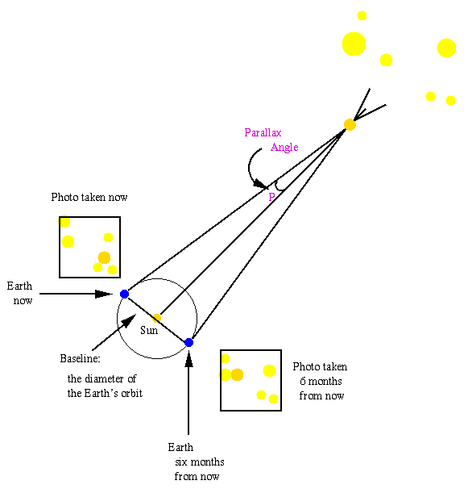
Notes:
http://www.astro.washington.edu/courses/labs/parallax/java_parallax.html

Slide 5
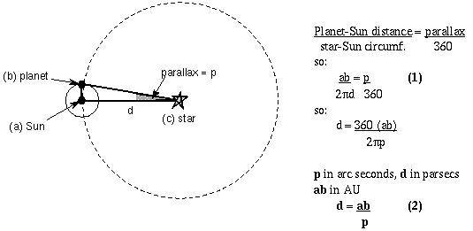
Planet-Sun distance = parallax
star-Sun circumference 360°
d (distance to star) is in parsec units 1 parsec = 206,265 x 1 A.U.
ab (distance Earth to Sun) has to be in Astronomical Units (A.U.)
p (parallax) has to be arcseconds

Slide 6
d = 206,265 x ab / p
d = 1 / p
d in parsec ab in AU p in arcsec
D = 360 (ab)
2π p
360 / 2 π = 57.30 degrees
There are 60 arcminutes in a degree and 60 arcseconds in an arcminute
57.30 degrees x 60 arcmin/degree x 60 arcsec/arcmin
= 206,265 arcsec
We define 1 parsec = distance of a star with a parallax of 1 arcsec
Substitute ab=1 AU p=1 arcsec so 1 parsec = 206,265 A.U.
d=(206265 arcsec)(1AU) = 206265 AU so d=206265 AU
p in arcsec p p
d=206265AU x 1 parsec = 1 so d=1/p
p 206,265 AU p

Slide 7
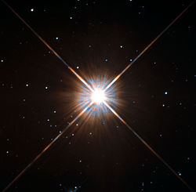
Stellar Parallax d = 1 / p d in parsec p in arcsec 1 parsec = 3.26 light years
Example Proxima Centauri has a parallax of
0.7687 arcseconds
d = 1/0.7687 = 1.3 parsecs or 1.3 parsecs (3.26 ly/parsec) = 4.24 ly
Notes:
Proxima Centauri nearest star to earth, in constellation Centaurus

Slide 8
Magnitudes
Apparent Magnitude (m) – how bright a star appears from Earth
Absolute Magnitude (M) – how bright a star really is
A star’s apparent magnitude equals its absolute magnitude at 10 parsecs

