Slide 1
Humans and Communication
By Adam Clark, Peter McColgan, and Roman Oharenko

Slide 2
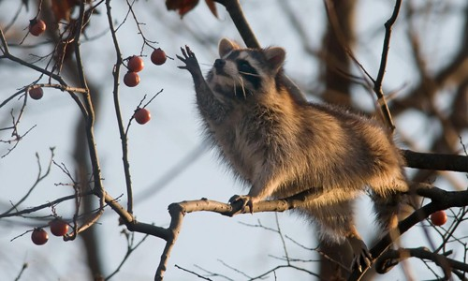
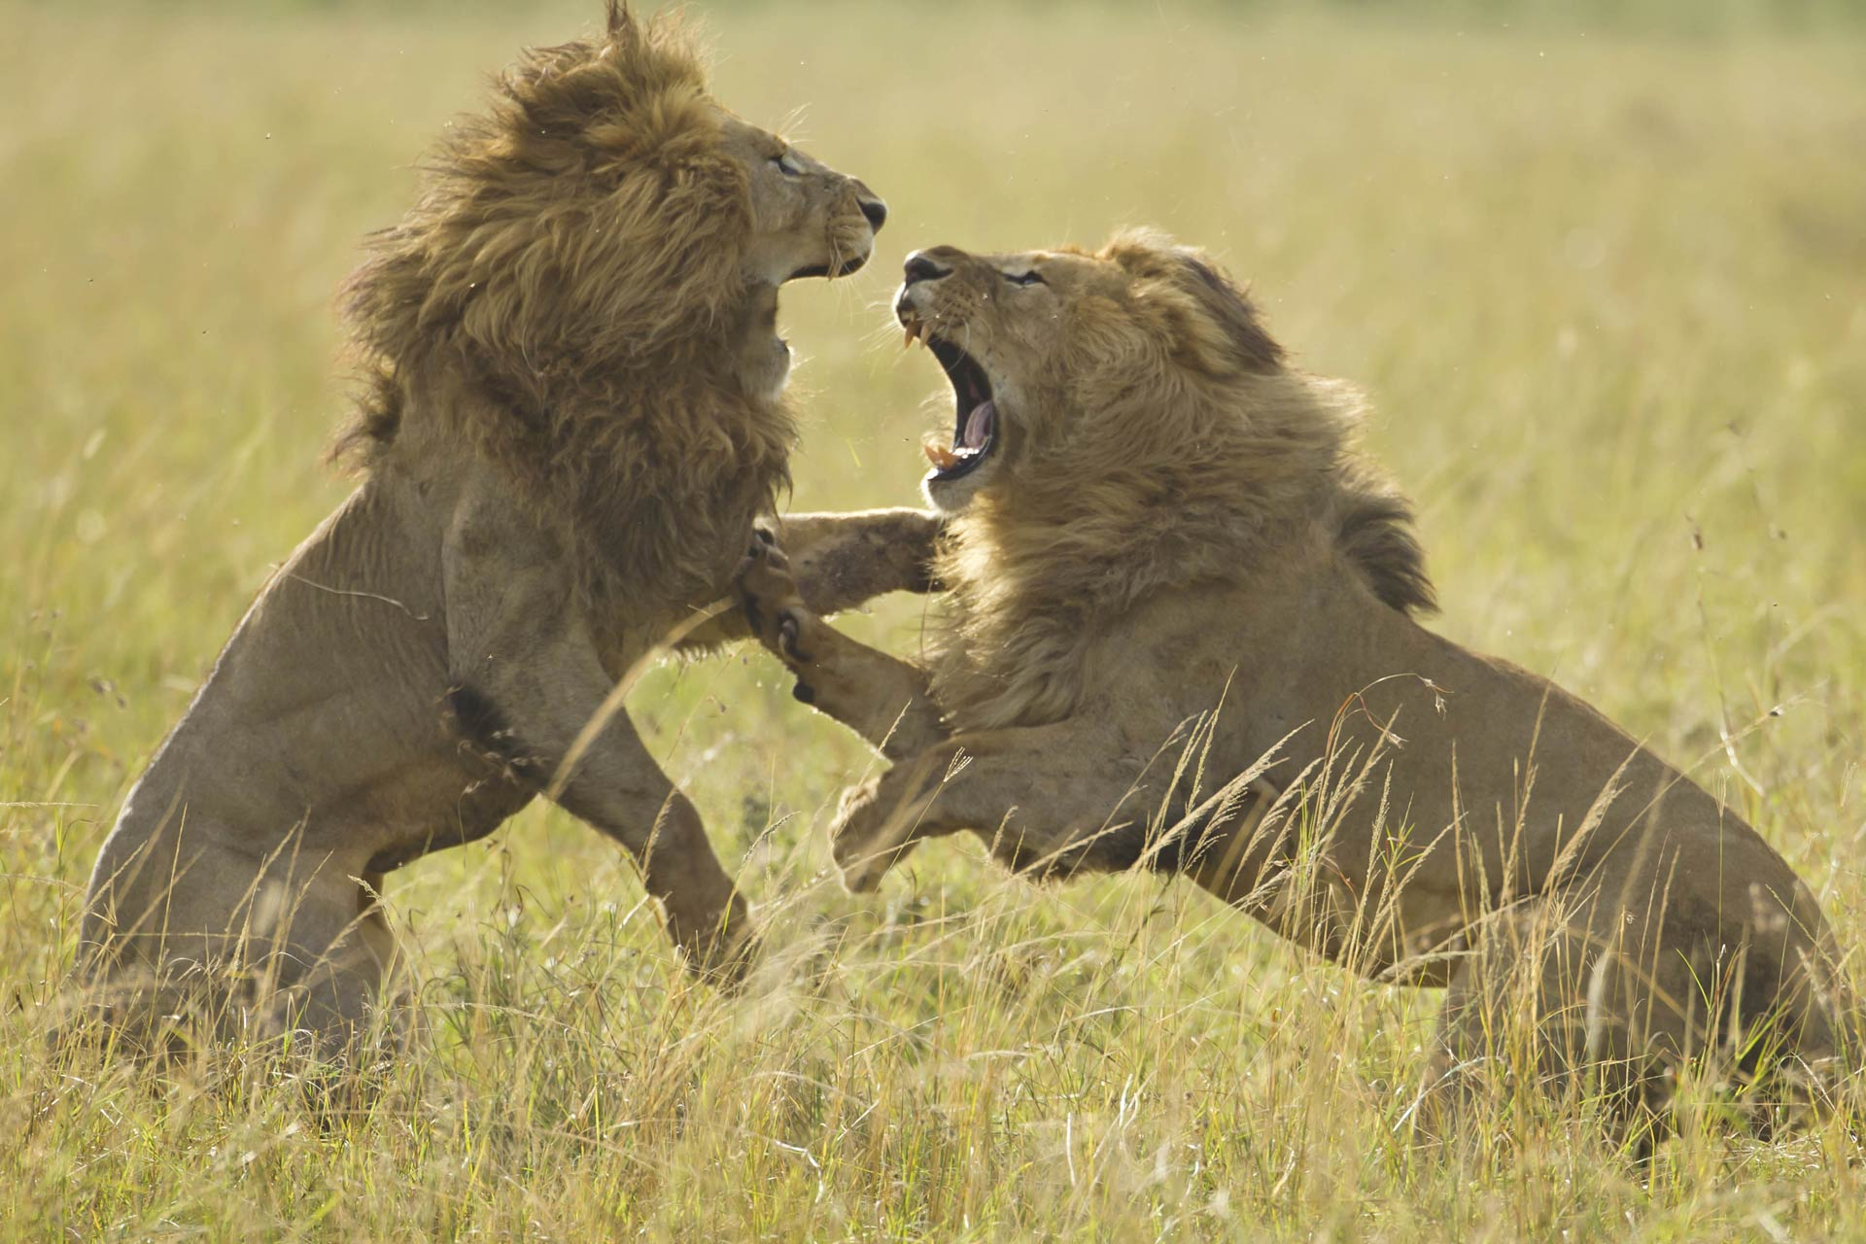
Why do non-human animals communicate?
Food
Danger
Mating
Territory

Slide 3
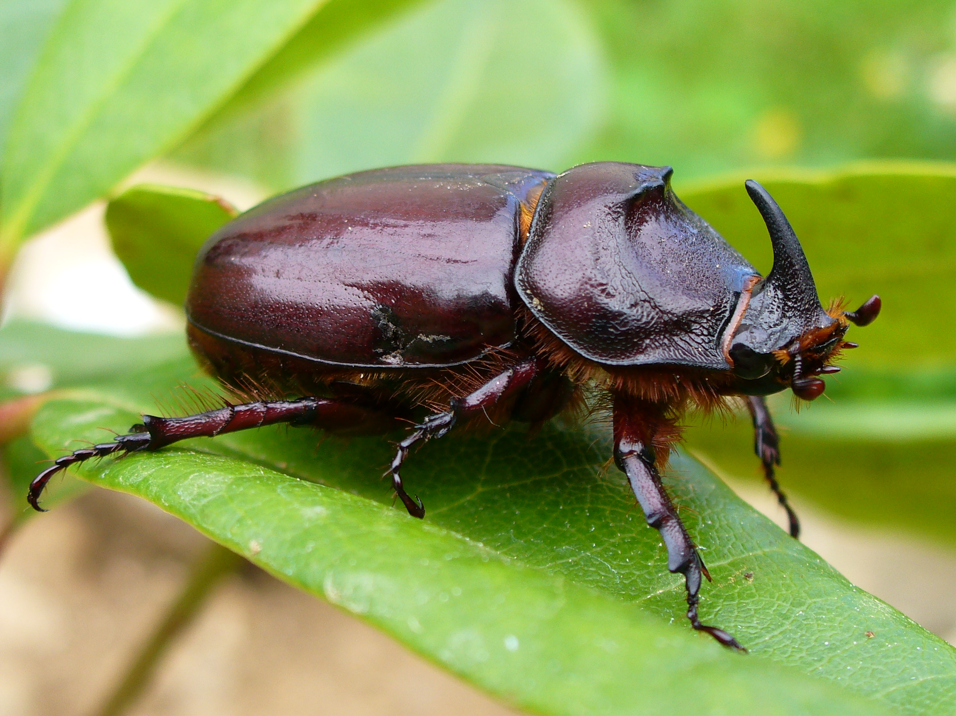
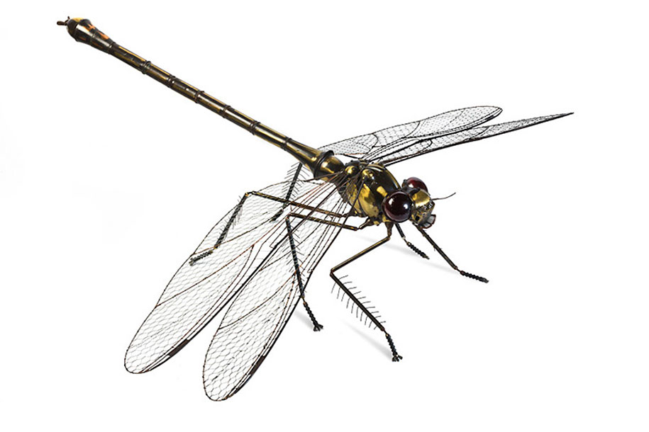
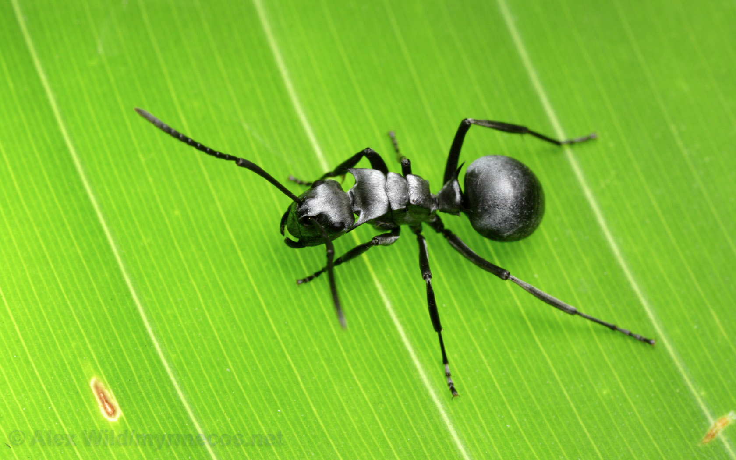
INSECTS

Slide 4
Learning Language
Insects are born being able to communicate with other.
Each bug is born with a distinctive "vocabulary" that is shared only with other members of its own species.
Learning plays little or no role in the ability to produce these signals or to understand them.

Slide 5
Insects: Forms of Communication
Visual Communication
Tactile communication
Acoustic Communication
Chemical Communication

Slide 6
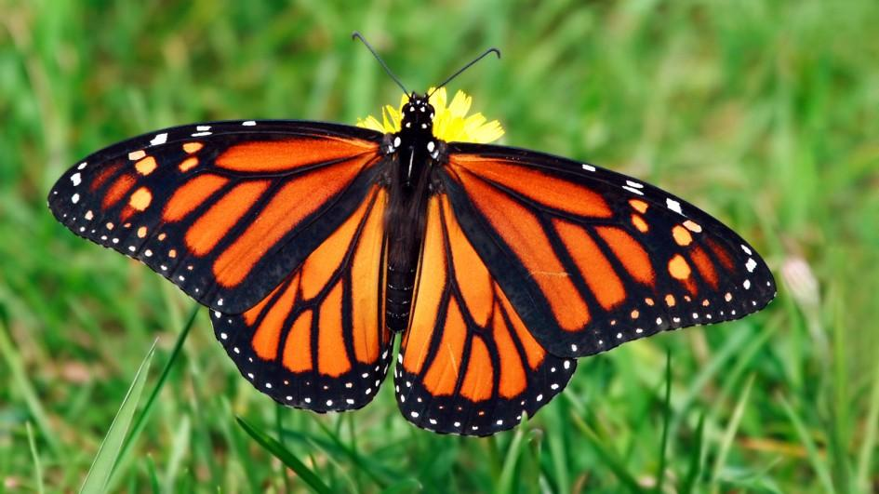
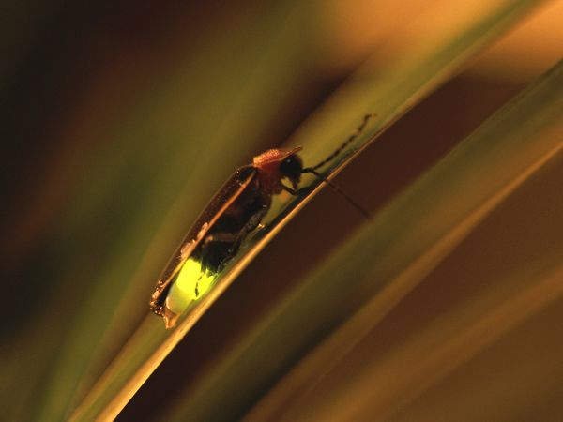
Insects: Visual Communication
Insects have passive and active visual communication
Passive communication involves different color patterns and designs that the insects are born with
Active communication involves body movements and light flashes that take up an insect’s energy
Good for long distances and instant communication
Only helpful during the daytime, when insects can see each other

Slide 7
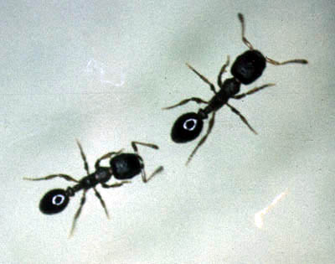
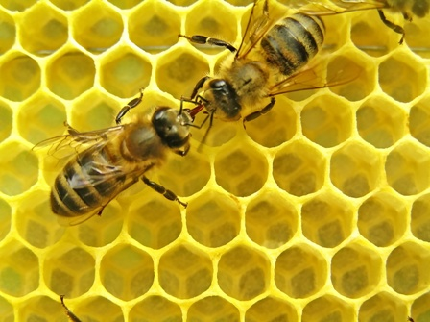
Insects: Tactile Communication
Tactile (or touch) communication involves insect antenna and wing movements to either touch other insects or create short distance visuals
Ants and bees use this commonly for mating, leadership, and territory purposes
Good for instant communication in the dark between two insects
Only good for short distances, repetitive, and attracts predators

Slide 8
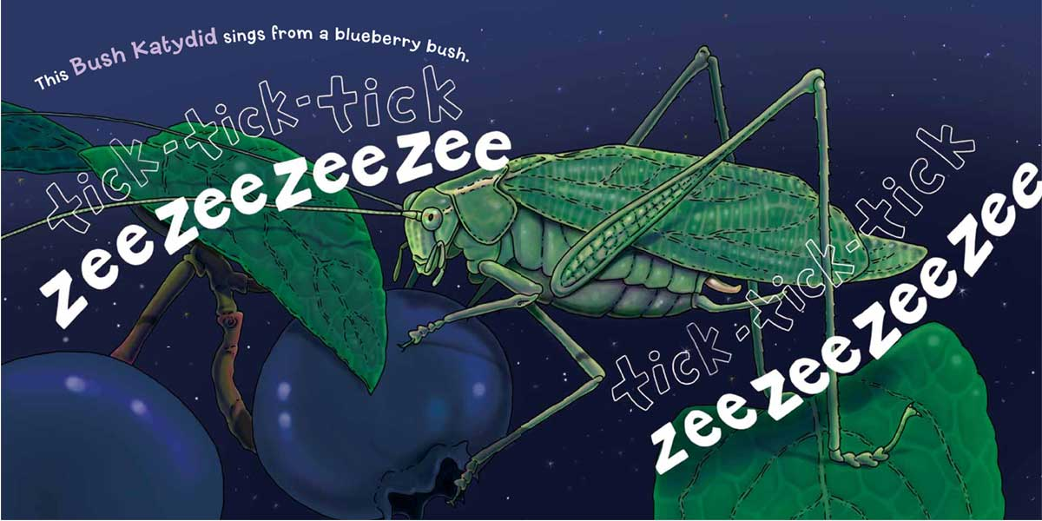
Insects: Acoustic Communication
Insects have a much higher range of frequencies they can hear than we do
They can create many different calls using various frequencies, volumes, and patterns
Useful for quick communication around barriers to express a wide range of ideas
Can expose insects to attentive predators, takes much energy, bad for noisy locations

Slide 9
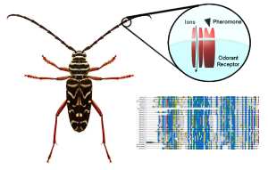
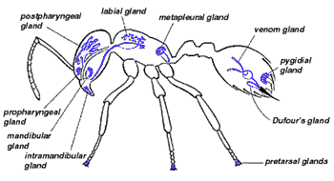
Insects: Chemical Communication
Insects communicate pheromones to their own species and allelochemicals to other species
Pheromones are used to attract mates, mark territory, and warn of dangers
Allelochemicals are used as defense against attackers or to attract other insects towards a plant that can be used as a resource for all
Same benefits as acoustic communication with less energy, also lasts longer
Can attract predators, limited usage, affected by wind

Slide 10
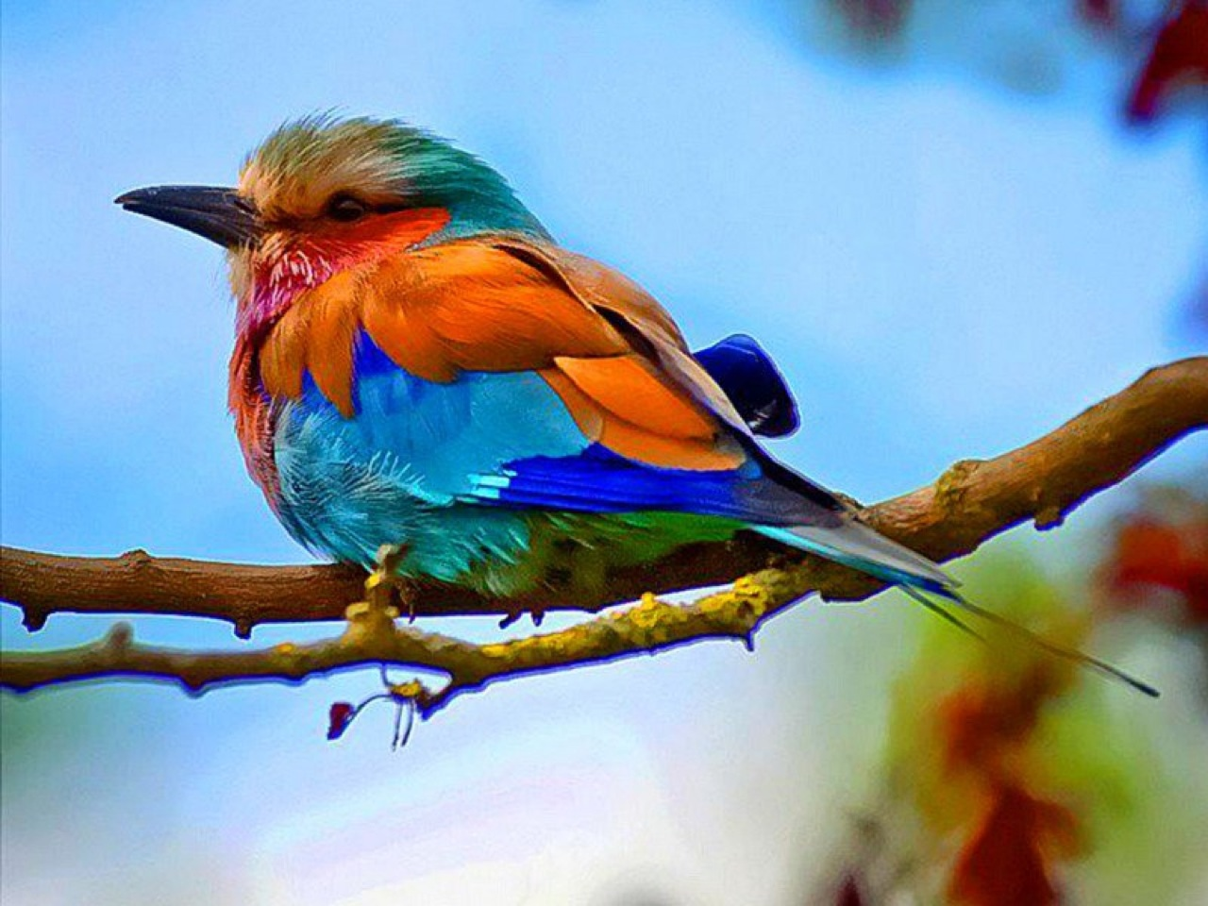
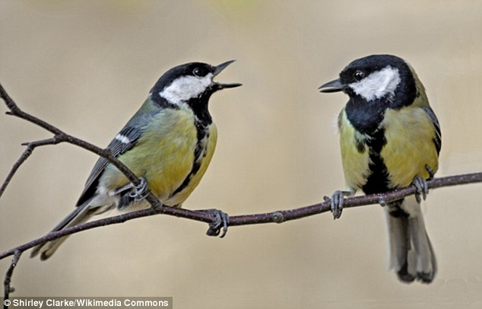
Birds
Visual:
Colorful feathers in order to attract mates
Vocalization:
Each species has a unique song or calling

Slide 11
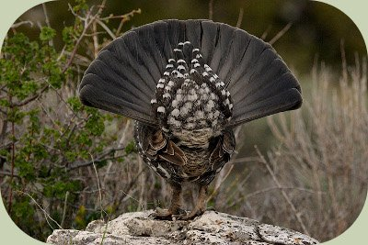
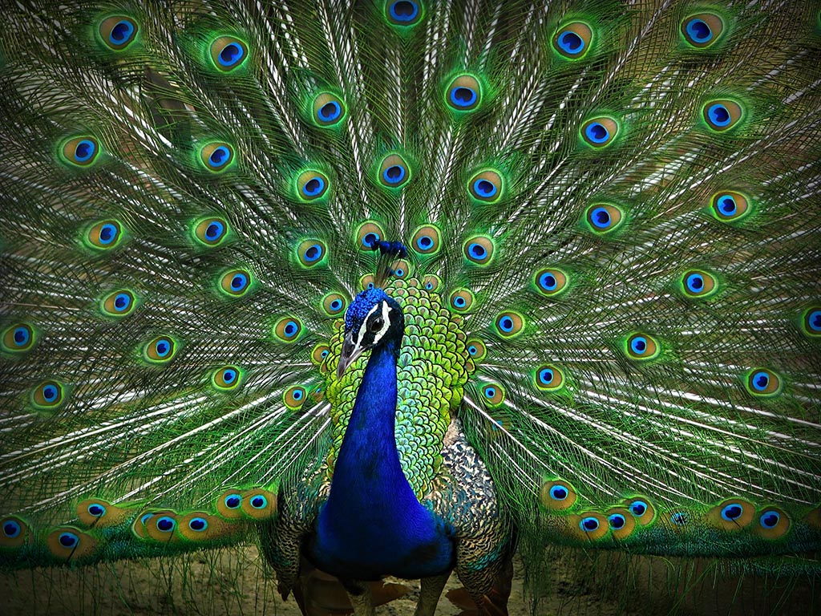
Birds (Continued)
Mini-sonic booms:
Birds like the Ruffed Grouse use these to communicate the location of food with other animals
Puffing Feathers
Birds like peacocks puff their feathers in order to make themselves seem larger when fighting enemies

Slide 12
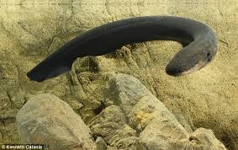
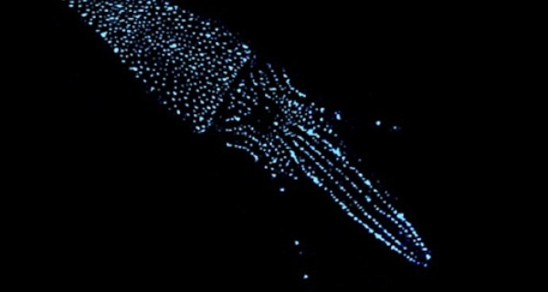
Fish
Bioluminescence
Chemical Reactions (Photoprotein) for feeding, mating and protection
Electrical Pulses
Navigation, communicating location of food or predators, sense the location of predators

Slide 13
Fish (Continued)
Smell and Taste
Vocalization
Fish like the Toadfish use the sonic muscle within their bladder in order to communicate with their species only

Slide 14
Humans

Slide 15
Humans- Origins of Spoken Language
100,000 years ago
Some babies start speaking as early as 6 months
Believed to be linked with the discovery of fire

Slide 16
Humans- Spoken Language and Noises
Many Variants
Main form of communication
Around 100 muscles used to speak a phrase

Slide 17
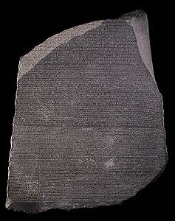
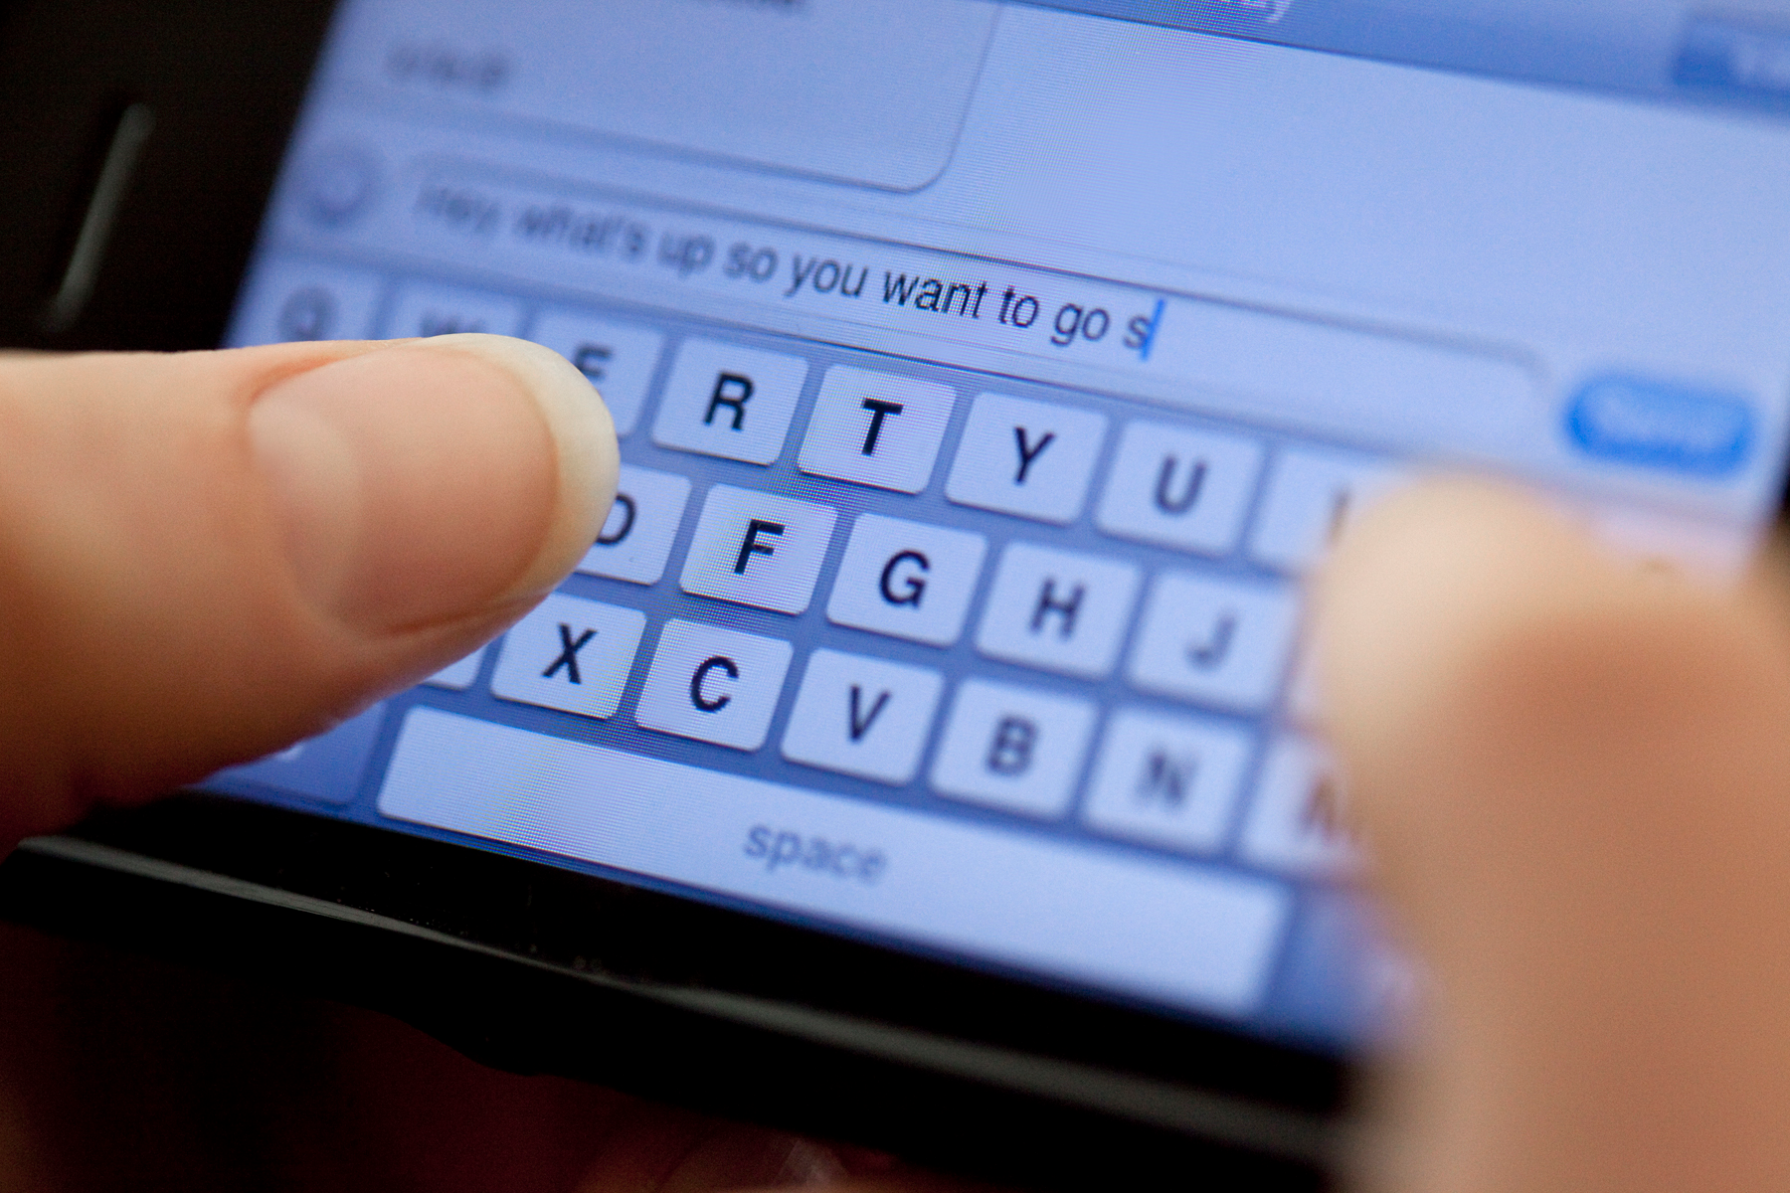
Humans- Written Language
Used to convey messages without having to be face to face
Has many different forms

Slide 18
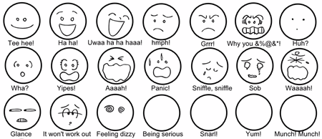
Humans- Facial Expressions
Used to convey emotion
43 muscles used just to smile

Slide 19
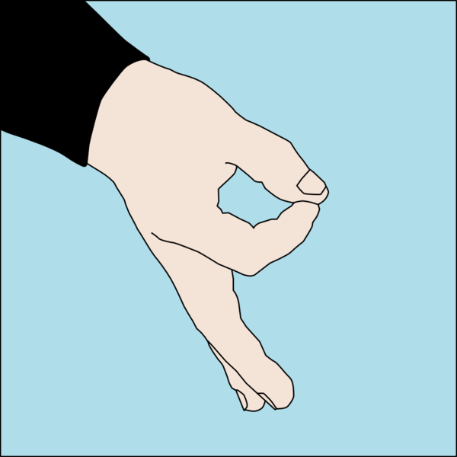
Humans- Gestures
Sign Language- language with gestures
Gestures to emphasize- used with
Greetings/insult
Threats

Slide 20
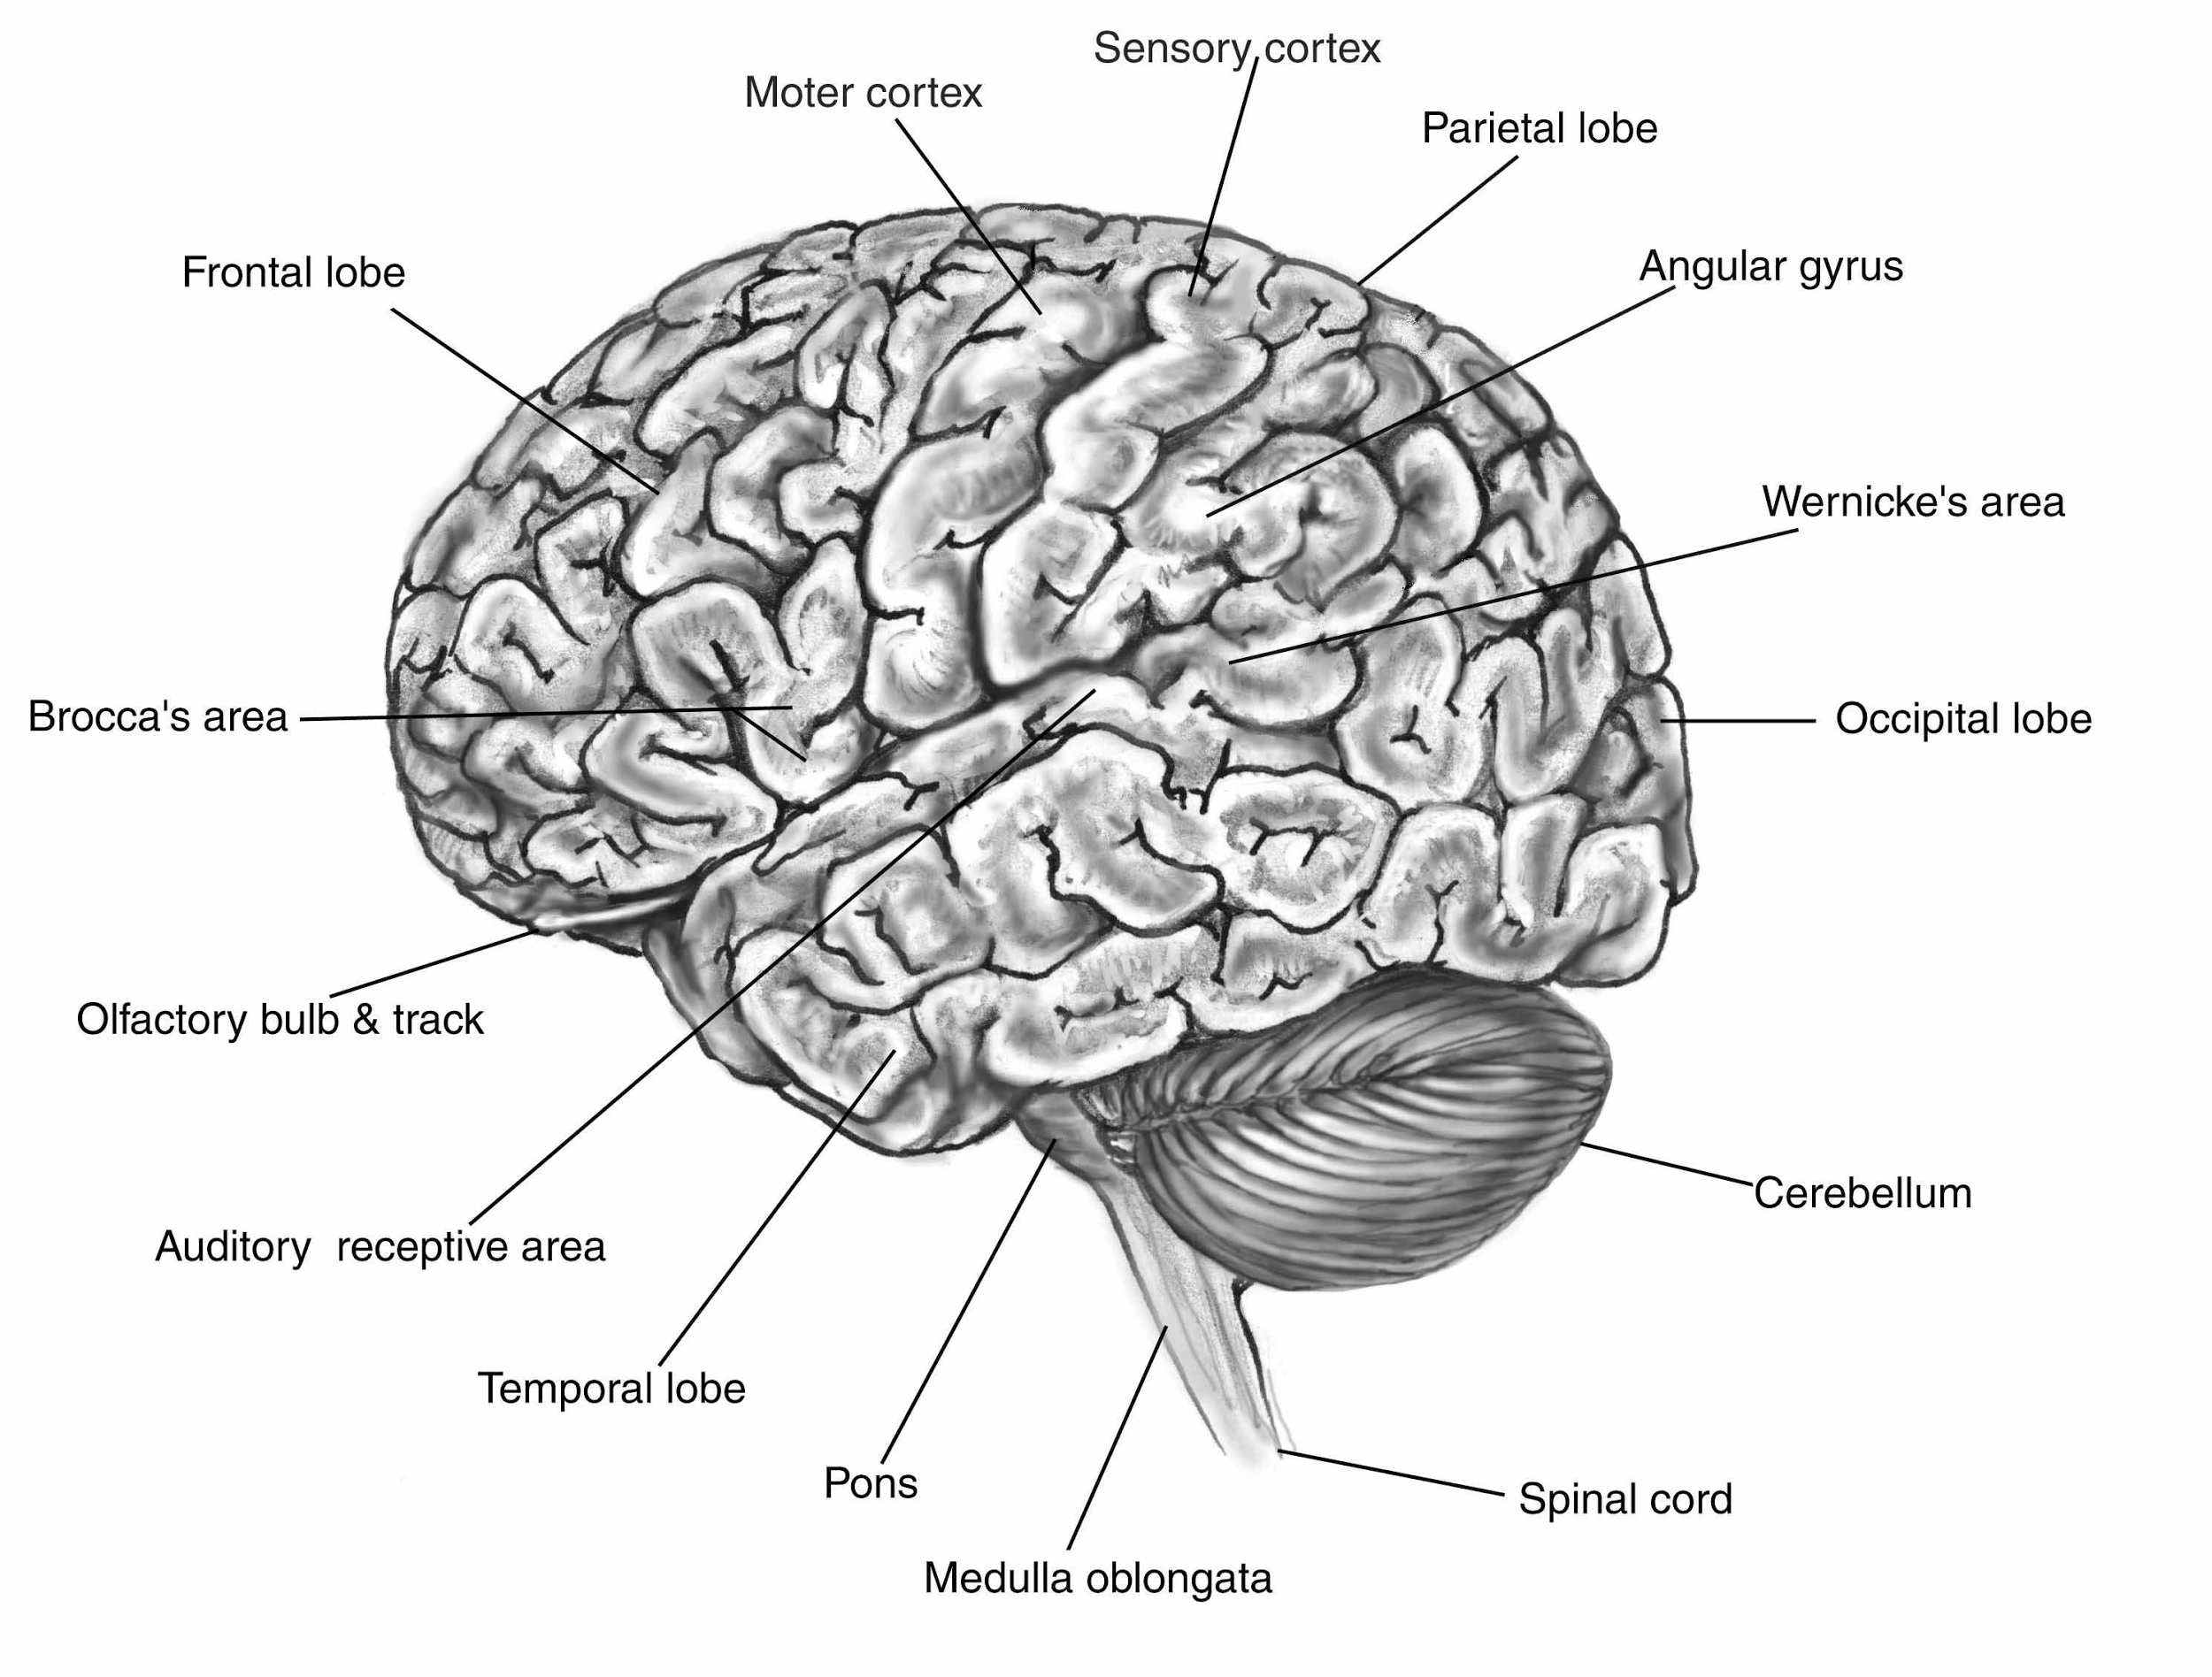
Humans-Brain Structures and Functions
Broca’s Area, Wernicke’s Area, Angular Gyrus, and the Motor Cortex allow the brain to process words, and express ideas based upon those words.

Slide 21
Conclusion-What Does it Mean to be Human?
Humans rely mostly upon verbal communication in order to express ideas and share information
Humans rely heavily upon verbal communication, as opposed to animals which
Humans communicate for reasons beyond survival

Slide 22
Sources
https://projects.ncsu.edu/cals/course/ent425/tutorial/Communication/index.html
https://projects.ncsu.edu/cals/course/ent425/tutorial/Communication/tactcomm.html
https://projects.ncsu.edu/cals/course/ent425/tutorial/Communication/chemcomm.html
https://projects.ncsu.edu/cals/course/ent425/tutorial/Communication/sound.html
https://projects.ncsu.edu/cals/course/ent425/tutorial/Communication/viscomm.html
http://www.npr.org/2015/08/27/432934935/good-vibrations-key-to-insect-communication
http://fac.ksu.edu.sa/sites/default/files/insect_communication_lecture_2.pdf
http://www.skwirk.com/p-c_s-11_u-26_t-72_c-258/insects/nsw/insects/way-out-communication/animal-communication-methods
http://www.huffingtonpost.com/entry/talking-with-hands-gestures_us_56afcfaae4b0b8d7c230414e
http://news.softpedia.com/news/10-Amazing-Facts-About-Human-Speech-70397.shtml
http://science.howstuffworks.com/life/inside-the-mind/emotions/muscles-smile.htm
http://www.sciencemuseum.org.uk/whoami/findoutmore/yourbrain/whatisspecialabouthumanlanguage/whendidhumansstarttalking
https://academy.allaboutbirds.org/birdsong/
http://www.wildernesscollege.com/bird-communication.html
http://www.wolfcollege.com/why-birds-sing-what-birds-say-their-languages-voices-vocalizations/
http://ir.uiowa.edu/cgi/viewcontent.cgi?article=4840&context=iowareview
http://www.dosits.org/animals/soundproduction/fishproduce/
http://www.eolss.net/sample-chapters/c06/e6-52-04-07.pdf
http://www.cornell.edu/video/electric-fish
http://home.wlu.edu/~ericksonj/engn267_f2013/articles/Inada_JTheoBio_2002.pdf
http://ocean.si.edu/bioluminescence

