Slide 1
What it Means to be Human: Communication
By: Emma Worrell

Slide 2
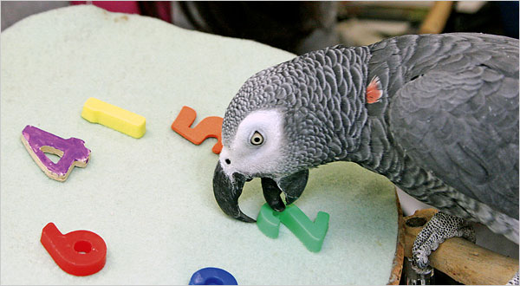
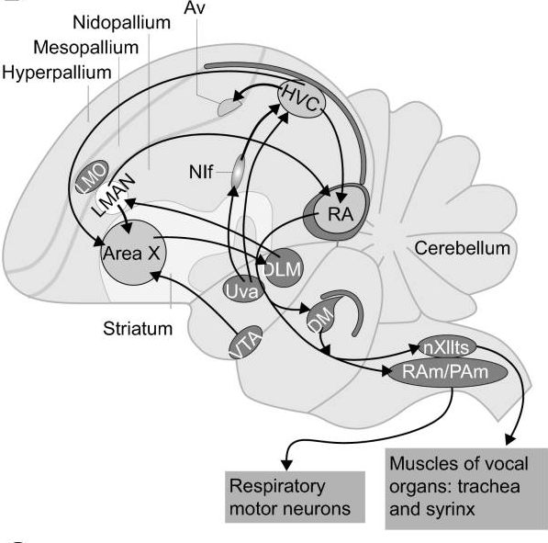
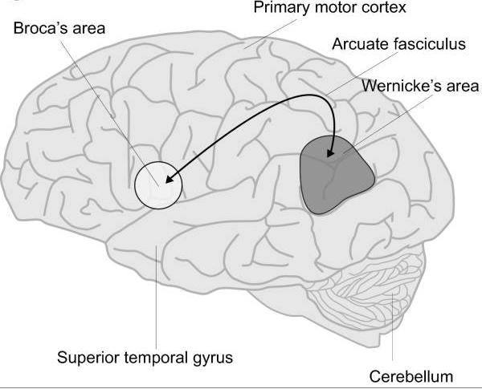
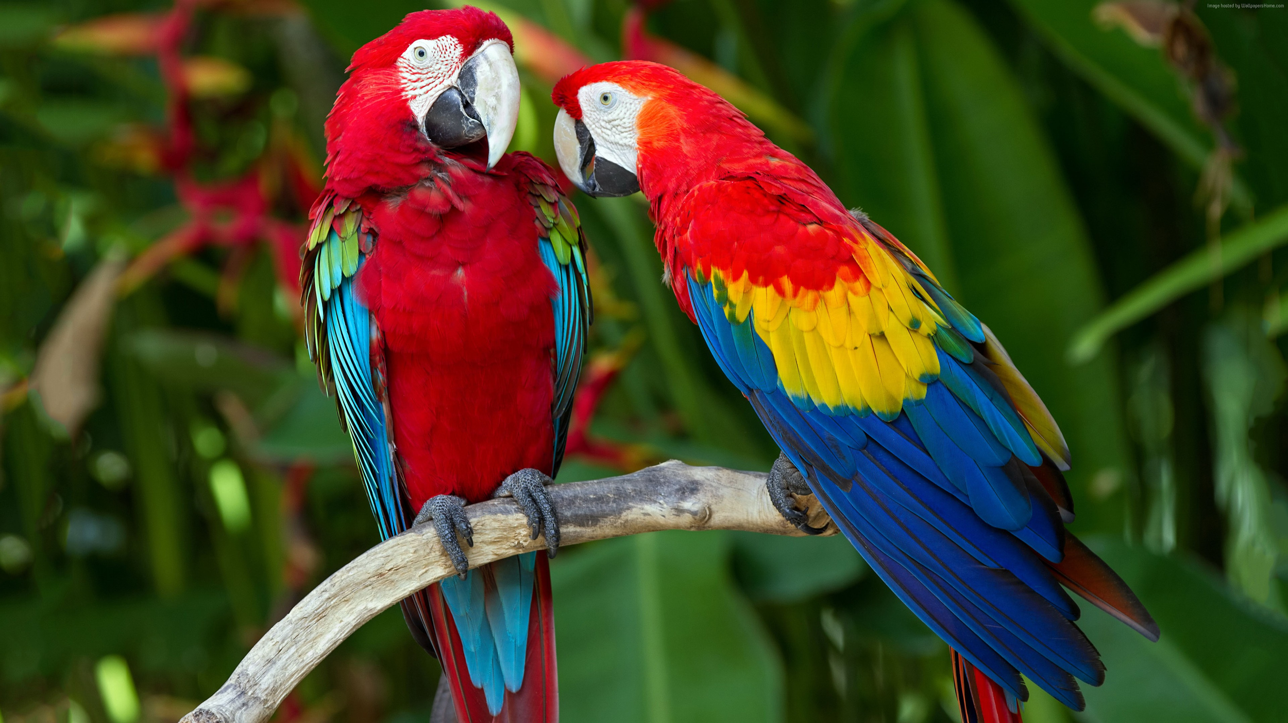
Parrots
Use sound to communicate with each other
Different Species have distinct songs/calls
Are vocal-auditory learners
Learn to vocalize much like human babies acquire spoken language
Have the capacity to understand very simple human language
Notes:
Parrots

Slide 3
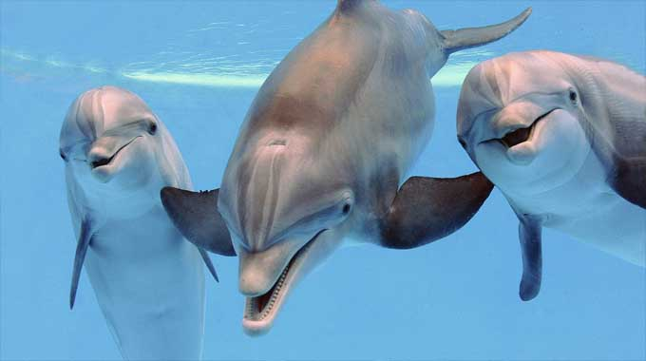
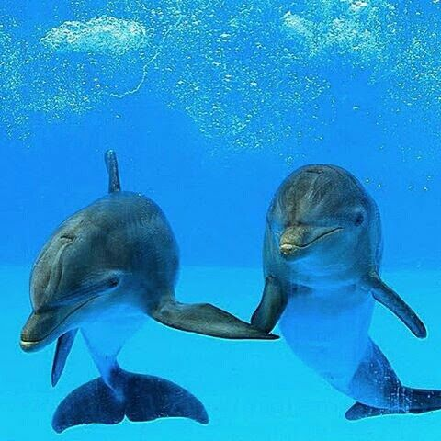
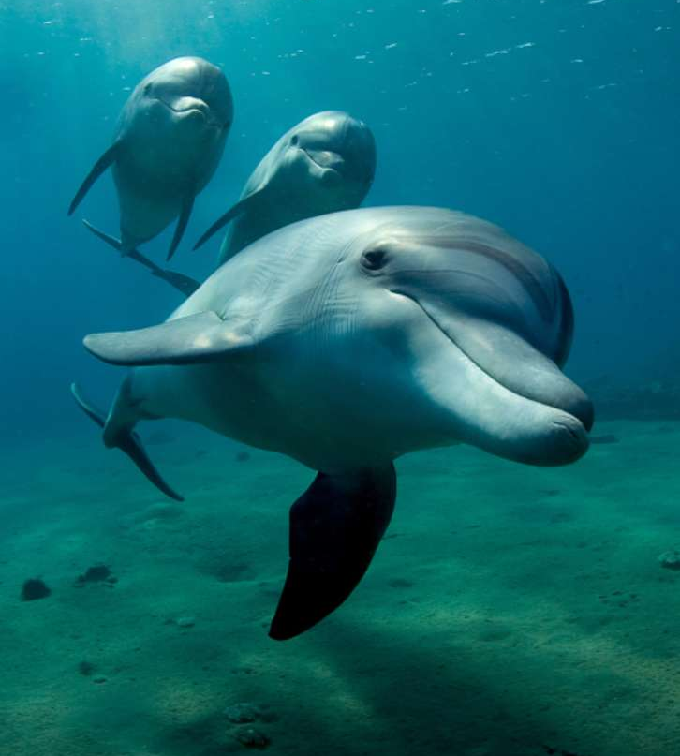
Dolphins
Use auditory-vocal communication when they are far away from each other
Each dolphin has a distinct whistle
Can communicate their location using their distinct whistles
Can vocally communicate emotions
When close, dolphins use visual and touch communication
Notes:
Dolphins

Slide 4
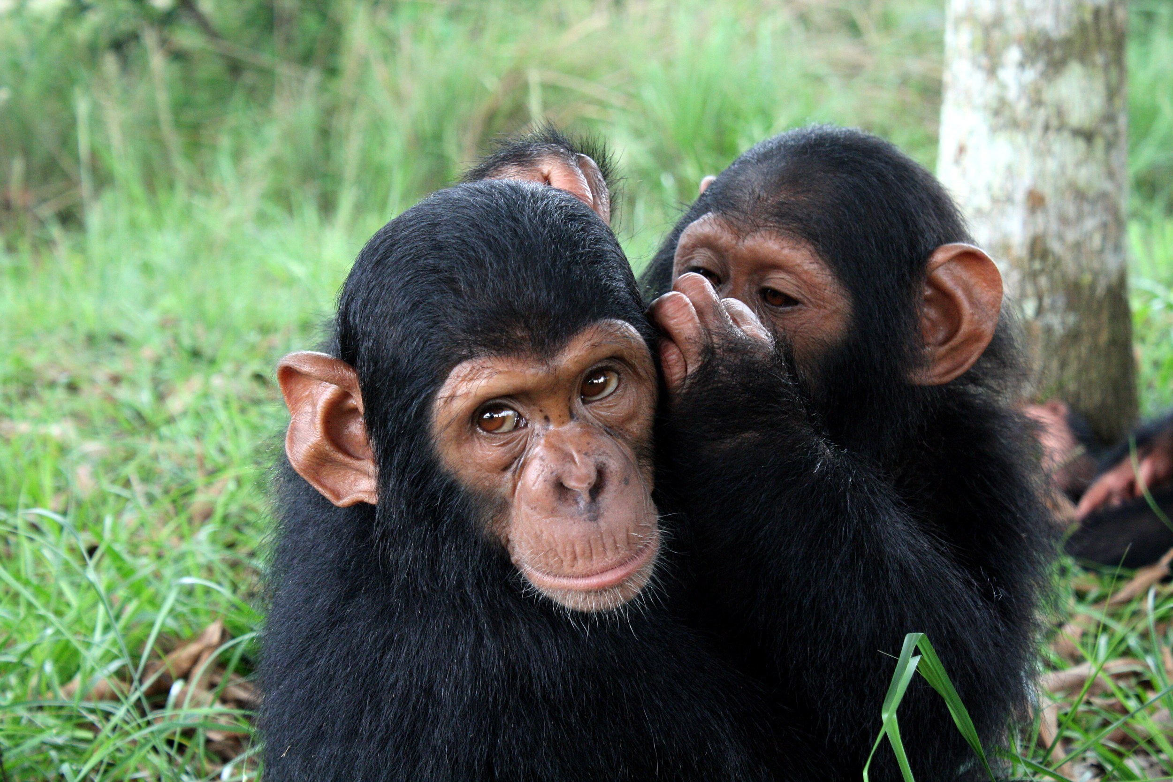
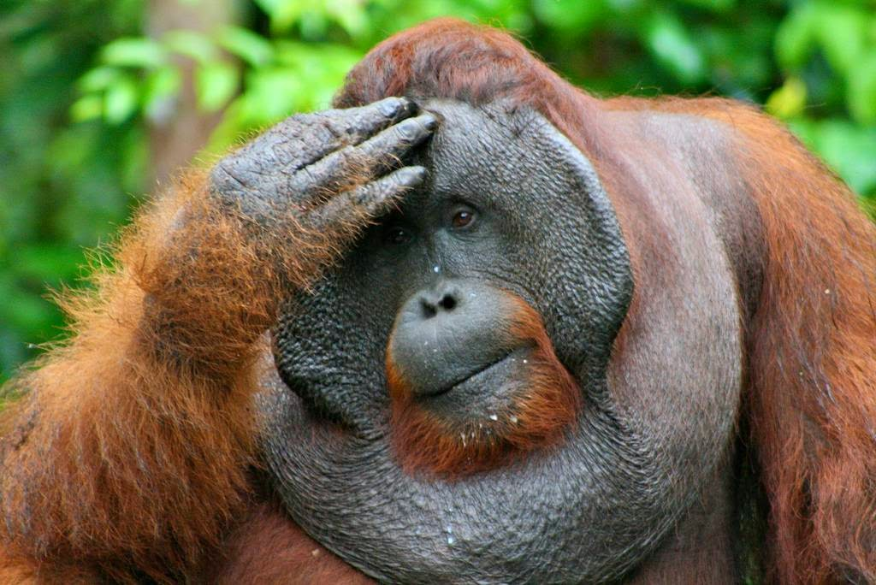
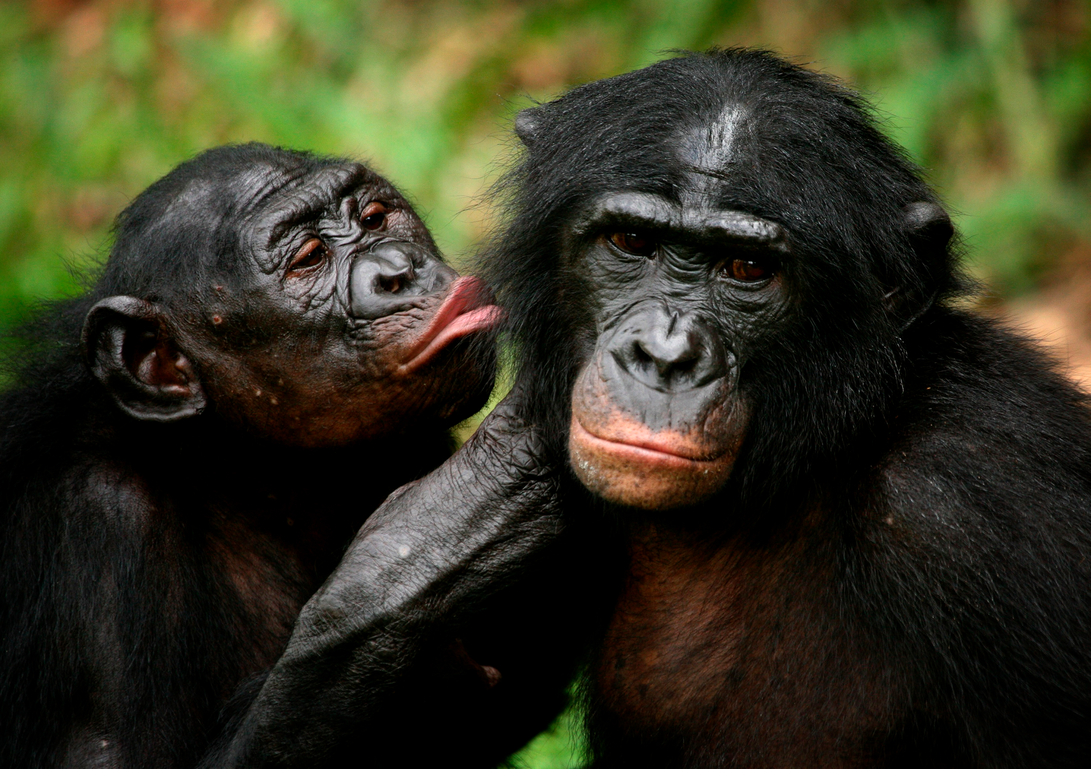
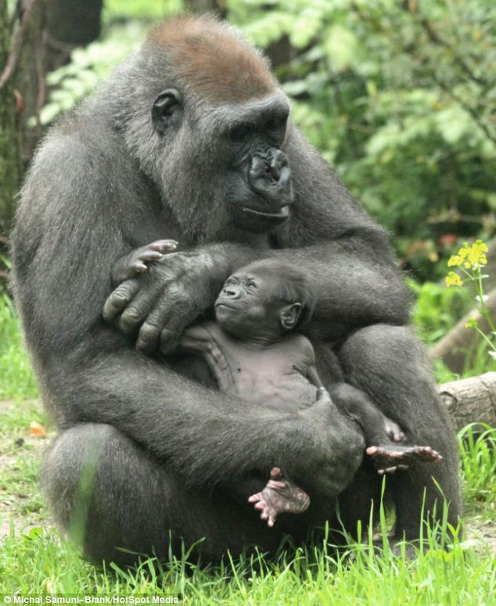
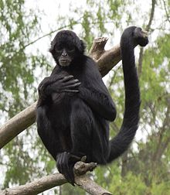
Apes
Use very similar ways to communicate as humans
Emphasize gestures more than humans since they do not have a symbolic language

Slide 5
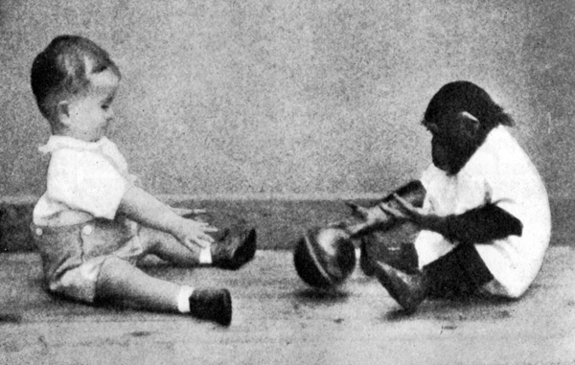
Gua is a chimpanzee who was raised side by side with a human baby, Donald, to see how a human upbringing influenced development in chimpanzees. Gua was learning at the same pace as Donald, until she hit a cognitive wall, she could not learn to talk.

Slide 6
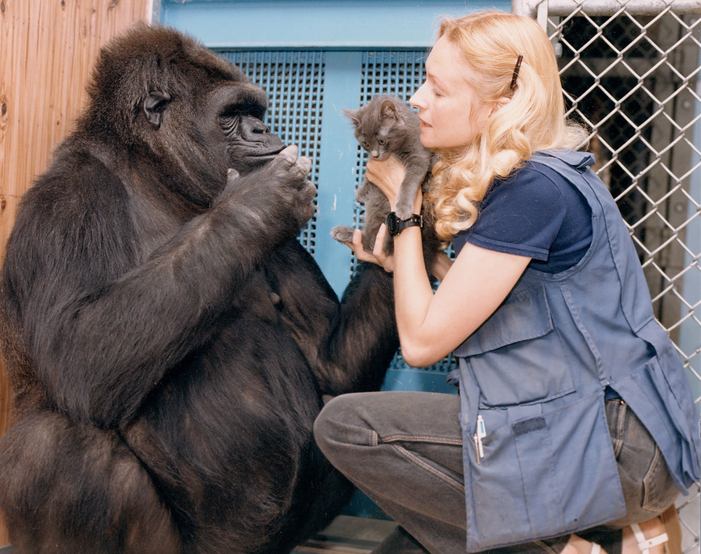
Koko is a gorilla who has been able to learn over 1,000 words in sign language - a vocabulary comparable to a 3 year old child.

Slide 7
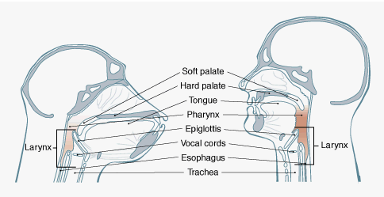
A common belief is that the reason chimpanzees cannot talk is because they lack a human vocal tract and therefore cannot form words. This claim is said to be incorrect, in fact chimpanzees and human infants have very similar vocal tracts.

Slide 8
Many scientists believe that the Broca’s Area and Wernicke's Area, parts of the brain unique to humans, are responsible for human’s advanced communication.

Slide 9
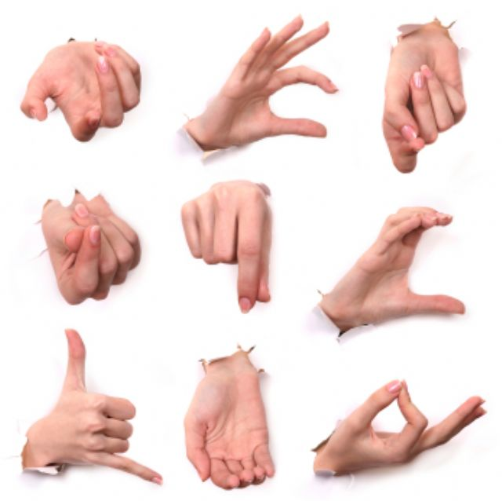
Some scientists believe that chimps use different parts of their brains for speech than humans, and do have the brain capacity to talk. These scientists claim that what limits apes is their small range of gestures. They say that the reason that humans were able to evolve to talk is because they could communicate with a large range of gestures which then evolved into a complex language.

