Slide 1
How We Are Unique
By: Pablo, Rodolfo, and Hank

Slide 2
Our Bone Structure

Slide 3
Bone types
There are two different types of bone
Compact
Cancellous

Slide 4
Compact
Bone that is the smooth white outside of the bone
Covers ¾ of bone
Marrow is stored in cavities in compact bones
Marrow helps prevents bleeding and aids in the clotting of the blood

Slide 5
Cancellous
Spongy bone inside the physical bone
Protects internal organs
Blood is produced here in this body
Red and white blood cells are produced here

Slide 6
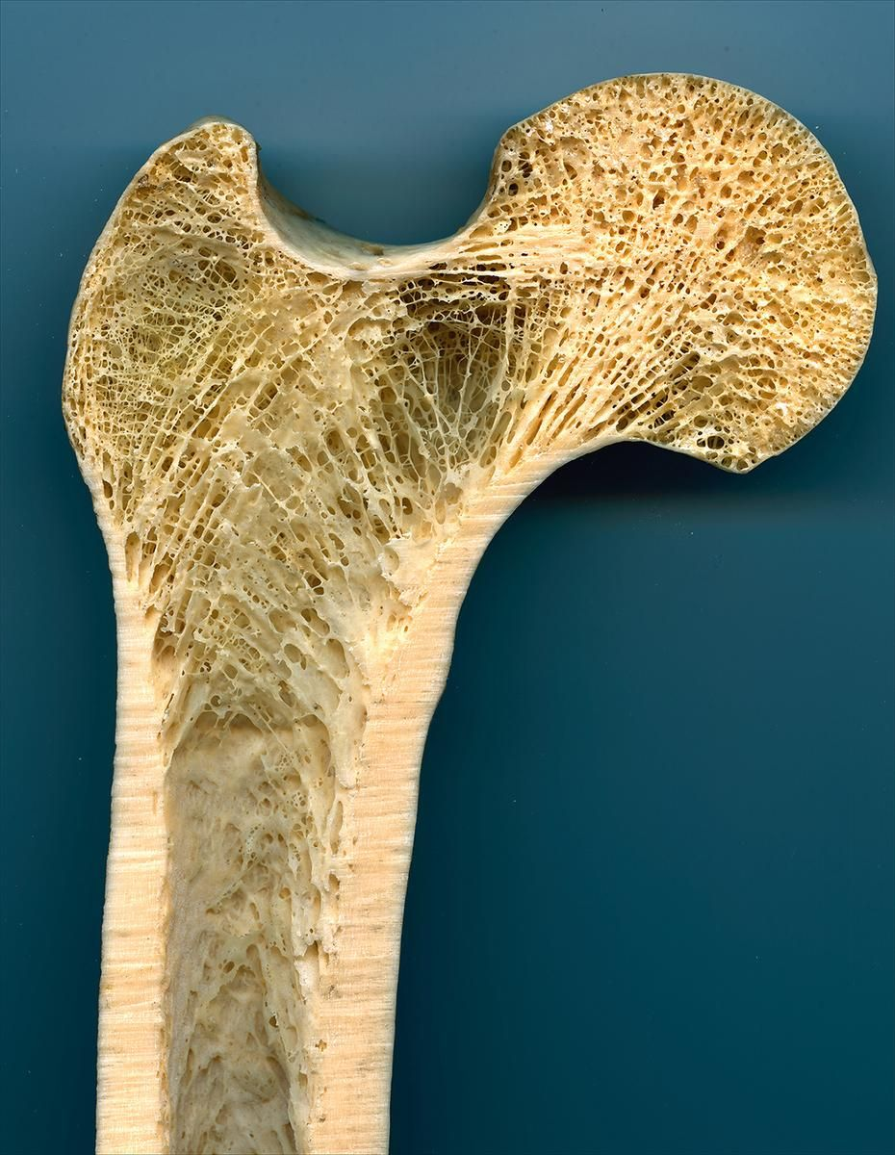
Example
--) (--
--) (--
--) (--
--) (--

Slide 7
How are we similar to others?
Other animals
Similar bone makeup(Compact and Cancellous)

Slide 8
How are we different?
Skeleton
Thumbs give us humans an advantage that other animals do not have
Thumbs
Allow us to do complicated movement that other animals such as chimps cannot do

Slide 9
Evolution

Slide 10
Definition
The process by which a species gradually changes over time

Slide 11
Cro-Magnons
Lived from
35,000 to 10,000 years ago
Used
Complex tools

Slide 12
Darnin’s Theory
More offspring are born in each generation that can survive

Slide 13
Offspring
Compete for resources
The best fit pass their traits onto future generations

Slide 14
Modern Science
Study
Gene pools
Fossils
Compare the embryo's, body structure, and the DNA of animals

Slide 15
Brain

Slide 16
Central Nervous System/Peripheral System
CNS:Made up of
Spinal Cord
Brain
When functioning together functions
Breathing
Memorizing

Slide 17
Sensory nerves
Gather information from the environment
Information goes to the spinal cord
Then, goes up to brain which admits a response

Slide 18
Main Components
Forebrain
Midbrain
Hindbrain

Slide 19
Forebrain
Contains
Cerebrum
Thalamus
Hypothalamus

Slide 20
Midbrain
Contains
Tectum
Tegmentum

Slide 21
Hindbrain
Contains
Cerebellum
Pons
Medulla
The pons and the medulla are referred to as the Brainstem

Slide 22
Cerebral Coretex
Contains
Frontal Lobe
Parietal Lobe
Occipital Lobe
Temporal Lobe

Slide 23
Frontal Lobe
Functions
Reasoning
Planning
Speech
Movement
Emotions

Slide 24
Parietal Lobe
Function
Movement
Orientation
Recognition
Perception of stimuli

Slide 25
Occipital Lobe
Function
Visual Processing

Slide 26
Temporal Lobe
Function
Perception of auditory stimuli
Memory
Speech

Slide 27
Our Differences
Our Brain
3 pounds
Chimpanzees
1 pound

Slide 28
FIN

