Slide 1
The Evolution of the Human Brain Size
By Jack McHugh

Slide 2
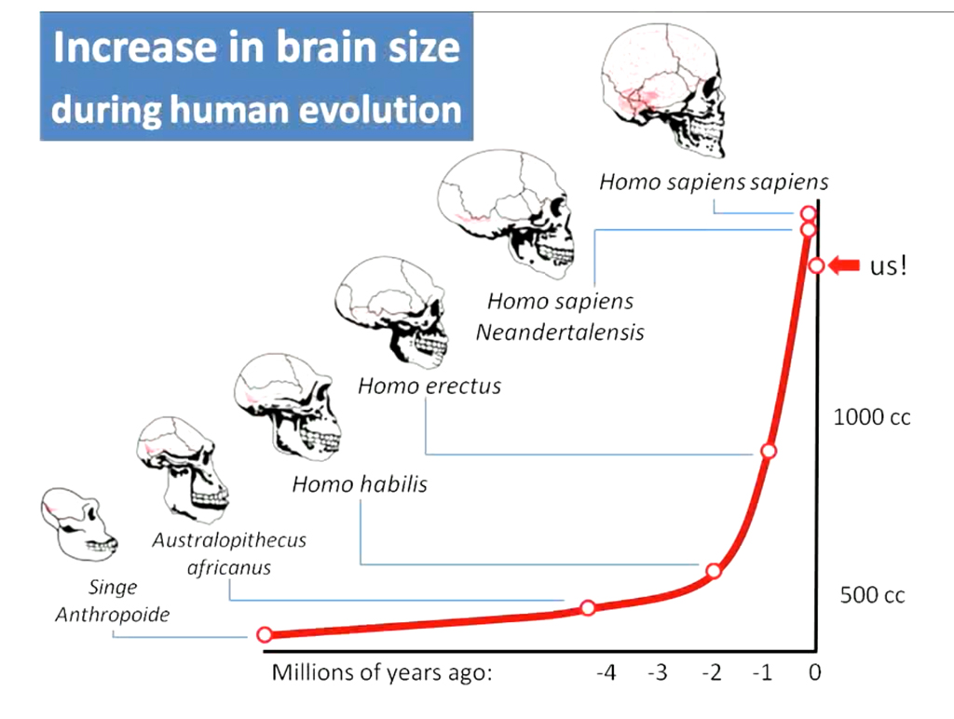
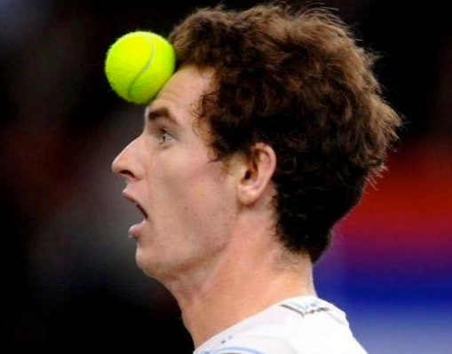
Big picture
Brain growing over last 2 million years
Brain shrinking over last 20,000 years
10% less volume (males)
150 cc (cubic centimeters)
Loss about the size of a tennis ball
“Since the Bronze Age, the brain shrank a lot more than you would expect based on the decrease in body size” - John Hawks
Notes:
As hominids evolved, so did their brain sizes, with homo sapiens having larger brains than their predecessors, a trend that is generally undisputed. However, there have been several reputable studies by scientists like John Hawks that show a significant amount of brain shrinkage over the last 20,000 years. This shrinkage is about 10% less brain volume, or 150 cubic centimeters, in males, with females losing a bit more. This loss is comparable to the size of a tennis ball. “Since the Bronze Age, the brain shrank a lot more than you would expect based on the decrease in body size” - John Hawks

Slide 3
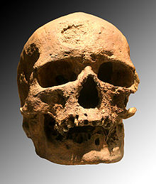
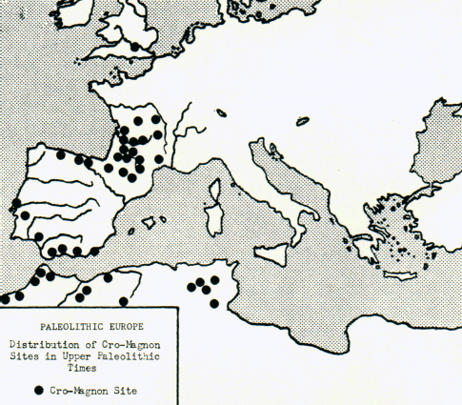
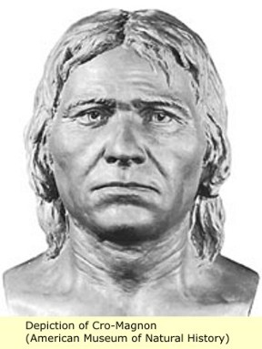
Cro-Magnons
Largest brains of Homo Sapiens
10,000-35,000 years ago
Europe
Theory: Larger brains because they were bigger
EQ same size as humans
Human brains shrunk after this
Notes:
The cro-magnons had the largest brains of Homo Sapiens in history, (homo sapiens have bigger brains than other hominid species)
The cro-magnons lived about 10,000-35,000 years ago
Predominantly found in Europe according to fossils
Many scientists believe that their larger brains were attributed to their larger body size
Their EQ, a ratio of brain volume to body mass, is about the same as that of modern humans
Human brains shrunk after this across the world
Why did our brains shrink?

Slide 4
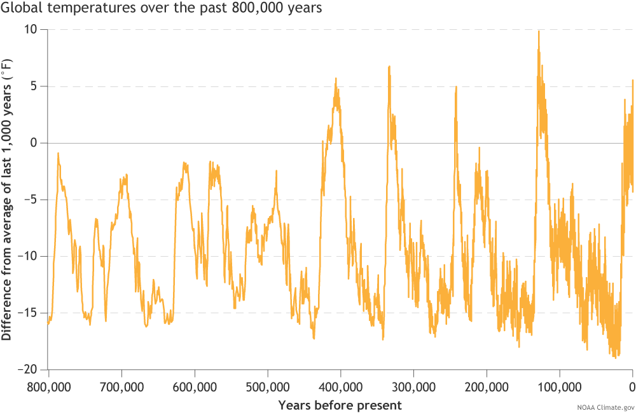
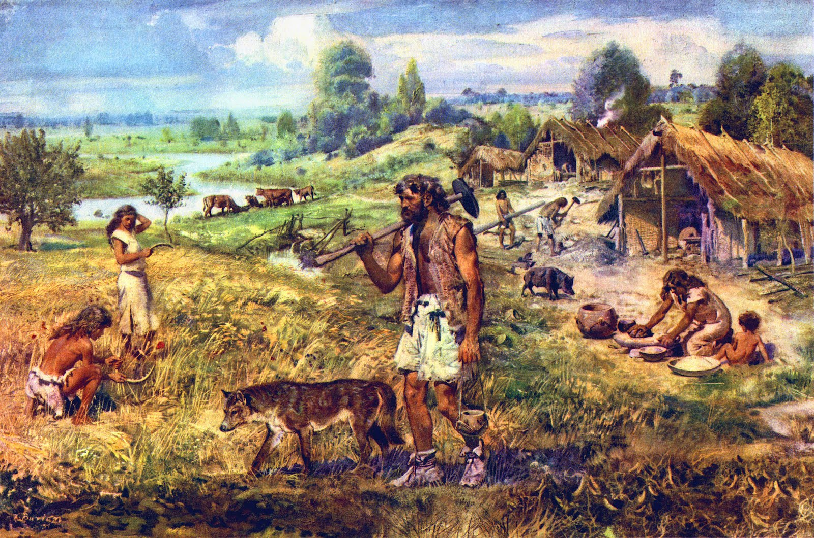
Some Rejected Theories
Global warming → smaller bodies → smaller brains
But similar trends have happened for a longer time period
Agricultural life → lack of nutrition → protein deficiency for brain growth
Brain shrinkage occurred on continents without agricultural revolutions
Notes:
Some scientists believed that global warming caused this trend. This is because a hotter climate would lead to evolving a smaller skeletal structure to reduce body temperature, which would have shrunk skull and brain size. However, these climate warming trends have happened periodically for the last 2 million years, so it seems that these modern developments would be caused by something else.
Others believed that the agricultural revolution could’ve caused a brain size decrease. Early agricultural life was often deficient in protein because many farmers didn’t grow any animals and relied heavily on grains. This would cause a protein deficiency, which can stunt brain growth. However, the brain shrinking trends were found in countries like Africa and Australia, where agricultural revolutions had not yet occurred.

Slide 5
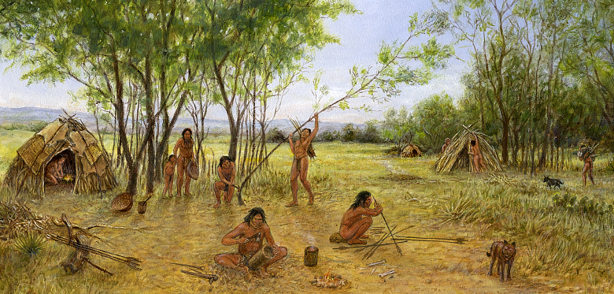
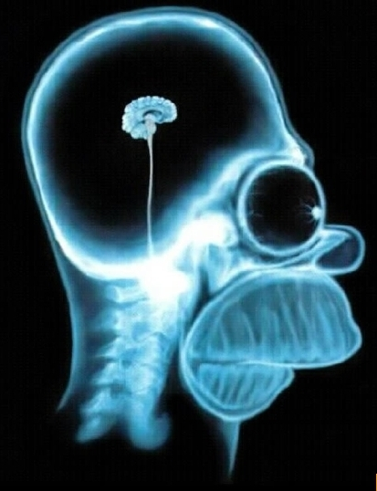
Idiocracy Theory
Theory: We are getting dumber
Research: As population density increases, brain size decreases
Conclusion: as societies become more complex, intelligence is not as key to survival
“Practically speaking, our ancestors were not our intellectual or creative equals because they lacked the same kind of cultural support. The rise of agriculture and modern cities based on economic specialization has allowed the very brightest people to focus their efforts in the sciences, the arts, and other fields. Their ancient counterparts didn’t have that infrastructure to support them. It took all their efforts just to get through life.” - David Geary
Notes:
David Geary and Drew Bailey believed in the Idiocracy Theory, which is that we have been losing intelligence over time. They did extensive research tracking population with brain size, and found that for sparsely populated areas, the brain grew over time. As population density grew, brain sizes decreased with about a 3-4% EQ drop about 15,000 years ago. The trend held true for every continent they studied. The researchers concluded that as societies become more complex, intelligence is not as key to survival. This was because of what they called “social safety nets” which allow individuals to rely on others for help in survival as opposed to their own intelligence.
David Geary says that “Practically speaking, our ancestors were not our intellectual or creative equals because they lacked the same kind of cultural support. The rise of agriculture and modern cities based on economic specialization has allowed the very brightest people to focus their efforts in the sciences, the arts, and other fields. Their ancient counterparts didn’t have that infrastructure to support them. It took all their efforts just to get through life.”

Slide 6
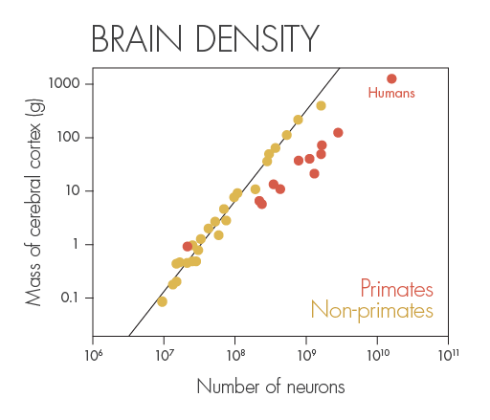
John Hawks
The ideal brain “yields the most intelligence for the least energy”
“So although a bigger brain can presumably carry out more functions, it takes longer to develop and it uses more energy.”
Similar to idea of brain density
Theory would require improbable mutations
Recent DNA rewiring supports this idea
Notes:
The scientist John Hawks, who developed the theory that brains are shrinking, posits that the ideal brain “The best brain “yields the most intelligence for the least energy”. The brain requires a tremendous amount of energy, and consumes about 20% of your body’s calories. “So although a bigger brain can presumably carry out more functions, it takes longer to develop and it uses more energy.” The kind of brain efficiency that Hawks talks about is similar to the idea of brain density, which compares the amount of neurons to the cerebral cortex mass. Critics argue that Hawks’s theory would need lots of very unlikely mutations over thousands of years. But a population boom from about 10-20k years ago could have allowed for some mutations that would decrease brain size. Recently, the DNA in our brains have been mutating and rewiring in ways that make it more efficient, and seem to agree with Hawks’s theory.

Slide 7
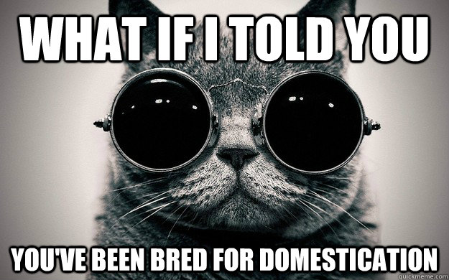
Domestication
Theory: Humans are becoming domesticated
“My suspicion is that the easiest way for natural selection to reduce aggressiveness is to favor those individuals whose brains develop relatively slowly in relation to their bodies.” - Richard Wrangham
Consistent with evolution and mutations
No group is more intelligent than others, “all you can say is that wild types and domesticates think differently” - Brian Hare
Notes:
Scientists Richard Wrangham and Brian Hare think the recent changes are because humans are becoming domesticated. In proving this, the scientist have studies on about 30 animals with about 10-15% loss of brain volume when domesticated. Wrangham thinks “My suspicion is that the easiest way for natural selection to reduce aggressiveness is to favor those individuals whose brains develop relatively slowly in relation to their bodies.” Unlike the previous theory, this theory relies on small incremental evolutions and changes to the brain over time, as opposed to large and very improbable mutations. Brian Hare believes no group is more intelligent than others, “all you can say is that wild types and domesticates think differently”. This implies that the changes in domestication do not necessarily imply a loss of intelligence.

Slide 8
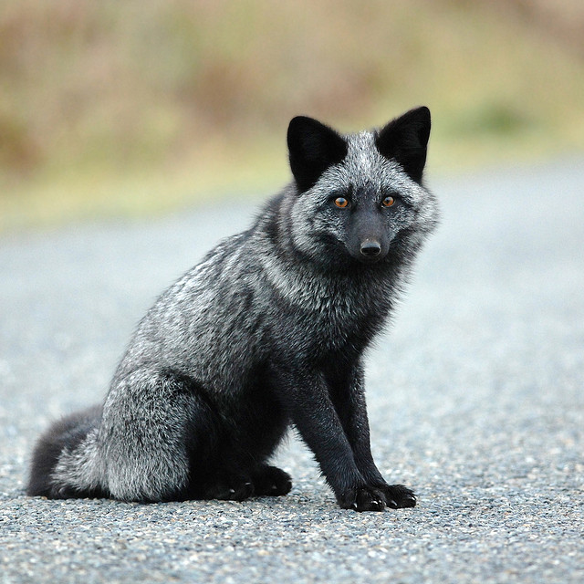
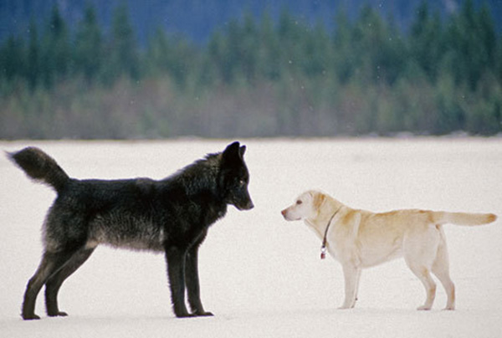
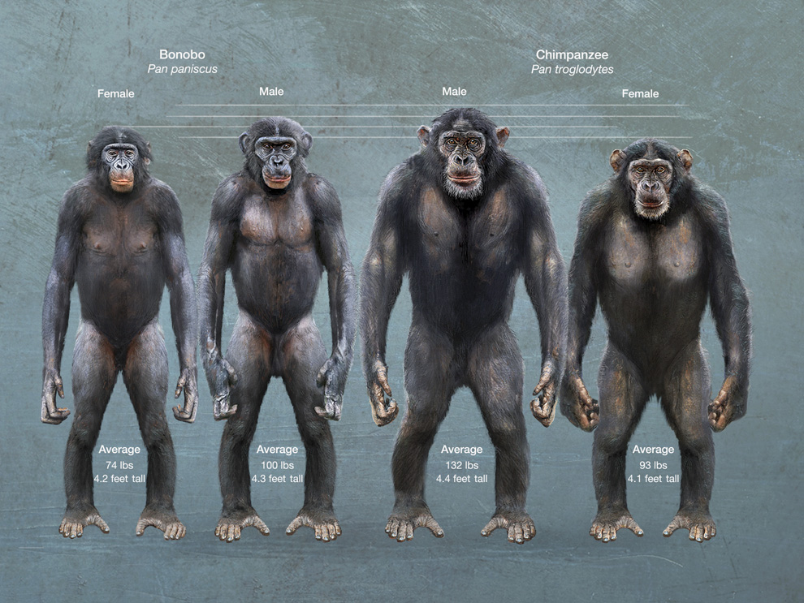
Domestication: Case studies
Silver fox experiment (Dmitri Belyaev)
Selectively bred for less snarling
Evolved to show signs of domestication
“Wolves seem to be a little bit more persistent than dogs in solving simple problems like how to open a box or navigate a detour … Wolves persevere when dogs readily give up.” - Brian Hare
“Bonobos look and behave like juvenile chimps… They are gracile. They never show lethal aggression and do not kill each other. They also have brains that are 20 percent smaller than those of chimps.” -Brian Hare
Notes:
Dimitri Belyaev conducted an experiment in which he raised silver foxes selectively breeding those that snarled slower to a threat. After over 12 generations they showed domesticated traits like floppy ears, curly tails, smaller skeleton, white spots on fur, less “sexual dimorphism” and lower aggression.
Another study shows that wolves have larger brains and are more independent than dogs, who have smaller brains and depend on humans moreso. Brian Hare says that “Wolves seem to be a little bit more persistent than dogs in solving simple problems like how to open a box or navigate a detour … Wolves persevere when dogs readily give up.”
Similarly, Hare hypothesizes that Bonobos are domesticated chimps. He continues, saying that “Bonobos look and behave like juvenile chimps… They are gracile. They never show lethal aggression and do not kill each other. They also have brains that are 20 percent smaller than those of chimps.” He thinks the trend toward domestication is because the Bonobos have a food surplus that led to more cooperation.

Slide 9
Conclusion
None of the theories alone are conclusive
Human brains are shrinking and humans are probably getting dumber
The human brain wasn’t designed to be the smartest or the best, it was meant to be beneficial
Humans aren’t special, they evolve like any other species
A bigger brain is not necessarily better
Notes:
Through studying the size of the brain over time, and the possible theories behind the trend, it seems that not one of the theories is conclusive or definite. However, many parts of these theories seem valid, and could be considered altogether to give a better understanding of how the brain has shrunk in recent times, and how humans might be losing intelligence. All of these theories point to the fact that the human brain is not designed simply to be the smartest or the best, like many people characterize it as. Much like other species and the rest of the human body, the human brain was designed to adapt to the environment and survive at all costs. The fact that humans evolve over time and that our brains are shrinking implies that a bigger brain is not necessarily better or more beneficial, and depends on the environment.

Slide 10
Images
http://pngimg.com/upload/small/tennis_PNG10405.png
http://i.imgur.com/aVUH1ON.jpg
https://upload.wikimedia.org/wikipedia/commons/thumb/f/f5/Cro-Magnon.jpg/220px-Cro-Magnon.jpg
http://realhistoryww.com/world_history/ancient/images_eman/cro_magnon_3.jpg
https://www.climate.gov/sites/default/files/PaleoTemp_EPICA_large.png
http://i.kinja-img.com/gawker-media/image/upload/zlh1iknpwenlxpqon60o.jpg
https://www.texasbeyondhistory.net/beene/images/Weir-woodworking.jpg
http://www.chicagoarchitecture.org/wp-content/uploads/2014/09/DSC_4245.jpg
https://www.quantamagazine.org/wp-content/uploads/2015/11/BrainDensity.png
https://www.metabunk.org/data/MetaMirrorCache/www_meteoritecollector_org_gallery_main_php_ea23a35e883058c4a63610e3e82c0fec._.jpg
http://s2.quickmeme.com/img/4a/4a1e5c89016adb8ee2ef643006f30e2784a66f043b66554ab11f10e20c2282d0.jpg
https://4.bp.blogspot.com/-Eo5XNbcxWfc/UN9pkOXae6I/AAAAAAAAg3E/FC0bhJWeM8I/s640/silver+fox+5.jpg
http://themindunleashed.com/wp-content/uploads/2016/04/encoun.jpg
http://ngm.nationalgeographic.com/2013/03/bonobos/img/physical-differences-990.jpg

Slide 11
Sources
"Our Brains Are Shrinking. Are We Getting Dumber?" NPR Science. NPR, 2 Jan. 2011. Web. 01 Nov. 2016.
McAuliffe, Kathleen. "If Modern Humans Are So Smart, Why Are Our Brains Shrinking?" Discover Magazine. Kalmbach Publishing Co., 20 Jan. 2011. Web. 01 Nov. 2016.
Henneberg, Maciej. “Decrease of Human Skull Size in the Holocene.” Human Biology, vol. 60, no. 3, 1988, pp. 395–405.
Stringer, Christopher. "Why Have Our Brains Started to Shrink?" Scientific American. Nature America Inc., 10 Oct. 2014. Web. 01 Nov. 2016.

