Slide 1
Rock Pocket MIce

Slide 2
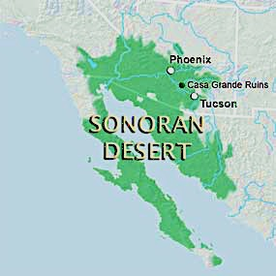
Notes:
Western US – Arizona, California, Northwest Mexico, Baja California

Slide 3
Notes:
Landscape – brown, sandy desert BUT also dark volcanic rock

Slide 4
Pocket Mouse
Notes:
Pocket mice are all over the desert
Average mass – 15 grams – paper clip bag

Slide 5
Notes:
There are 2 populations – One matches the color of the sandy desert and the other matches the darker volcanic desert

Slide 6
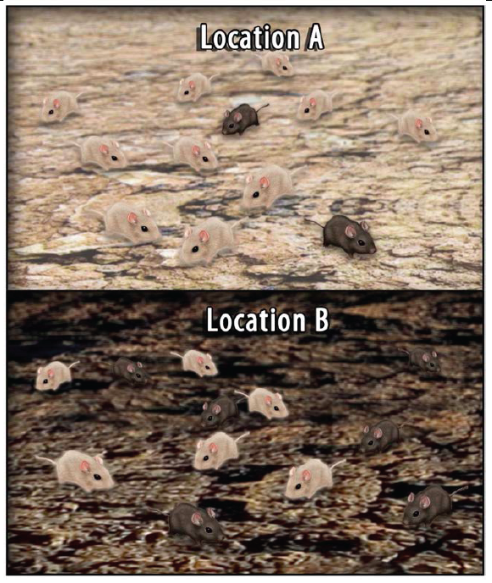
Notes:
Give out Handout – have students do the 1st page

Slide 7
Notes:
2nd page #4 has students watch a video about these mice and their environment - VIDEO
http://www.hhmi.org/biointeractive/making-fittest-natural-selection-and-adaptation

Slide 8
Natural Selection
Mutations
Random & Rare events
Selective advantage – an adaptation that gives an organism an advantage over other organisms – selects for an organism
Depends on environment
Allows organism advantage to survive and reproduce
Natural Selection
Not random
Sorts out the individuals better suited to survive in their environment
Notes:
Go over these ideas – students take notes

Slide 9
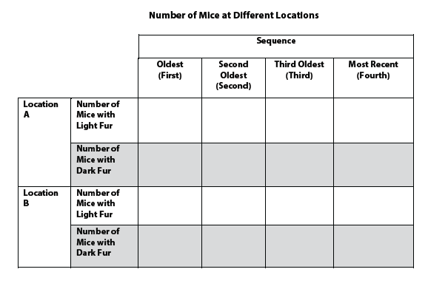
Back to handout
Notes:
Go back to handout. Have students complete Pages 2 & 3 - Questions #5, 6 then questions on page 4

