Slide 1
Accommodations in the classroom

Slide 2
Room Arrangement
Place student away from distractions
Example: the door, window, friends, etc.
Sit student close to the board
Don’t completely exclude student but ensure that the student is not taking away from others learning.

Slide 3
Material Organization
Classroom buddy
Extra set of books and materials at home
Consistent progress report
Consistent reminders
Homework system
Assignment notebook

Slide 4
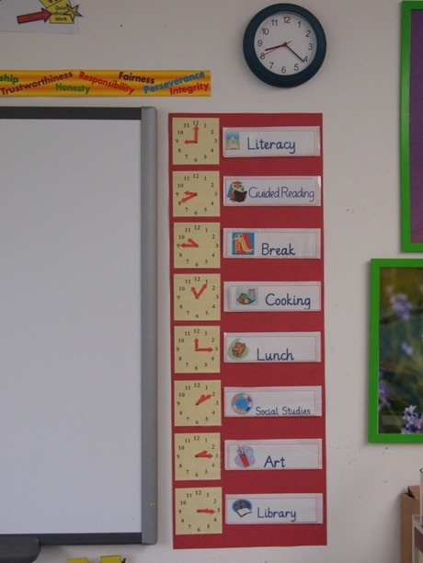
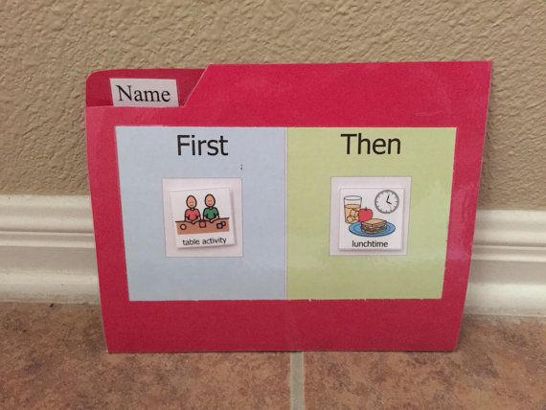
Transitions
Visible schedule
Consistency
Practice transitions
Especially fire drills or other non normal activities
Extra time
Visual prompts

Slide 5
During lessons
Verbal and visual directions
Model what you want done
Brain breaks
Provide written notes
Large print
Do not write in cursive
Warn student before you call on them
Secret warning

Slide 6
Giving directions
Specific and short
Write them out if possible
Create procedures in the beginning of the year and use them all year wrong
Practice the directions
Have students repeat directions back to you

Slide 7
Assignments and worksheets
Allow typed assignments
Specifically say when assignments are due
Large print
Extra time
Give less problems to students who take longer
Do not focus on mechanics
Especially in writing

Slide 8
Test Taking
Allow exams to be oral
Extra time
Study guides
Extra space on the test for witten out work
Multiple choice
Teach study habits
Have student test in a separate room

Slide 9
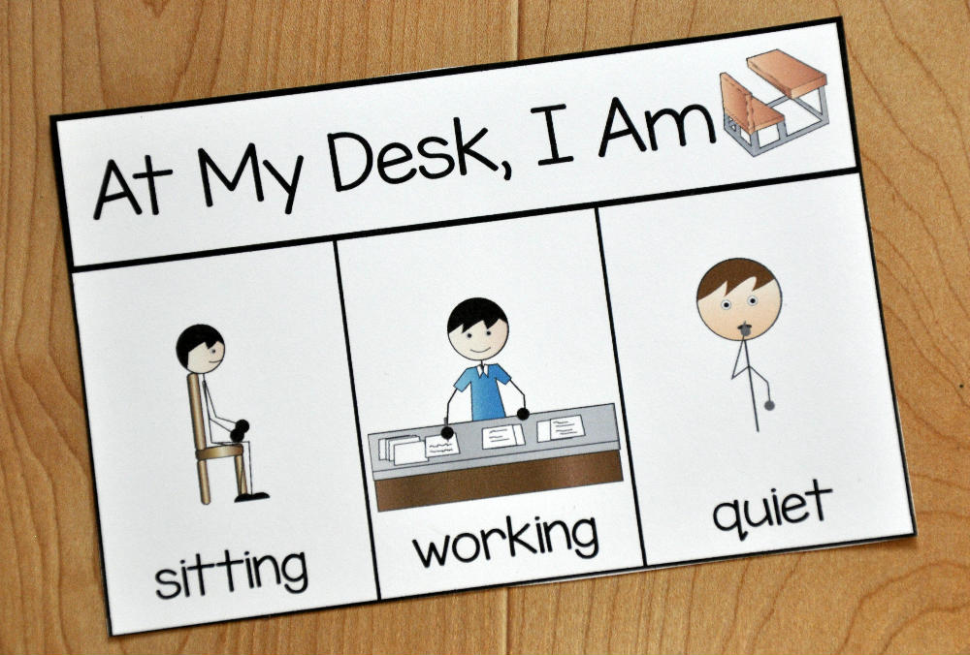
Management
Implement procedures from day 1
Practice all procedures multiple times throughout the first week of school
Ensure students know the schedule
Use visual prompts
Pictures of what is next
Pictures of what to do for specific procedures
Expectations

Slide 10
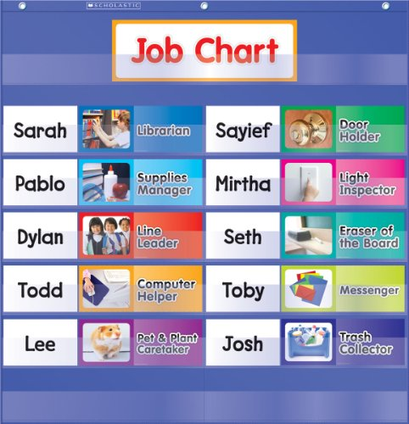
Motivation
Classroom economy
Use rewards that you don’t have to buy
Example: teacher helper, lunch with teacher, sit next to a friend for a lesson, chew a piece of gum, homework pass
Class jobs
Check off sheet
Younger students - puzzle powerpoint
Plan lessons around their interests

