Slide 1
How to Talk like TED
ENGE 1320
March 20, 2017

Slide 2
April 1!

Slide 3
“The Happy Secret to Better Work”
Shawn Achor
https://www.ted.com/talks/shawn_achor_the_happy_secret_to_better_work?language=en#t-62687

Slide 4
Unleash the master within
What wakes you up (besides going to 1320)? What do you enjoy doing (besides writing poetry essays)? What takes you to another world? To a place where you can be you? WHAT IS YOUR INSPIRATION?! WHAT IS YOUR PASSION?
Notes:
Science shows that passion is contagious. Your audience will be drawn to what you are saying if they see and feel just how inspired and passionate you are about your topic.

Slide 5
Unleash the Master Within
Science shows passion is contagious
Your audience will be drawn to you if they see how inspired you are about your topic
This your chance to show how you and your interests are special!

Slide 6
2. Tell three stories
What you DON’T want your classmates and tutor to look like when you are presenting:
What you DO want your classmates and tutor to look like when you are presenting:

Slide 7
2. Tell three stories
Your talk should not be a cramming session of facts and figures because that is BORING.
People won’t remember statistics, but they will remember stories.
Make 3 main points and you can convey each point through a story.
Notes:
Science also shows that stories stimulate and engage the human brain, which allows the speaker to connect with the audience much more. Before there was writing, radio, television, movies, Youtube, 3D movies, 4D movies...there was storytelling. Simple person to person interaction, no media needed. People cannot remember the facts and figures, but they will remember the story. Take them on a journey. Make them forget they are in a classroom, but that they are with you inside the story.

Slide 8
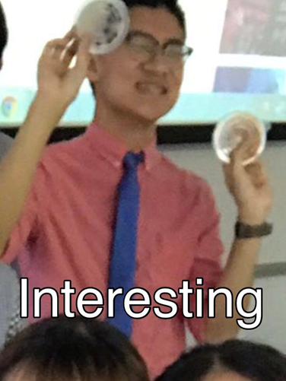
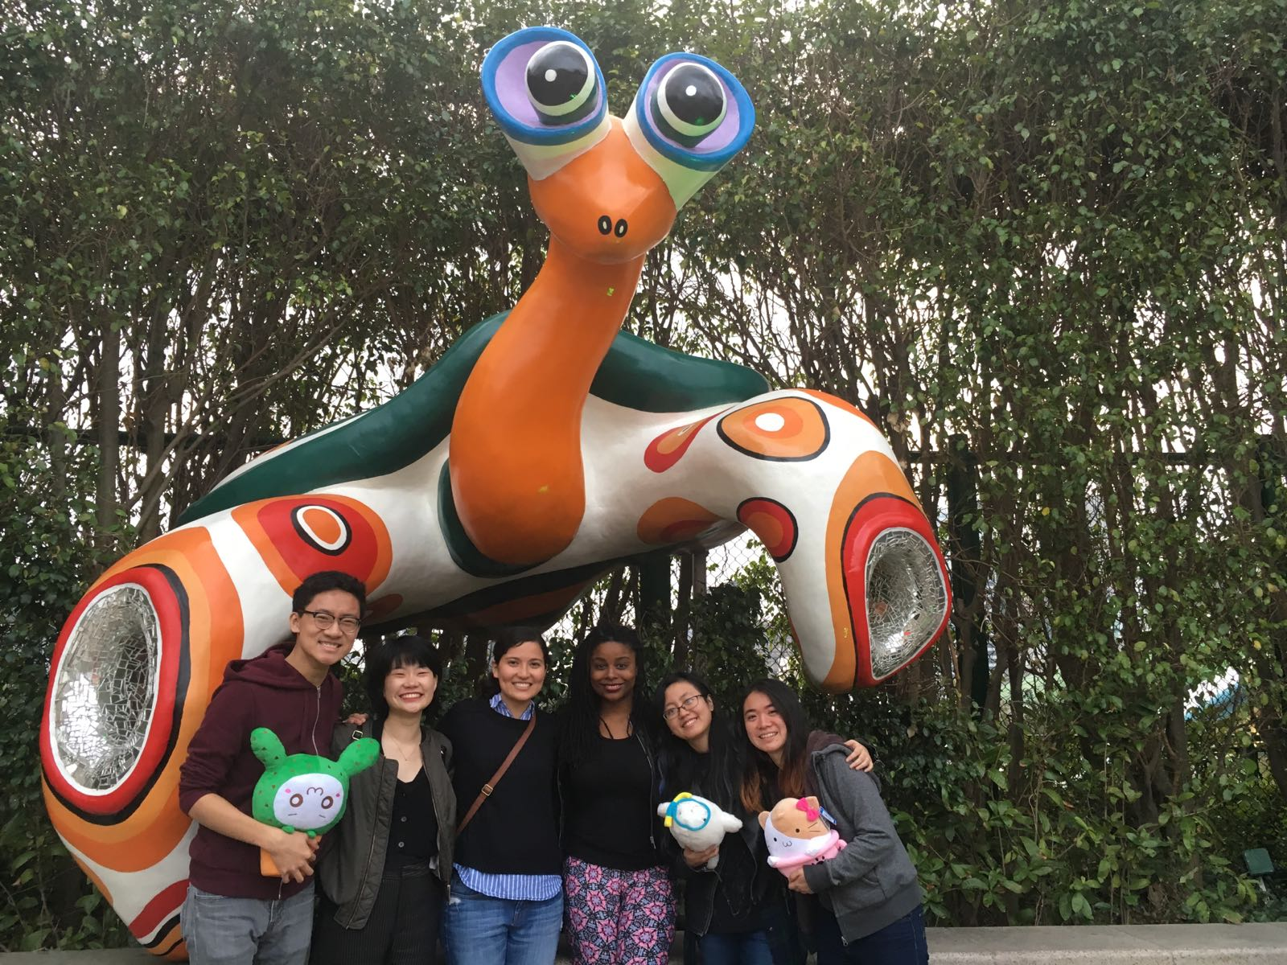
2. Tell three stories: Types of Stories
Personal story: stories about you and your experiences, share with them a little about yourself
Other people’s story: stories about others/people you know who have learned a lesson/gone through an experience the audience can relate to...aka spread some gossip ;)
Brand story: stories about the success/failure of a popular brand/company/figure

Slide 9
3. Practice relentlessly
Malcolm Gladwell’s “10,000 Hours Rule”
TAKEAWAY: Practice make perfect!

Slide 10
4. Teach your audience something new
How many of you knew that story?
TAKEAWAY:
Your talk should not be new to you…
...But it should be very new to your audience.

Slide 11
4. Teach your audience something new
Exercise is good for you.
Bodybuilders (and people who exercise in general) create new muscle when they exercise by tearing apart the old muscle - the muscle that grows back is larger and stronger.

Slide 12
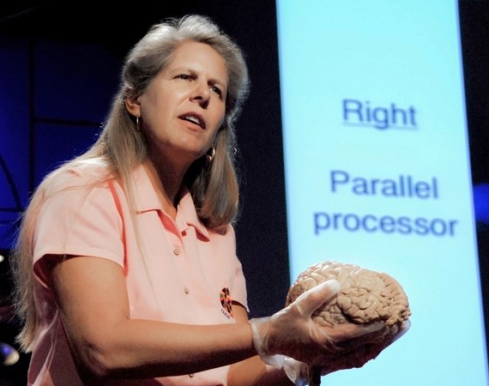
5. Deliver jaw dropping moments

Slide 13
5. Deliver jaw dropping moments!
Create an emotionally charged event (Attempt to induce shock, surprise, fear, sadness, joy, wonder...)
Stimulate your audience’s imagination
Make a startling assertion
Make your presentation interactive

Slide 14
6. Use humor without telling a joke
Benefits of Using Humor
Makes audience more likely to remember what you say
Makes your audience more receptive
breaks through barriers
makes you likeable!

Slide 15
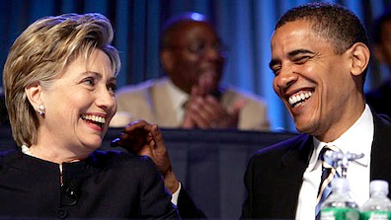
6. Use humor without telling a joke
How to Use Humor
Use it near the beginning
Create an expectation and break it
Be self deprecating!
Think about pace
Mix verbal and physical humor
Make it relevant
Don’t force it!

Slide 16
7. Favor pictures over text

Slide 17
Animal Facts:
The elephant is the largest land mammal
Oysters can change genders
Ostriches can run faster than horses
You’re probably reading these facts instead of listening to me
Giraffes have four stomachs

Slide 18
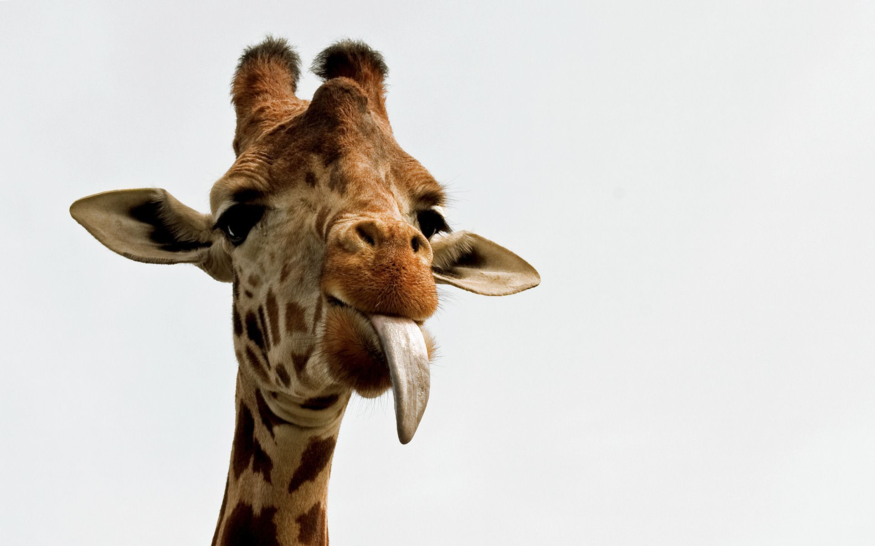
“I have four stomachs and use pictures in all of my presentations”

Slide 19
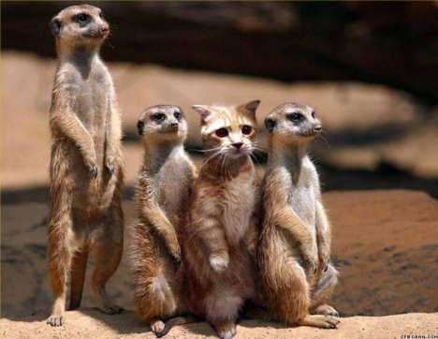
8. Stay in your lane

Slide 20
Conclusion
Review - What were the eight tips for magical TED talks?

