Slide 1
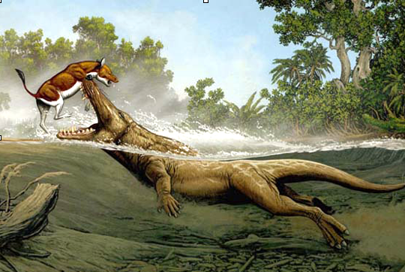
Ambulocetus
Carl Buell
Notes:
Questions on handout

Slide 2
What is the closest land dwelling relative of whales?

Slide 3
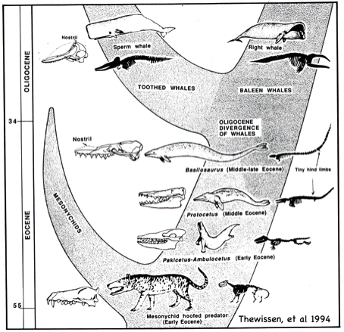
Whale Phylogeny, 1994 Hans Thewissen

Slide 4
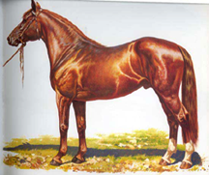
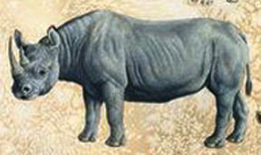
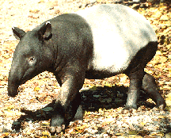
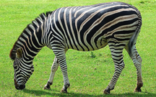
Perissodactyls Odd-Toed Ungulates
Horses & Zebras
Rhinos & Tapirs

Slide 5
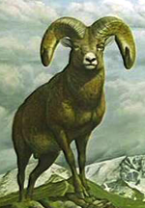
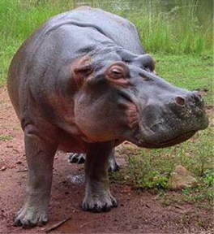
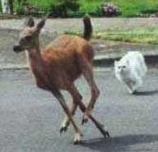
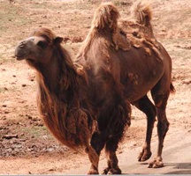
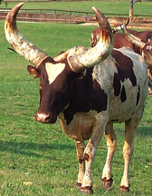
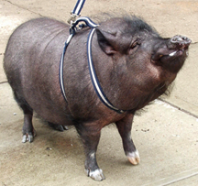
Artiodactyls Even-Toed Ungulates

Slide 6
But WHICH Hooved animals?
Is there a way to demonstrate relatedness between hoofed animals and whales?

Slide 7
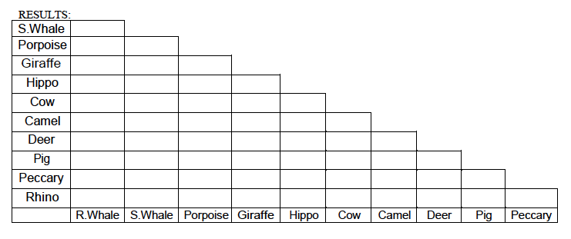
DNA Analysis Compare segments of beta-casein gene
Notes:
We will look at 7 land animals

Slide 8
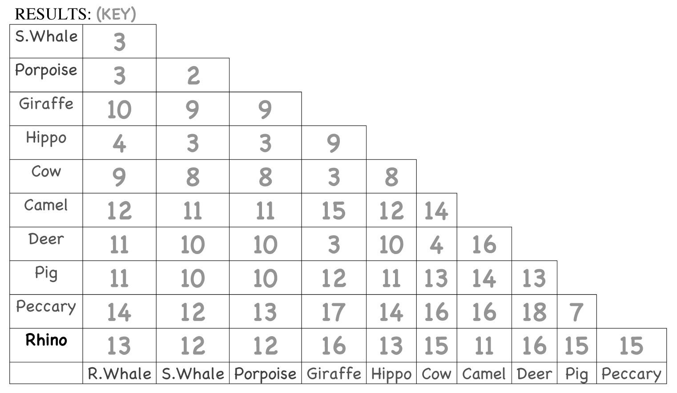
DNA Differences
Notes:
40-48: DNA analysis indicates hippos are the most closely related living animals to whales.

Slide 9
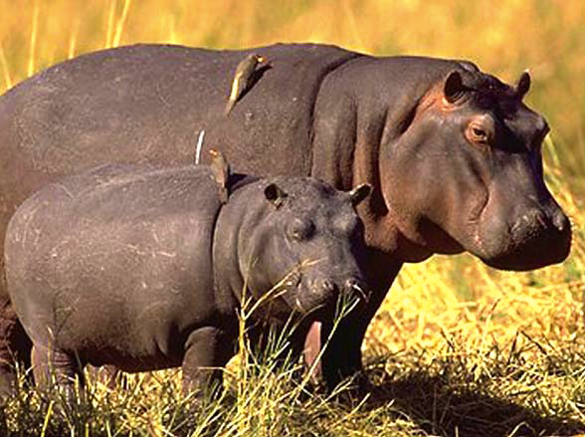
Whale’s Closest Land Dwelling Cousin: Hippos

Slide 10
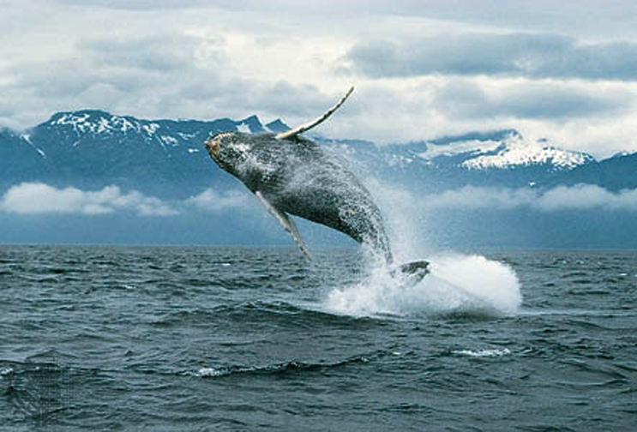
FAREWHALE!

