Slide 1
Normal Coronary Artery
Images: Coronary artery:
Microscopic image of a cross section of a coronary artery:
http://www-medlib.med.utah.edu/WebPath/CVHTML/CV004.html
Information on coronary artery anatomy and physiology:
Cleveland Clinic Heart Center:
http://www.clevelandclinic.org/heartcenter/pub/guide/disease/cad/cad_arteries.htm
Cardiovascular Consultants:
http://www.cardioconsult.com/Anatomy/

Slide 2
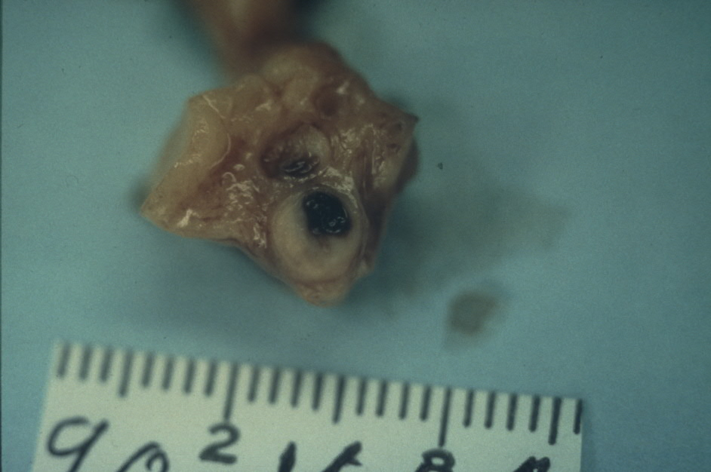
Coronary Artery Thrombosis
Thrombosis or blood clot
Atherosclerosis
or build up of artery wall

Slide 3
Coronary Artery Disease or Atherosclerosis
Images: Coronary artery disease:
Microscopic cross section of narrowed coronary artery:
http://www-medlib.med.utah.edu/WebPath/CVHTML/CV007.html
Gross cross section of atherosclerotic coronary artery:
http://www-medlib.med.utah.edu/WebPath/CVHTML/CV108.html
Information on coronary artery disease:
Medline Plus Medical Encyclopedia:
http://www.nlm.nih.gov/medlineplus/ency/article/000171.htm
How Stuff Works:
http://health.howstuffworks.com/adam-200034.htm - Atherosclerosis
http://health.howstuffworks.com/adam-200138.htm - Coronary bypass surgery
http://health.howstuffworks.com/adam-200082.htm - Coronary artery blockage

