Slide 1
Movement Across Membranes

Slide 2
Solvent – the substance that dissolves something else Solute – the substance that gets dissolved

Slide 3
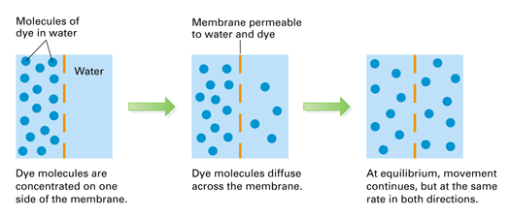
DIFFUSION Getting to Equilibrium
Notes:
Dye molecules diffuse across a membrane. At equilibrium, the concentration of dye is the same throughout the container.
Diffusion – the movement of molecules from high concentration to low

Slide 4
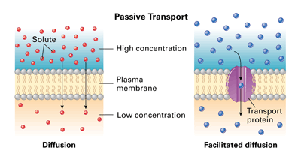
Passive Transport – No extra energy needed
Notes:
Both diffusion and facilitated diffusion are forms of passive transport, as neither process requires the cell to expend energy. In facilitated diffusion, solute particles pass through a channel in a transport protein.

Slide 5
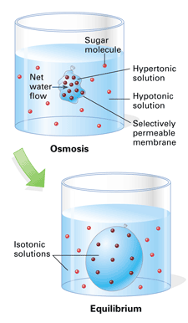
Osmosis
Selectively permeable membrane = lets through only some molecules
Osmosis – passage of water
Hypertonic – higher [solute]
Hypotonic – lower [solute]
Isotonic – equal [solute]
[ ] = concentration
Notes:
A selectively permeable membrane (the bag) separates two solutions of different sugar concentrations. Sugar molecules cannot pass through the membrane.
Osmosis – the passage of water
Hypertonic – higher concentration of solute
Hypotonic – lower concentration of solute
Isotonic – concentrations of solute equal

Slide 6
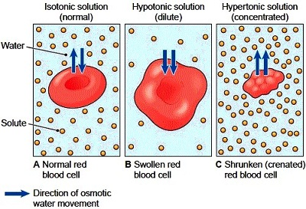
Example of Osmosis
B. If the cell ruptures = hemolysis C. If the cell shrinks = crenation

Slide 7
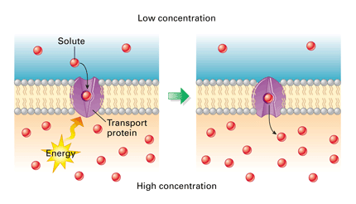
ACTIVE TRANSPORT – Energy Needed
Notes:
Like an enzyme, a transport protein recognizes a specific solute, molecule or ion. During active transport, the protein uses energy, usually moving the solute in a direction from lesser concentration to greater concentration.

Slide 8
Solvent Solute Concentration Gradient Diffusion Passive Transport Facilitated Diffusion Osmosis Selectively Permeable Membrane Hemolysis Crenation Active Transport

Slide 9
A Chicken Egg – A Single Cell

Slide 10
It takes
24 – 26 hours to create an egg
So
~ 1 egg/day

Slide 12
You Can’t Tell the Difference

Slide 13
Shell-less Eggs

