Slide 1
Mitosis & Meiosis

Slide 2
To go from a zygote to a chicken, you have to have mitosis happening. You want every cell in the chicken to have the full amount of DNA
But how do you go from a regular cell, which has the full amount of DNA to a gamete cell with ½ the amount of DNA?
This calls for a special process - Meiosis
Notes:
The problem – Getting from 1 full set of DNA to ½ set in the gamete cells

Slide 3
Regular cells (not sex cells) are called somatic cells. These have to undergo mitosis.
Sex cells, or gametes, have to undergo mieosis.
Both types have to start with DNA being replicated in the Synthesis phase of the cell cycle.
Notes:
Gamete vs Somatic Cells

Slide 4
The Cell Cycle
Notes:
Recall the different phases of the cell cycle.

Slide 5
Notes:
Each chromosome in a reproducing cell undergoes the duplication and separation process shown here. Duplication occurs during interphase, in preparation for cell division.
Usually you can’t see the sister chromatids. This happens in both mitosis and meiosis.

Slide 6
Notes:
Review of mitosis – Notice the names of the different stages. Cytokinesis is the actual splitting of the cell into two.

Slide 7
Mitosis Video
Video of mitosis in a pig’s cell
http://40two.info/barge/bio/bscs/unit4/Two color male pig kidney epithelial cells undergoing mitosis.mp4
Same video on youtube
https://www.youtube.com/watch?v=P7m3WfzgZdI
Notes:
This video shows two cells from the epithelial layer of a pig’s kidney. One cell is undergoing mitosis, while the other is just doing it’s normal job.

Slide 8
Cancer
Notes:
Review of cancer – Remember the article about cancer. What turns a normal cell into a cancer cell? What are oncogenes? What are tumor suppressors? How are they involved in cancer?
Hint: Think about the gas pedal and brake pedal in a car
Most illnesses involve something that is missing or a process that is defective. In cancer, the process works too well. Cell division happens so much that you end up with a lump of cells which we call a tumor.

Slide 9
Notes:
In a dividing plant cell the growing cell plate eventually fuses with the plasma membrane of the parent cell, and the cell wall material joins the existing cell wall. Two daughter cells result, each with its own plasma membrane and cell wall.

Slide 10
Karyotype
Notes:
Karyotype displays are made when chromosomes are visible during metaphase; therefore, each chromosome actually consists of two chromatids. In a true karyotype you would not be able to distinguish the sister chromatids. This illustration, however, shows how a homologous pair would look if you could distinguish the sister chromatids on each chromosome.

Slide 11
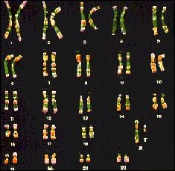
Notes:
Can’t see the sister chromatids

Slide 12
Notes:
In the human life cycle a haploid egg and sperm fuse and form a diploid zygote. Mitosis produces an embryo with numerous cells that continue to multiply and develop.

Slide 13
Notes:
This simplified diagram highlights the major points that distinguish meiosis from mitosis. Meiosis produces four haploid cells, rather than two diploid cells. Also, meiosis involves two divisions, whereas mitosis involves only one.
N = the number of chromosomes

Slide 14
Notes:
The stages of meiosis begin after interphase. (This example starts with a cell that has two homologous pairs of chromosomes, 2n = 4.)
Prophase I = tetrads (paired chromosomes that each have sister chromatids) exchange dna material (genetic material); this is called crossing over. This allows for DNA variation.

Slide 15
Notes:
Compare Meiosis II to Meiosis I. Notice what is lining up in Metaphase II and what is getting pulled apart in Anaphase II. How is the end result different from Mitosis?

Slide 16
Notes:
In a diploid cell with four chromosomes (two homologous pairs), there are two equally possible ways for the chromosomes inherited from the two parents to be arranged during metaphase I. This variation in the orientation of chromosomes leads to gametes with four equally possible combinations of chromosomes.

Slide 17
Notes:
This diagram illustrates an example of crossing over in one pair of homologous chromosomes, shown here side-by-side for ease of viewing. (The process can occur in all pairs.) Early in prophase I, a chromatid from one chromosome exchanges a segment with the corresponding segment from the other chromosome. These altered chromosomes give rise to what are known as "recombinant chromosomes" in the gametes.

Slide 18
Main Differences between Mitosis & Meiosis
1. Metaphase:
In Mitosis - No homologous pairing (synapsis)
In Meiosis – Homologous chromosomes pair up
Anaphase:
In Mitosis – Centromere split
In Meiosis – Homologous pairs split
Division:
In Mitosis – 1 Division into 2 cells; 2n → 2n (n→ n)
In Meiosis – 2 Divisons into 4 cells; 2n → n (n→1/2n)
Notes:
Both mitosis and meiosis begin after the chromosomes have been duplicated during interphase. Though similar, the results of the two processes differ in the number of cells produced and in the number of chromosomes the cells contain.

Slide 19
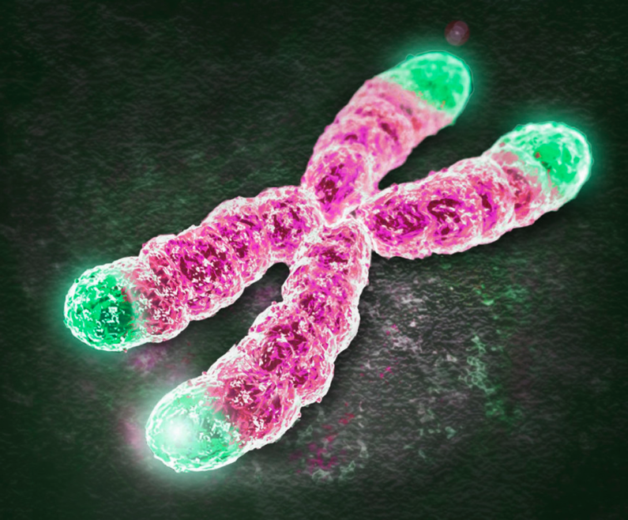
Telomeres
The tip of the chromosome gets shorter every time the cell divides. The only allows the cells to divide a certain amount before it dies. Read this interesting explanation: http://genetics.thetech.org/ask-a-geneticist/cancer-cells-without-telomerase
Notes:
If the link doesn’t work, copy and paste the address into a webpage. http://genetics.thetech.org/ask-a-geneticist/cancer-cells-without-telomerase

