Slide 1
What Makes Us Human?
By Annabel Howington

Slide 2
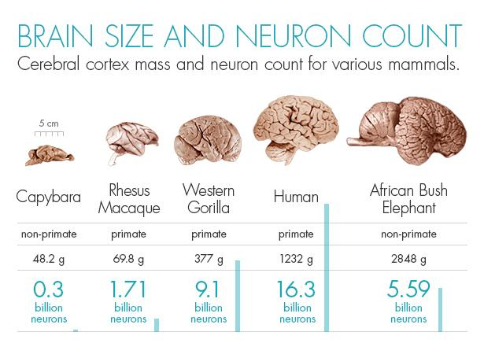

Slide 3
Amount of neurons
there are approximately 16 billion neurons in the human cerebral cortex
300 million in capybara
9.1 billion in a western gorilla
5.59 billion in an african bush elephant

Slide 4
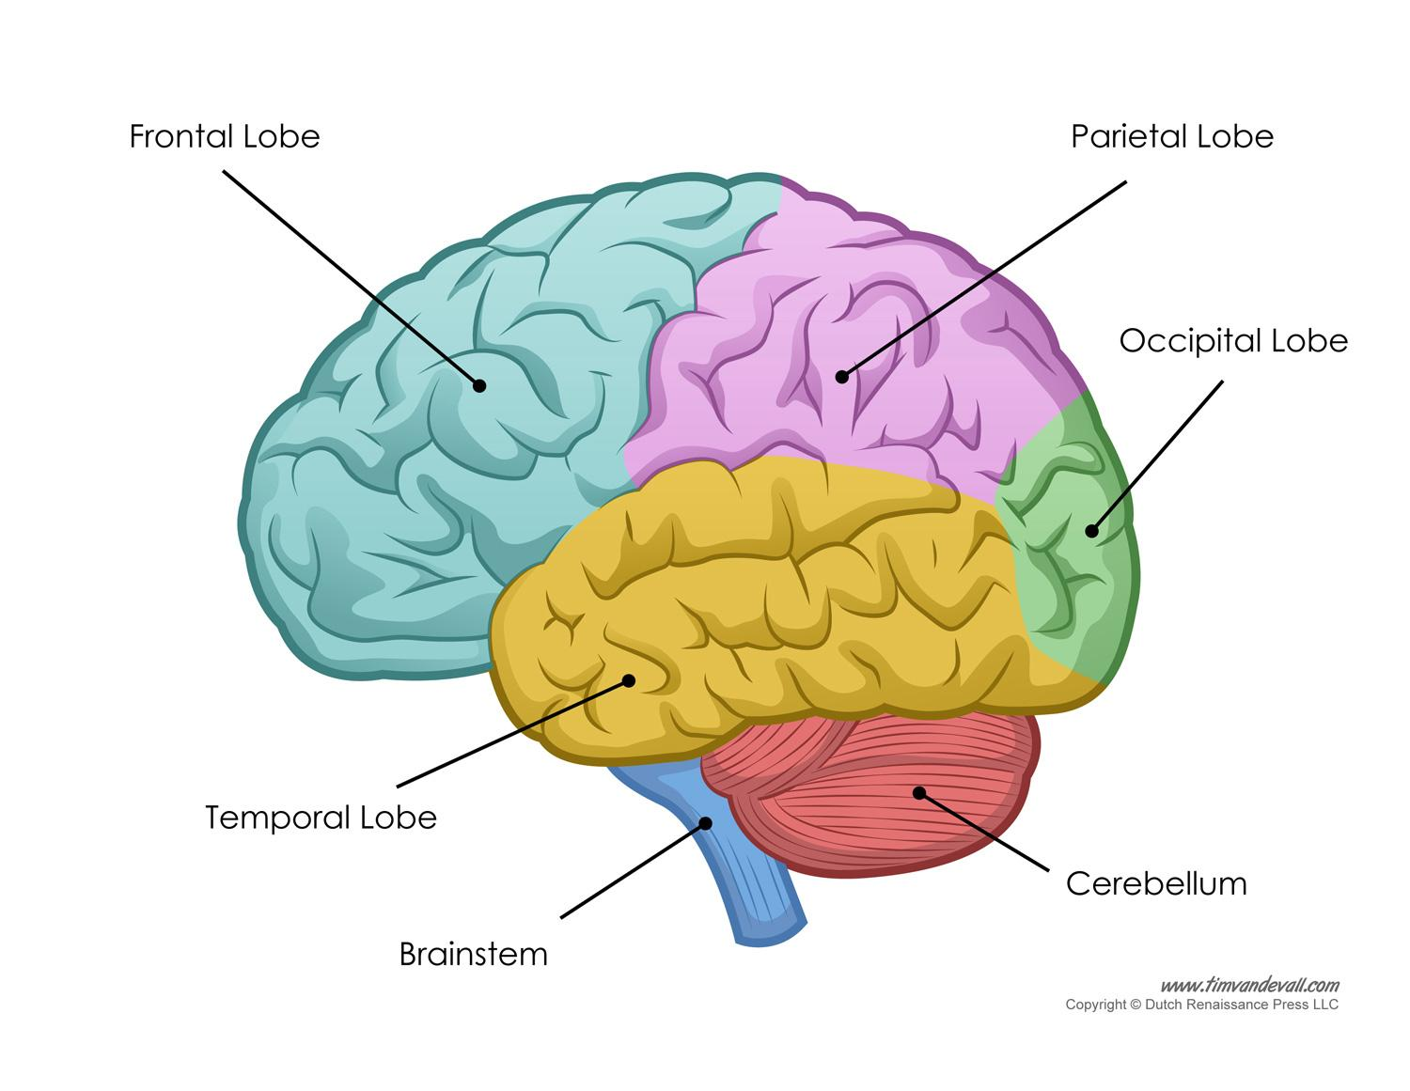

Slide 5
To gain neurons….

Slide 6
We cook!

Slide 7
Cerebral cortex’s main functions
plan ahead
look back
learn from mistakes
self awareness
abstract reasoning

Slide 8
86,000,000,000
The amount of neurons in the average human brain

Slide 9
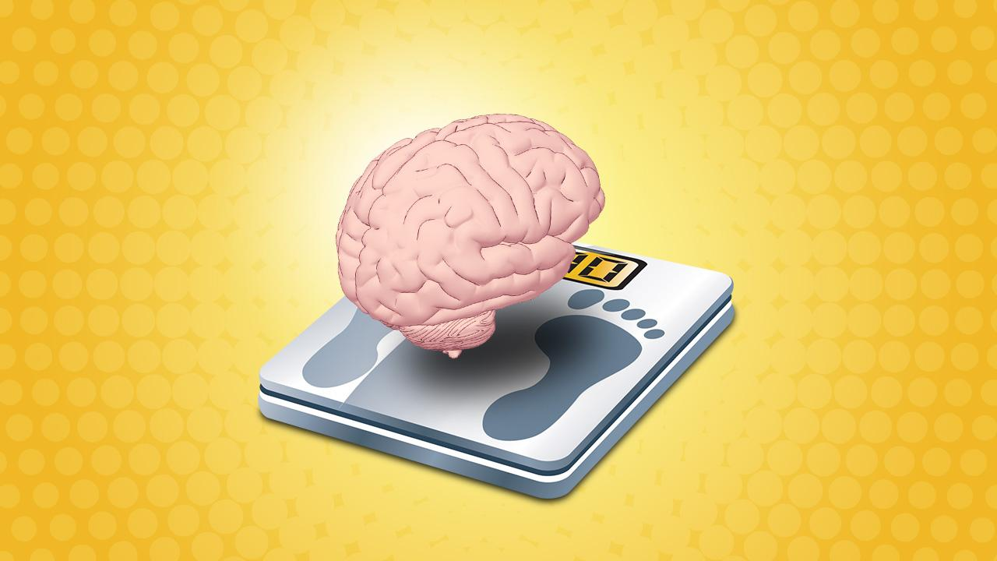

Slide 10
large brain
more intelligence

Slide 11
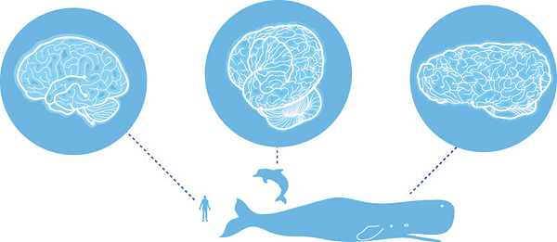

Slide 12
We are human because….
We invented cooking!

