Slide 1
Craftsmanship and Communication of the Human Species
Bert Stroka

Slide 2
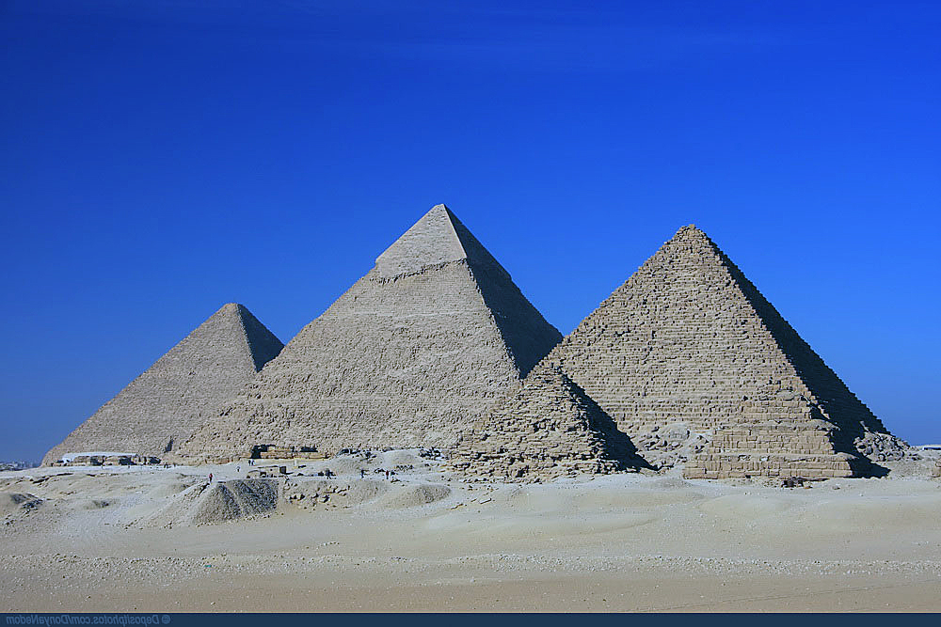
Craftsmanship
Thumbs
Brain Size
Tools
Buildings

Slide 3
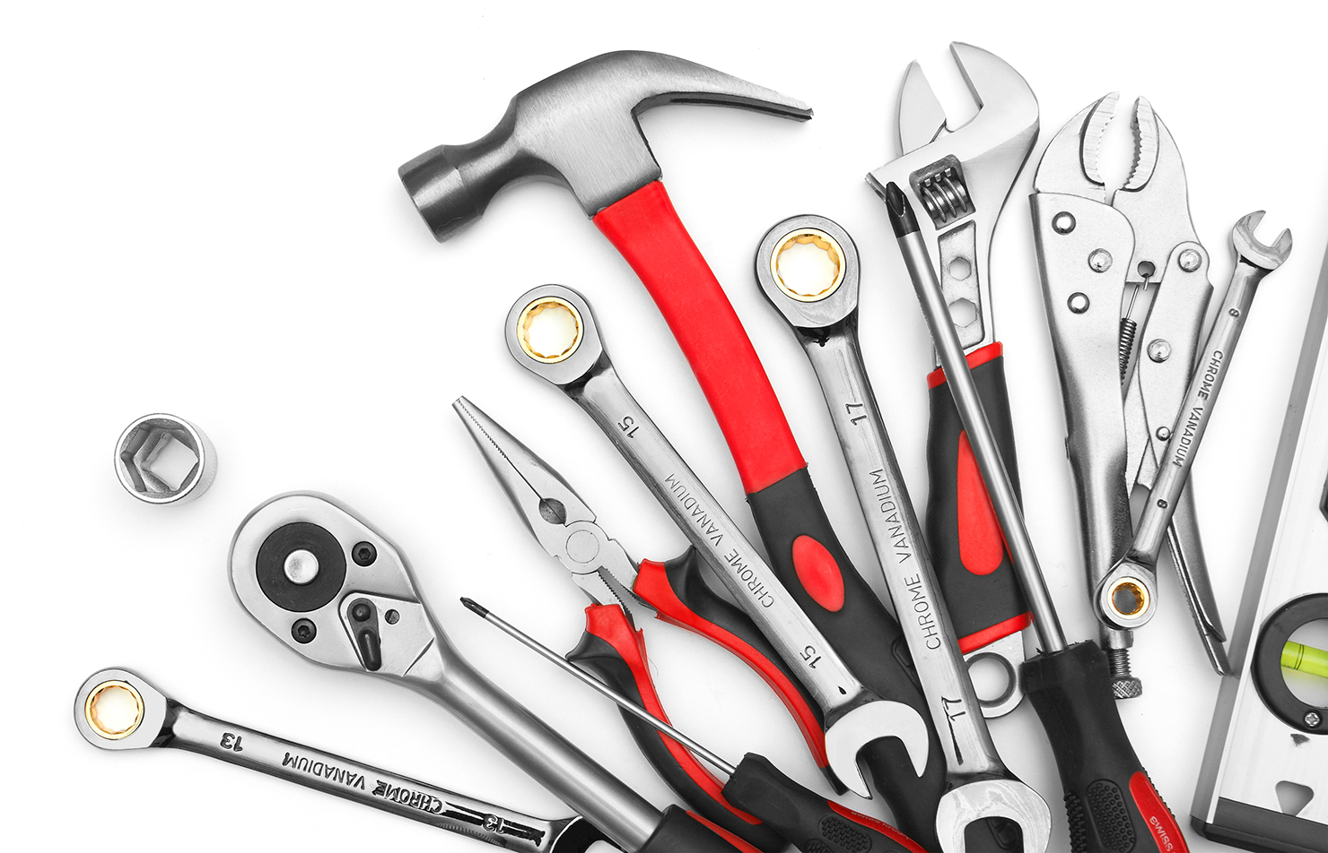
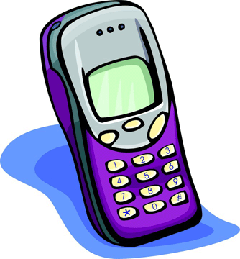
Communication
Language
Telephone
Email
Ideas
Schools

