Slide 1
What is a human?

Slide 2
Conceptually speaking…

Slide 3
Factually rather...
“Homo Saepiens- (are) the species of bipedal primates to which modern humans belong, characterized by a brain capacity averaging 1400 cc (85 cubicin.) and by dependence upon language and the creation and utilizationof complex tools.”

Slide 4
A Human Must Be Alive!
Life (/līf/) :
When an object (made of cells) displays a capacity for: responsiveness to the environment; passing traits onto offspring; growth and change; reproduction; metabolism and respiration; (and) maintenance of homeostasis.
(To clarify) A human must have or have had life!
And/or (debatably) be capable of life.

Slide 5
Humans must have a capacity for complex self-reflection!
As it relates to personality and social interactions…
(ex. 1.) Psychology!
(ex. 2.) Sociology!
As it relates to autonomic functions…
(ex. 1.) Biology!
(ex. 2.) [More specifically...] Anatomy!

Slide 6
“Complex self-reflection!” Cont’d!
By extension, OR, to simplify…
Humans must be capable of analyzing the WHY of themselves.

Slide 7
Humans must be capable of reflecting on their environment!
Humans must be capable of reflecting the WHY of their environment (in a complex manner that is to say...)!
(See: Environmental Science!)
(Key point: to be able to reflect on one’s environment is not sheerly human. )
To specify: humans must be able to reflect on their environment to enable drastic ALTERING of their environment (See next slide.).

Slide 8
Humans do display a capacity to create complex institutions…
→
(That said)
(See: Government(s), The UN, The A.M.A., )
(A larger part of environment alteration.)

Slide 9
(And, to have done so..) Humans must display (must have displayed) capacity for language.
Humans must display a capacity for understanding of: formalized, outlined, or otherwise universally understood meanings of specific sounds and symbols relative to a cultural vernacular - i.e. language.
Language - “A method of ... communication, either spoken or written, consisting of the use of words in a structured and conventional way.”
Humans must display a capacity for language rather than improvised (non-standardized) gestures meant to communicate a meaning.
(Sign language while still involving gestures, is standardized and certain gestures are universally understood among those who speak it fluently.)

Slide 10
Within these complex systems humans must have had a capacity for reasoning to maintain the systems/ the systems’ order...
Reasoning would have allowed for minimal clashing of individual choice actions.
To clarify/expand, reasoning as it applies to morality is a fairly unique staple of humanity.
-(ex.) Leopards do not recognize the moral choices involved in consuming other animals, hence it is a rare and typically unnatural thing to see a vegan leopard.
Notes:
To be human could simply mean to have a capacity to understand the world in a complex fashion. Humans are just ahead.. Not special.

Slide 11
Morality
Morality, n. - the extent to which something is “right” or “wrong.”
Morality is very much a gray-area as animals can display both sympathy and cruelty. Morality and moral choices are also very much high-level brain functions and choices, which leads me to my next point…

Slide 12
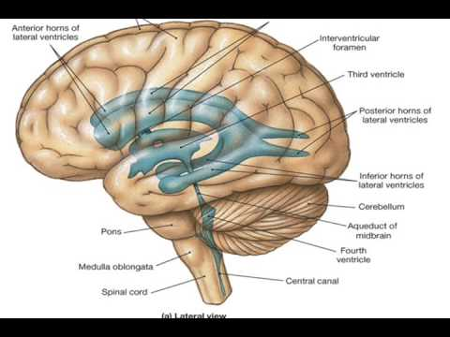
The Brain…
(1)
The human brain developed from the bottom up.
The medulla:
attached to/is a part of, the brainstem.
controls a human’s most primal functions (breathing, heartbeat, and swallowing) - the “step one” in living.

Slide 13
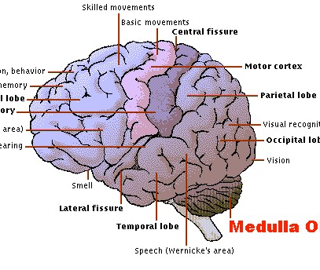
The Brain… (2)
The regions of the brain responsible for the senses developed next - (ex.) the temporal, parietal, and occipital lobes.
Notes:
Step 2 in existing - recognizing the world around oneself.

Slide 14
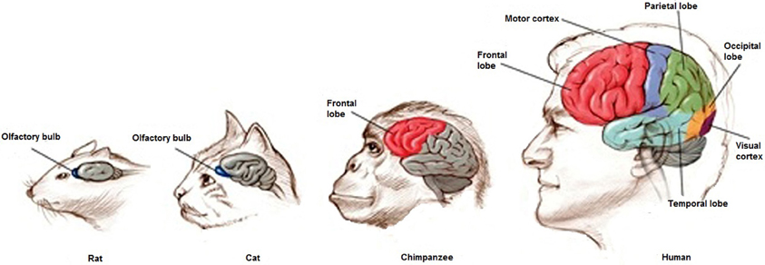
The Brain, Pt. 3
The portion(s) of the brain responsible for thought and decision making (as well as personality) - the frontal lobe(s) - developed last.

Slide 15
Sooooo...
Notes:
See document for area 10 specs.

Slide 16
What this boils down to...
Humanism is not something distinctly human - it is simply a way humans have termed their complexity/advanced nature.
Many humanistic traits can be observed across species which means humanism is never truly unique, just a means of terming specific advanced qualities of the mind which, for example, include but are not limited to:
Thought
Decision-making
Emotion/Empathy/Sympathy
Personality/psycho-individuality
All of which are facilitated by the frontal lobe…

