Slide 1
How does Clothing make us HUmans?
By: Carlos Eloisa & Ben Lohman

Slide 2
Why is clothing unique to humans?
From your shirt and shoes to your socks and undies. All of which are a part of your daily outfit. Those are all things that we today would never think to leave the house without. However, at some point in history all those items were merely just a cape or very few articles of clothing. This project will analyze how humans have developed from creatures with more fur and natural warmth to the species we are today and how that has affected how we see clothing today.

Slide 3
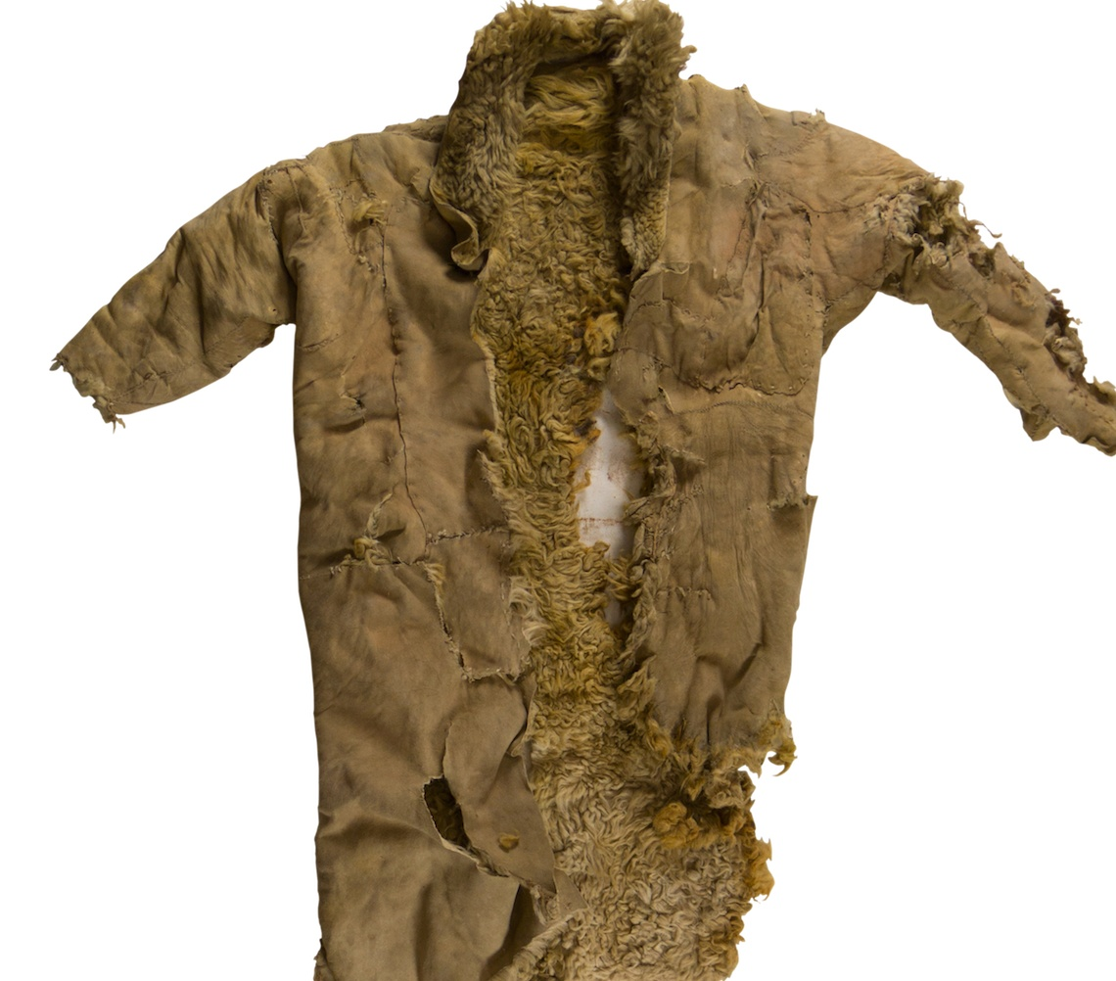
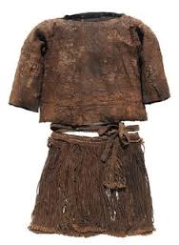
Origin Of Clothing
Humans began to wear clothes approximately 170,000 years ago.
Most prehistoric clothing was made up of animal hides and leaves.
Clothing began as a way to stay warm in the cold and protect one from potential predators

Slide 4
Why was it necessary to wear clothes
Humans began to develop from species that had more hair to more nude species. This forced early caveman to make a new layer of warmth and protection
Many scientist have stated that lice was a large part of why humans lost their hair
Clothing allowed for humans to explore more
Discover colder climates and higher altitudes
Helped protect against mosquitos and other diseases

Slide 5
Evolution of Clothing
Clothing began as a basic necessity to humans. But, today clothing is used very differently in society.
Clothes can show wealth as it was used in the Elizbethan Era. Purple indicated you were of wealth and red indicated you were poor. Showed status and power.
People have used clothing to stand together to fight for what they believe in. For example, Women in the 1900’s started to wear more bikinis exposing skin to protest societys views on women at the time.

Slide 6
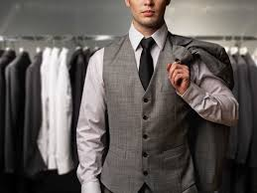
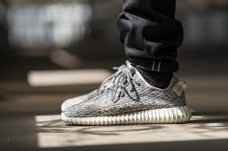
Clothing Today
Today clothing is not only a necessity, but also a lifestyle. Clothing is not only what keeps us warm and covered but also gives us identity. Clothing is a way of expression and individuality, something that other animals can’t display.

Slide 7
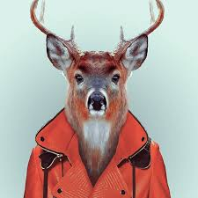
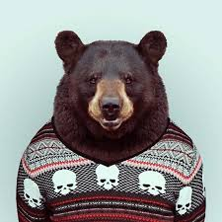
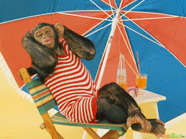
How Clothing Separates Humans From Other Animals
Animals use the hair covering their bodies to keep them warm as human use clothing to do this. Although, this is not what makes human unique when comparing to other animals. Clothing gives humans identity and character, someone thing other animals cannot choose. Look how goofy animals would seem with clothes on...

Slide 8
Bibliography
http://www.dailymail.co.uk/sciencetech/article-1345109/Man-started-wearing-clothes-170-000-years-ago-according-study-LICE.html
http://mbe.oxfordjournals.org/content/28/1/29.abstract
http://www.elizabethan-era.org.uk/meaning-colors.htm

