Slide 1
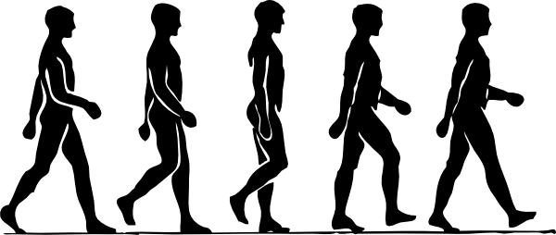
What Does It Mean to Be Human?
By: Dharma Seda Gonzalez

Slide 2
Works Cited
"What Does It Mean to Be Human?" Smithsonian National Museum of Natural History. N.p., n.d. Web. 26 Oct. 2016.
Zimmerman, Cathy. "Growing Brains: Development from Birth to Age 3 Sets Stage for All of Life." The Daily News. N.p., 18 Apr. 2011. Web. 26 Oct. 2016.
https://www.thedodo.com/12-remarkable-interspecies-rel-523336558.html
Connor, Steve. "Humans Evolved Monogamous Relationships to Stop Men Killing Rivals' Babies, Says Study." Independent News. N.p., 29 July 2013. Web. 30 Oct. 2016.

Slide 3
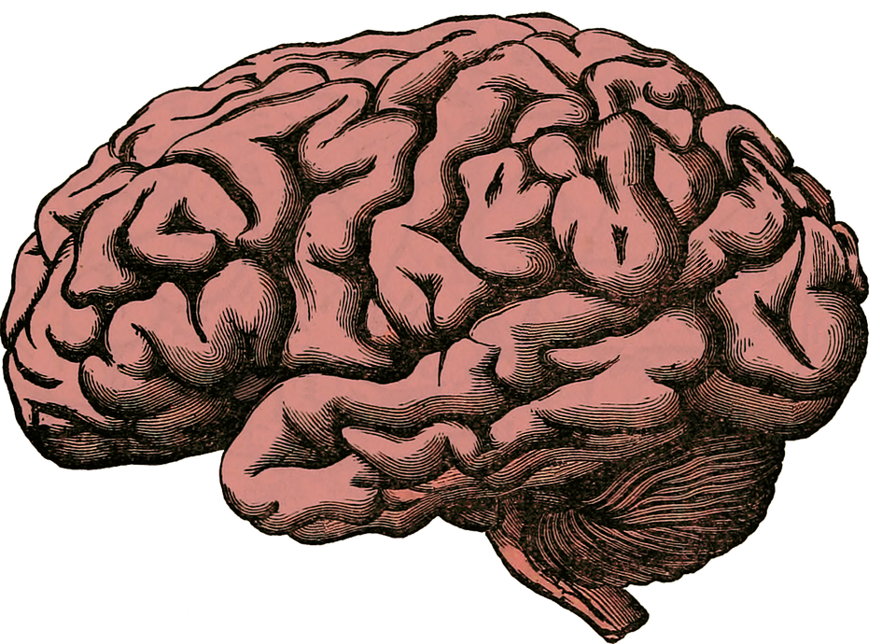
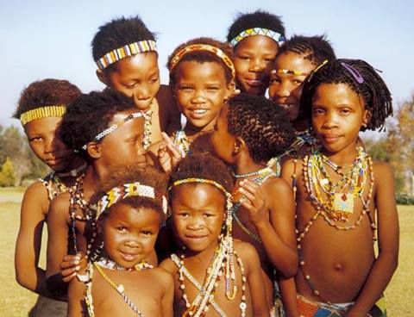
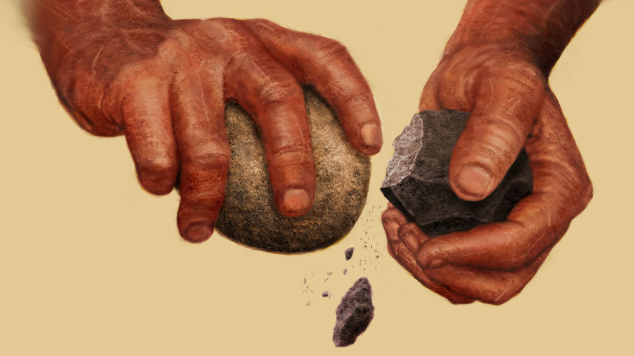
LIFESTYLE
Notes:
Humans don’t need to focus on survival and can instead focus on societal development

Slide 4
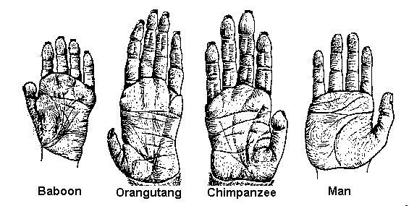
Physical: Hands
Opposable thumbs→grips→technology

Slide 5
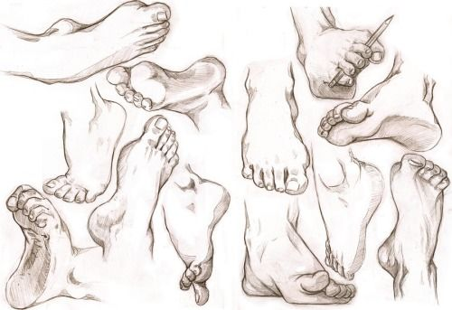
Physical: Feet
Humans can grasp with feet.
Arches, shorter toes, and a big toe →walking

Slide 6
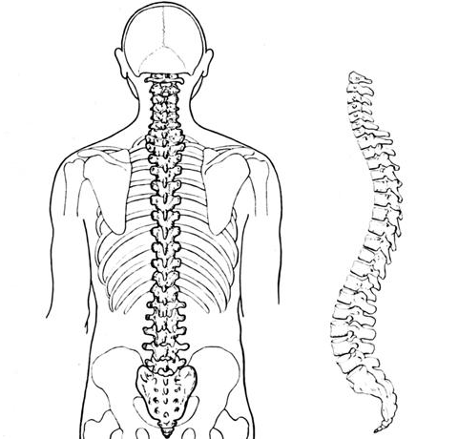
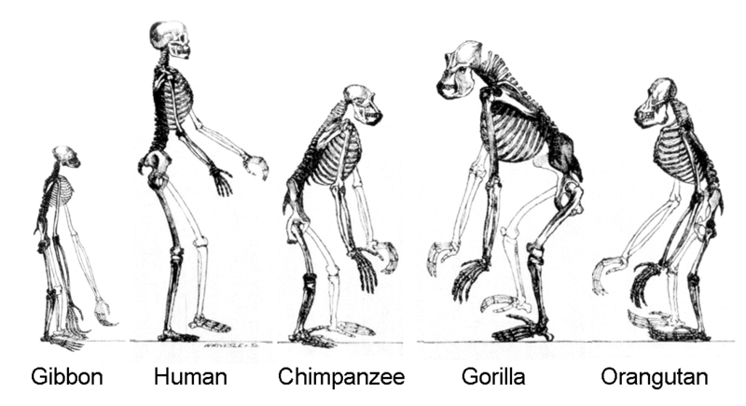
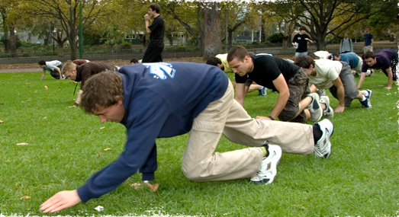
Physical: Bipedal Movement
S-shaped spine.
Bipedal vs. quadrupedal.
Long distances.

Slide 7
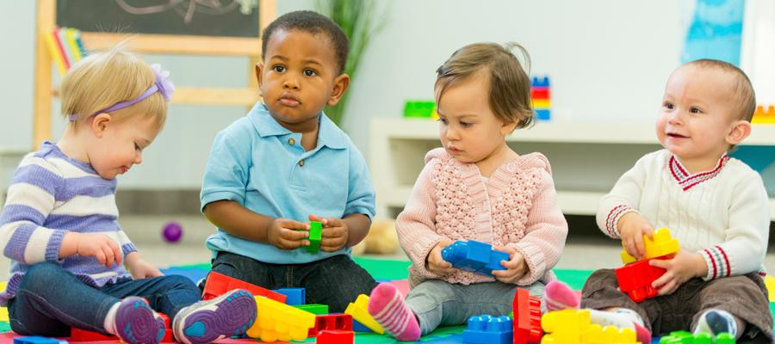
Emotional: Childhood
Long childhood→huge learning capacity→cultural adaptation and technology.
→language, communication.

Slide 8
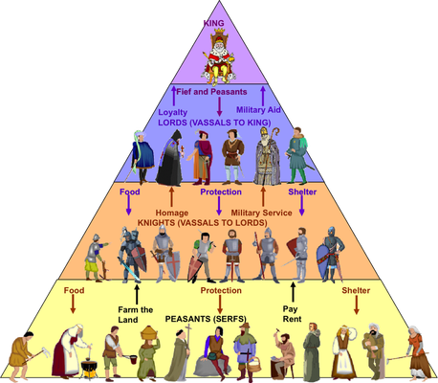
Emotional: Behavior
Innate vs. learned.
Fight or flight instincts.
Social Structures.

Slide 9
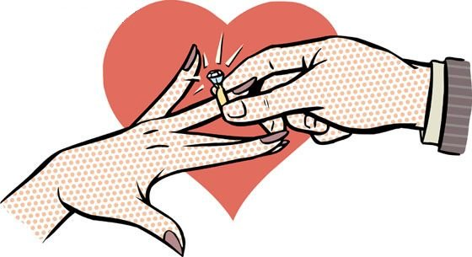
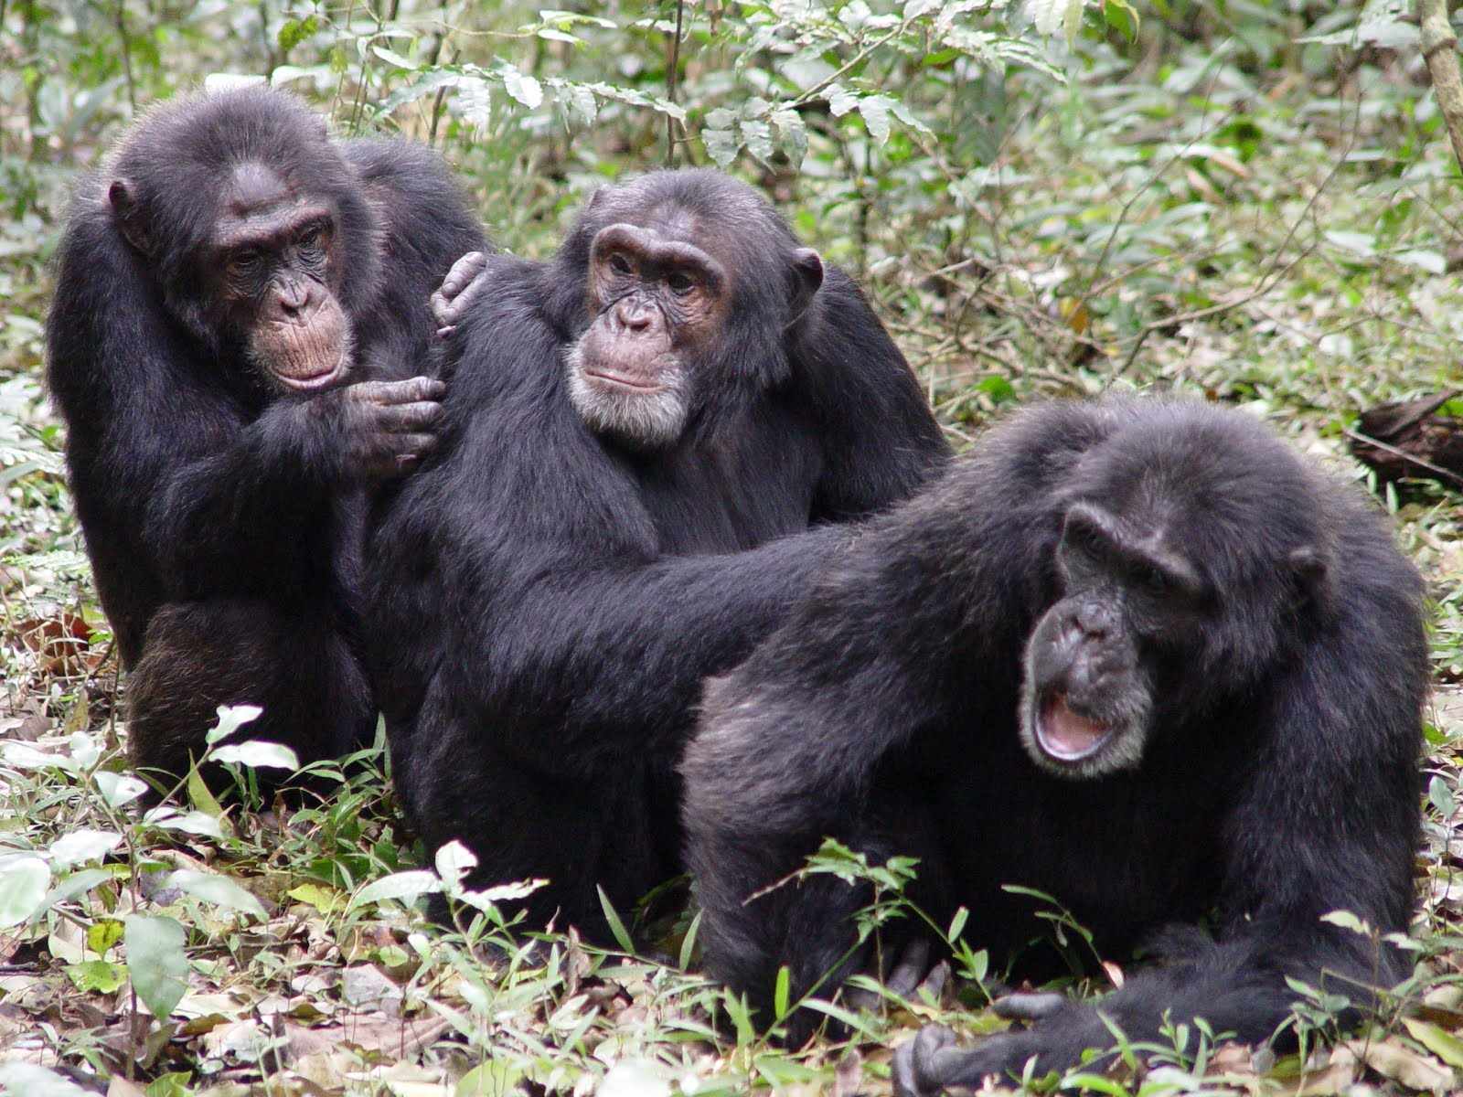
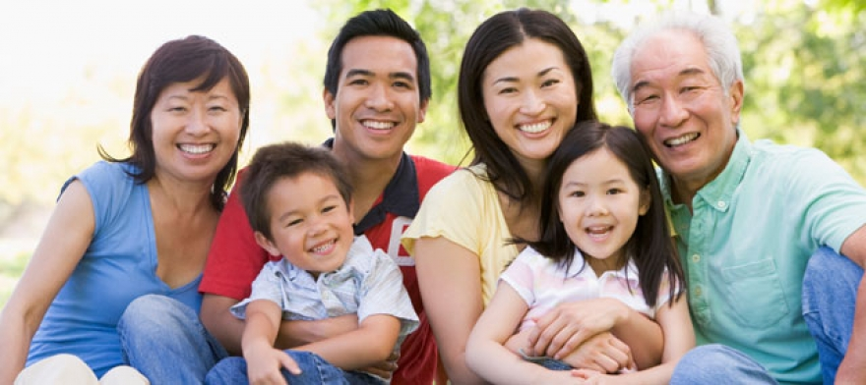
Emotional: Families
Humans ~ other primates.
Only 3% of mammals are monogamous.

Slide 10
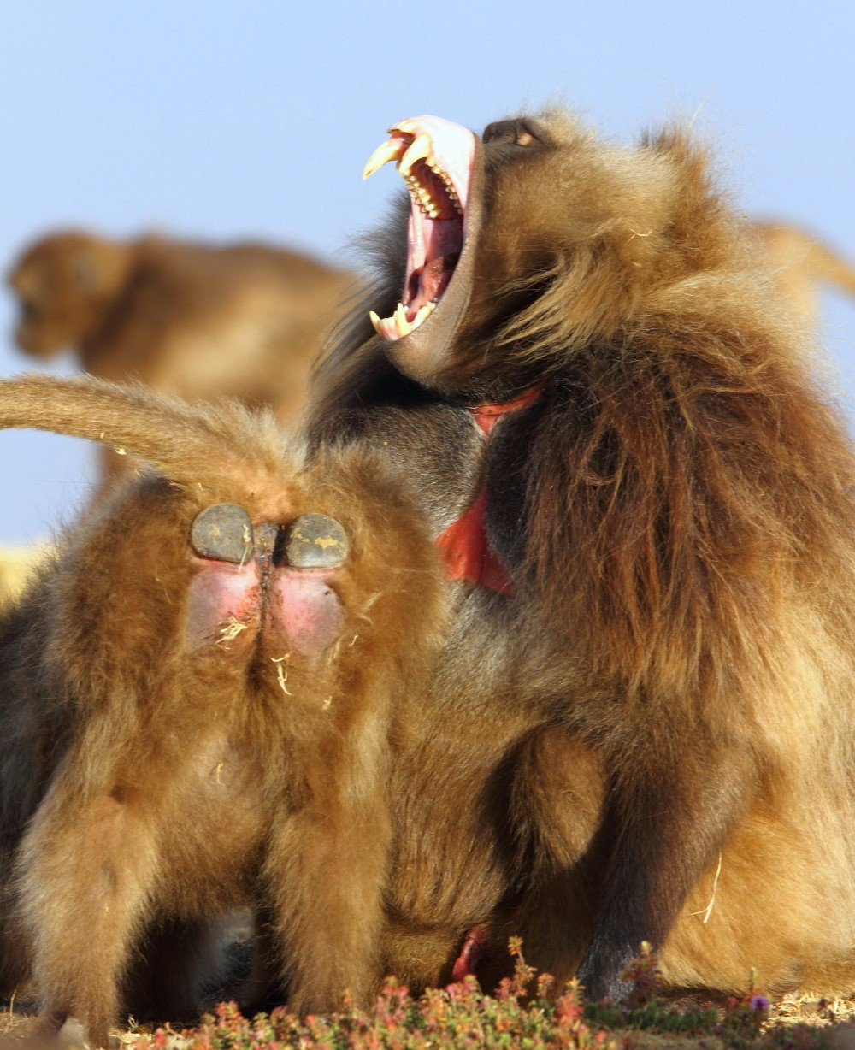
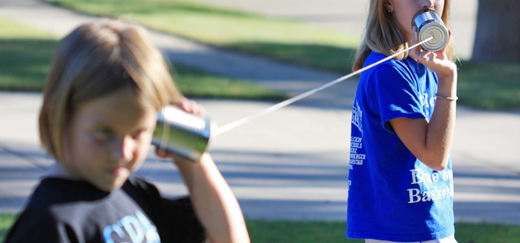
Mental: Communication
Tens of thousands of words, compared to 22 baboon calls.
Grammar rules.
Reading.
Writing.
→Information passed on.

Slide 11
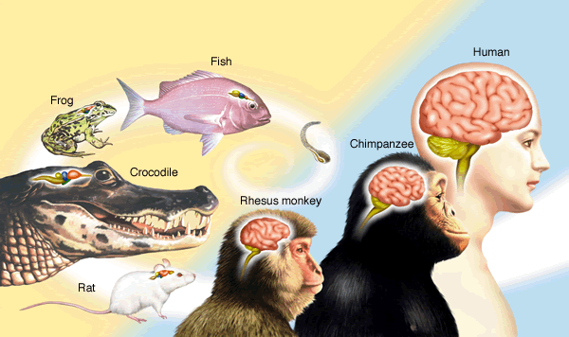
Mental: Brain Development
Childhood cerebrum development.
"As experiences are repeated over and over, or as an experience triggers a strong emotional reaction, that experience literally sculpts the brain." - Langley.

Slide 12
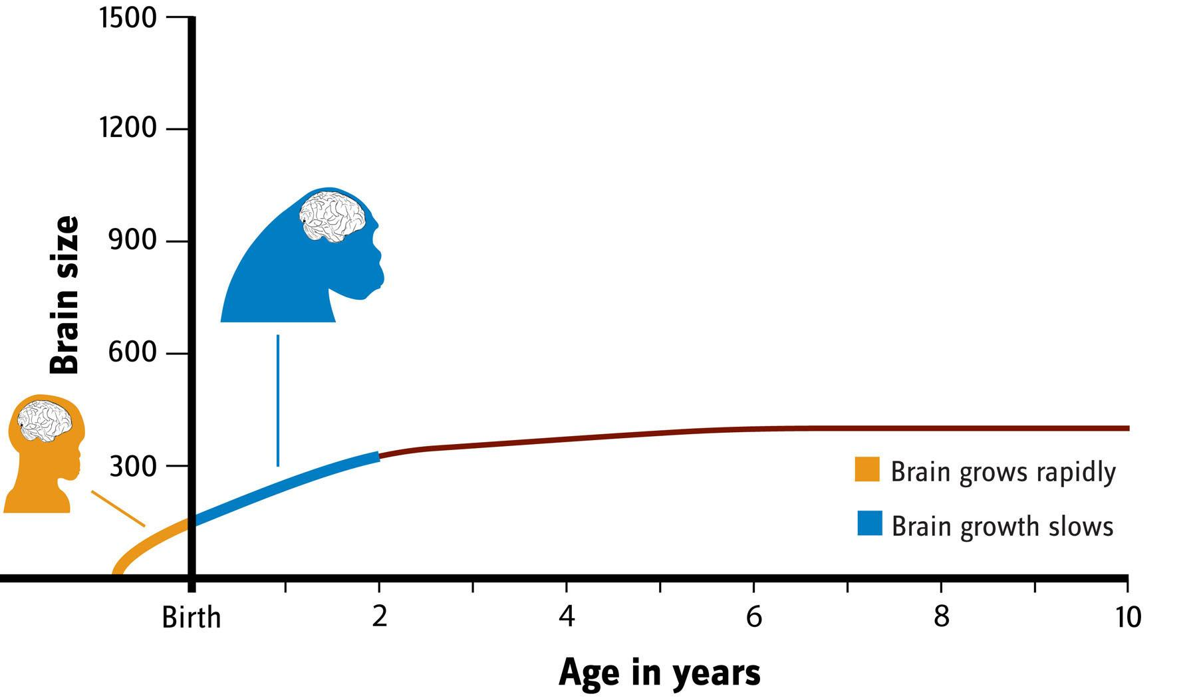

Slide 13
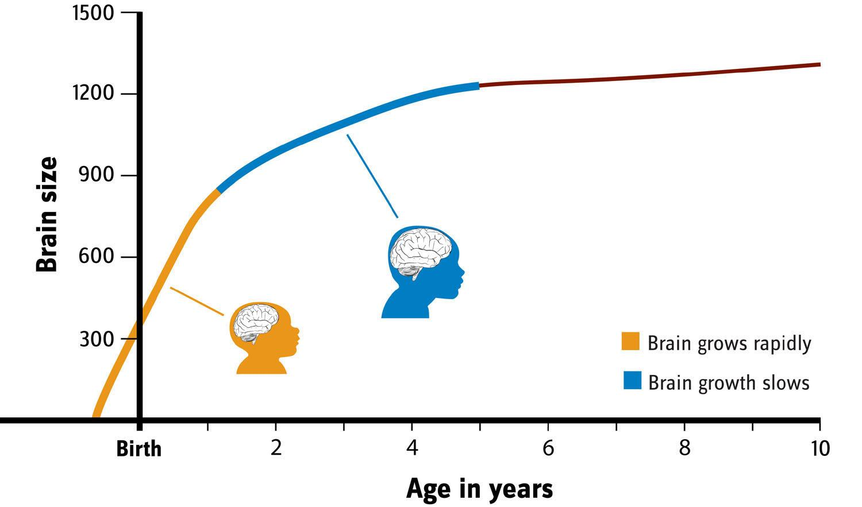

Slide 14
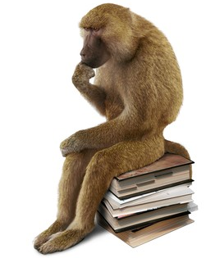
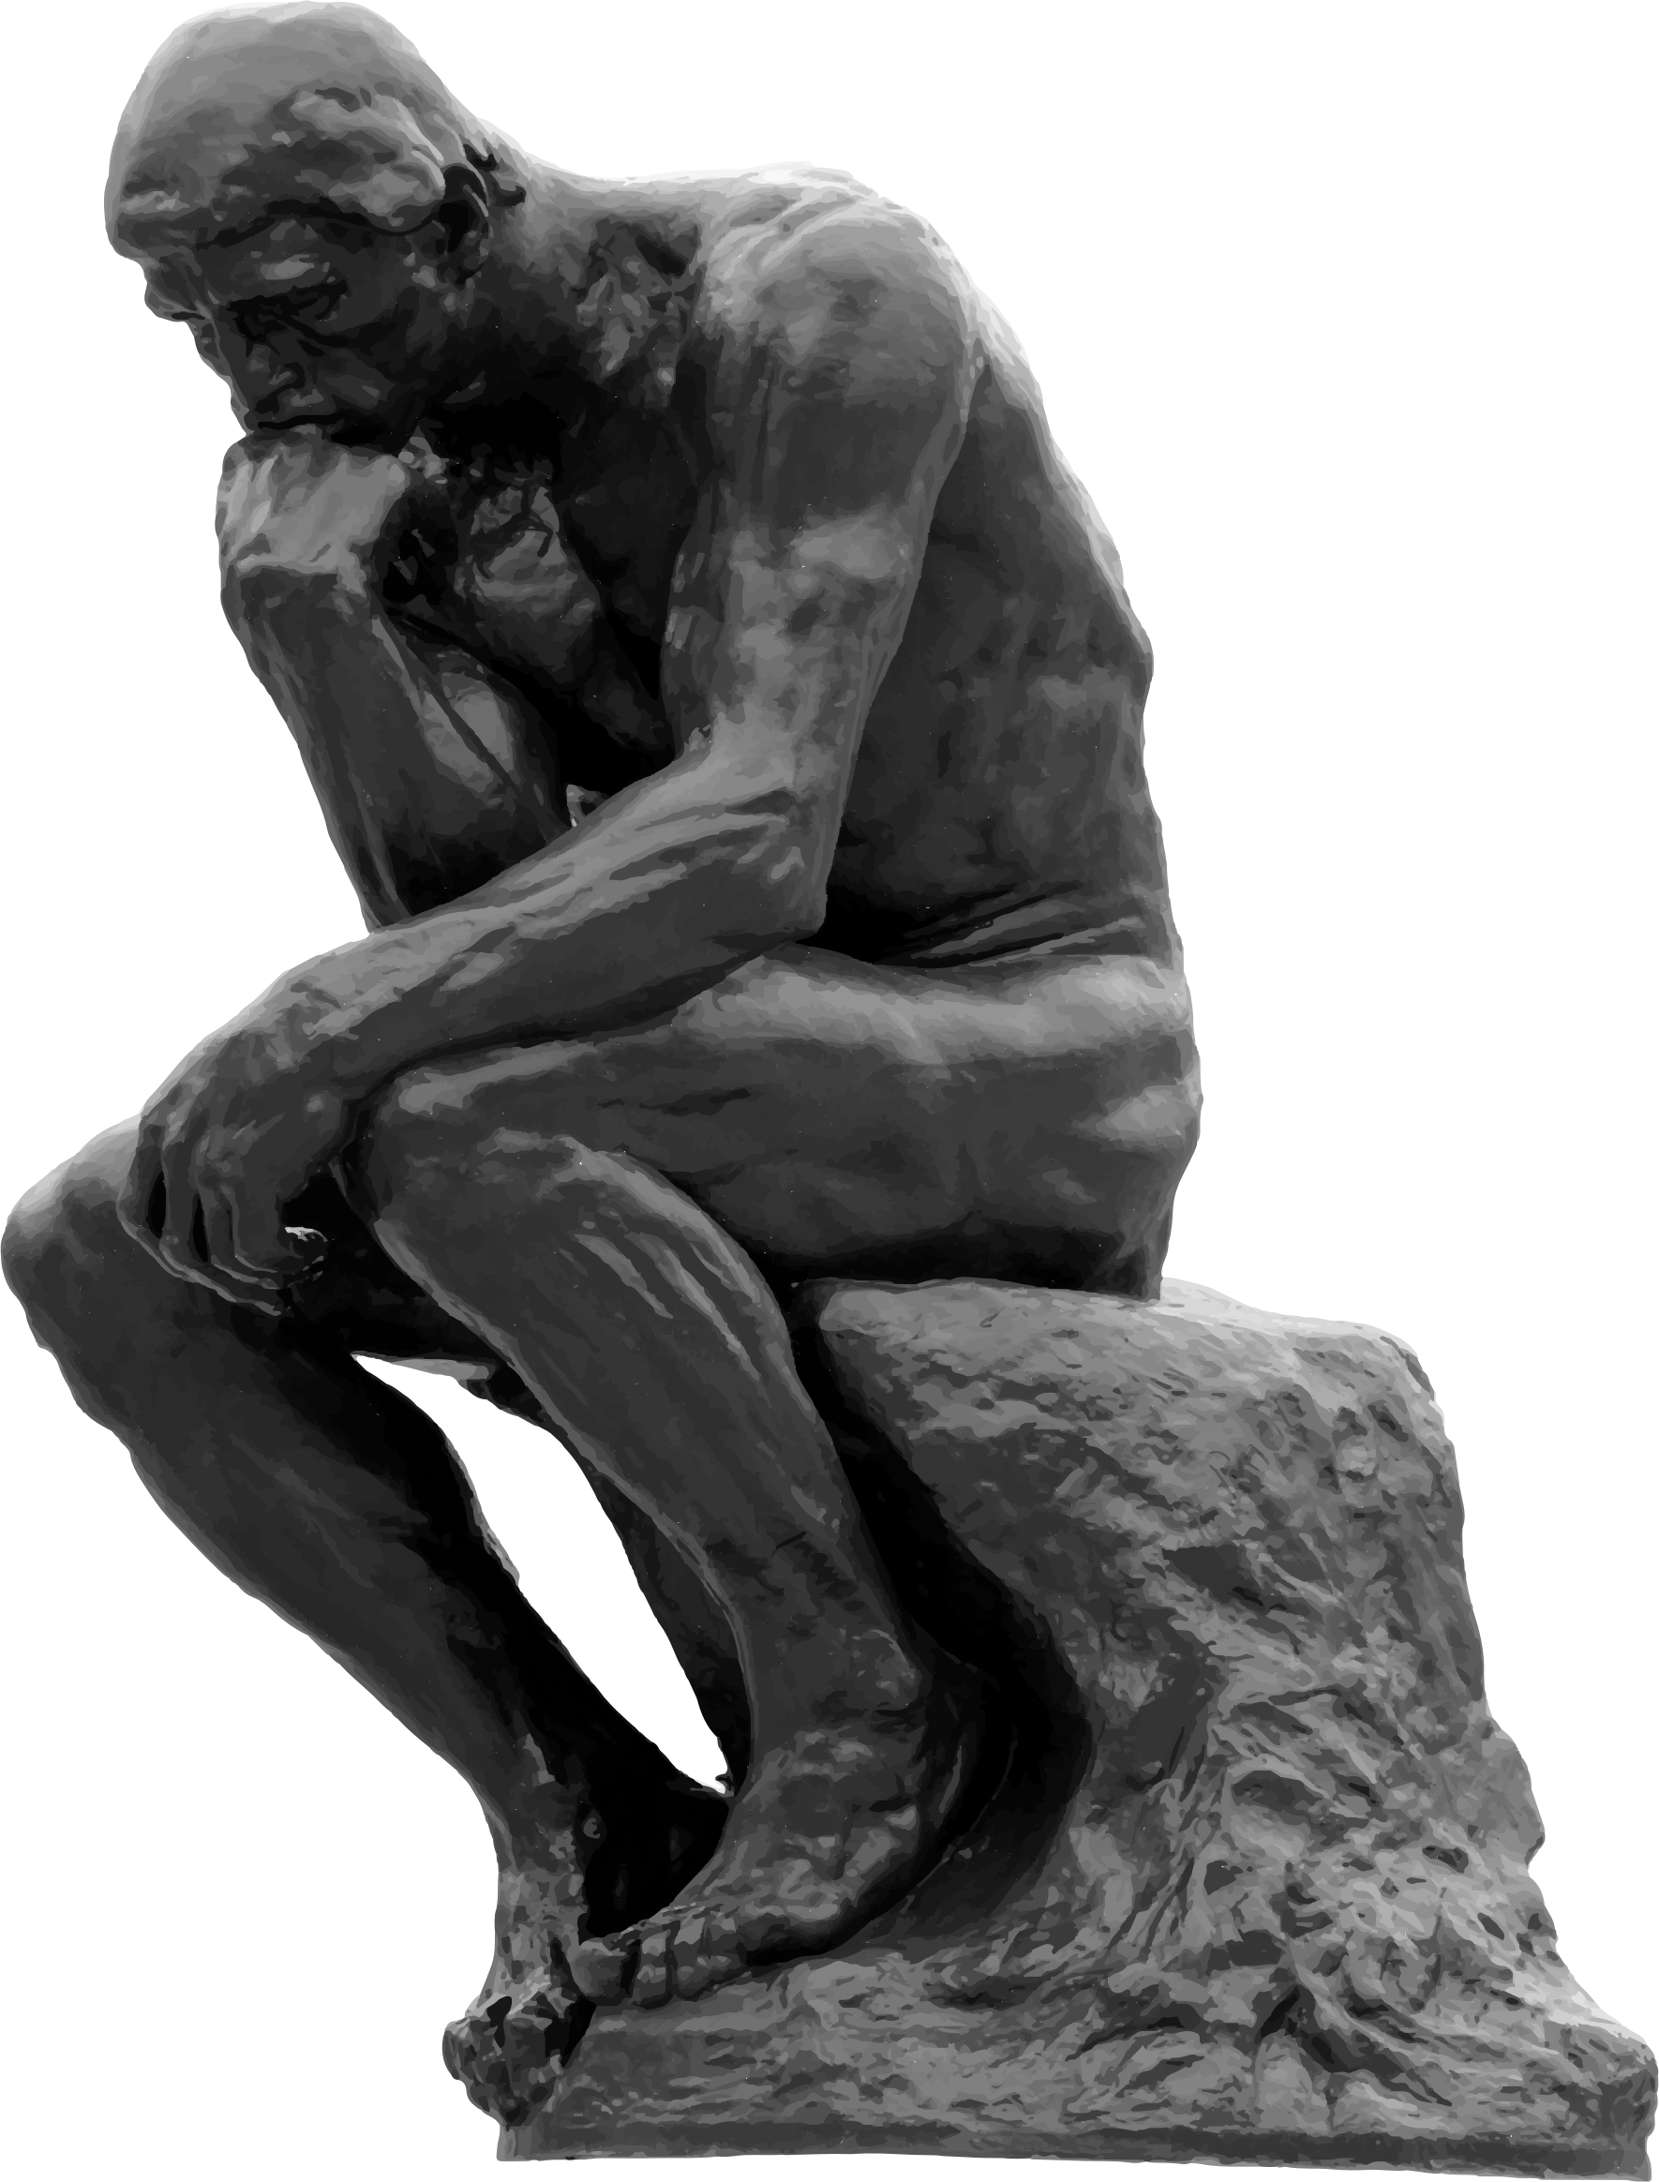
Mental: Thinking
The Theory of the Mind.
Solutions.
Symbols.
Memory.
Inference.
Reflection.

Slide 15
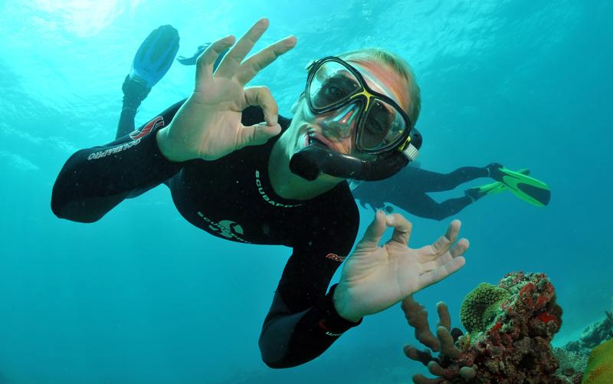
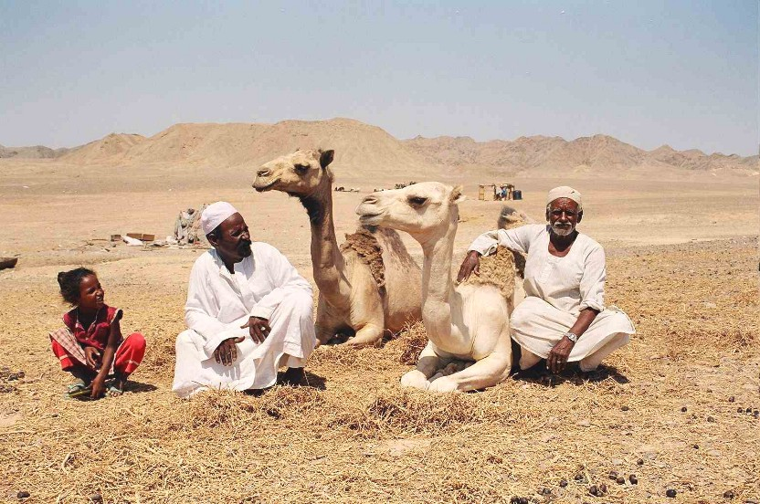
Conclusion
Diversity of experiences and social structures.
Survival goals vs. developmental goals.

