Slide 1
The Advantage of the Human Thumb
By Mao Bergan, Emily Ilkanic, Grace Johnson

Slide 2
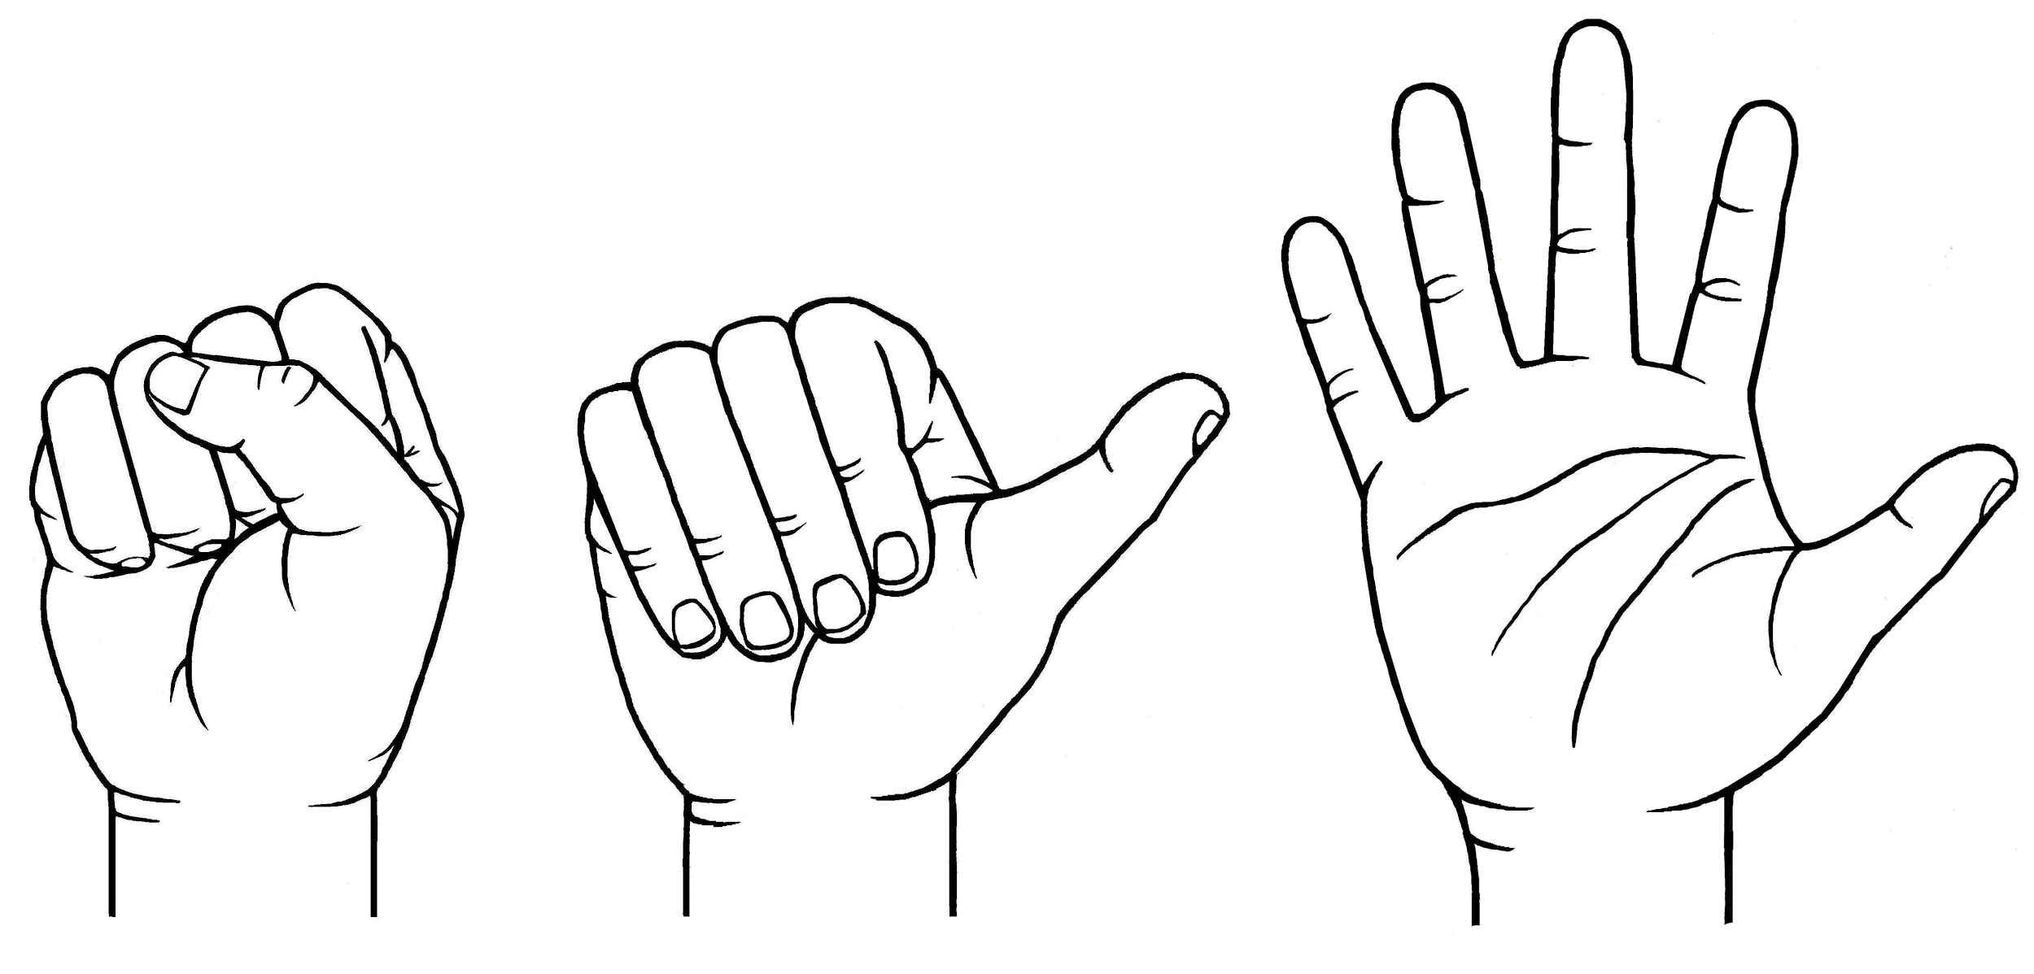
The human thumb distinguishes us from other species.
While humans have many similarities to our evolutionary relatives, the dexterity of our thumbs is what makes us unique.

Slide 3
The human hand, while less evolved than a chimp’s, is more advantageous.
Chimp hands are stronger and further evolved than human hands, but humans have more specific control over the muscles of our hands.

Slide 4
The human hand, while less evolved than a chimp’s, is more advantageous.
The human hand has greater functionality, due to our greater dependability of tool usage, and has remained ambiguous to allow for a variety of exceptional uses.

Slide 5
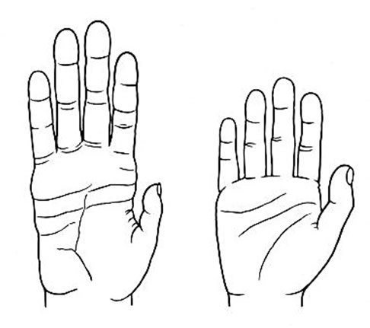
Chimp hands are suited for tree life, which is not central for humans.

Slide 6
Chimp hands are suited for tree life, which is not central for humans.
Chimps’ hands have longer fingers and more powerful grips to provide a firmer hold on branches while traveling through trees, but are not “equipped” for finer movements.

Slide 7
The human hand allows more accessibility to a wider tool range.
Chimps use nearby leaves, twigs, and sticks to help get food; however, humans have crafted more complex tools to help our lives each day.

Slide 8
The human hand allows more accessibility to a wider tool range.
Chimps at Gombe, as studied by Jane Goodall, are noted using simple tools like unmodified sticks, but humans have craft more intricate tools from metal, stone, wood, and more.

Slide 9
The human thumb is our distinguishing characteristic.
The main evolution, or lack thereof, separating humans from our closest evolutionary relatives are our uniquely dexterous thumbs, which keep us better suited for toolmaking.

Slide 10
Bibliography
http://www.amnh.org/exhibitions/permanent-exhibitions/human-origins-and-cultural-halls/anne-and-bernard-spitzer-hall-of-human-origins/understanding-our-past/living-primates/the-grasping-hand/
https://www.ncbi.nlm.nih.gov/pmc/articles/PMC1571064/
http://www.smithsonianmag.com/smart-news/why-are-chimpanzees-stronger-than-humans-1379994/
http://www.janegoodall.ca/about-chimp-behaviour-tool-use.php

