Slide 1
What Does It Means to be Human?
Isabel Roney

Slide 2
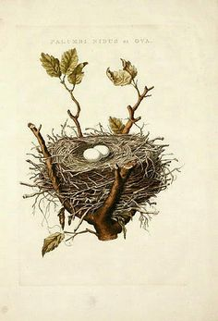
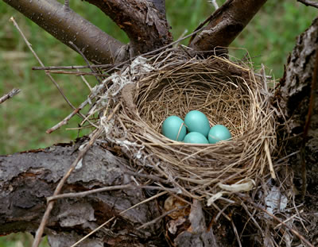
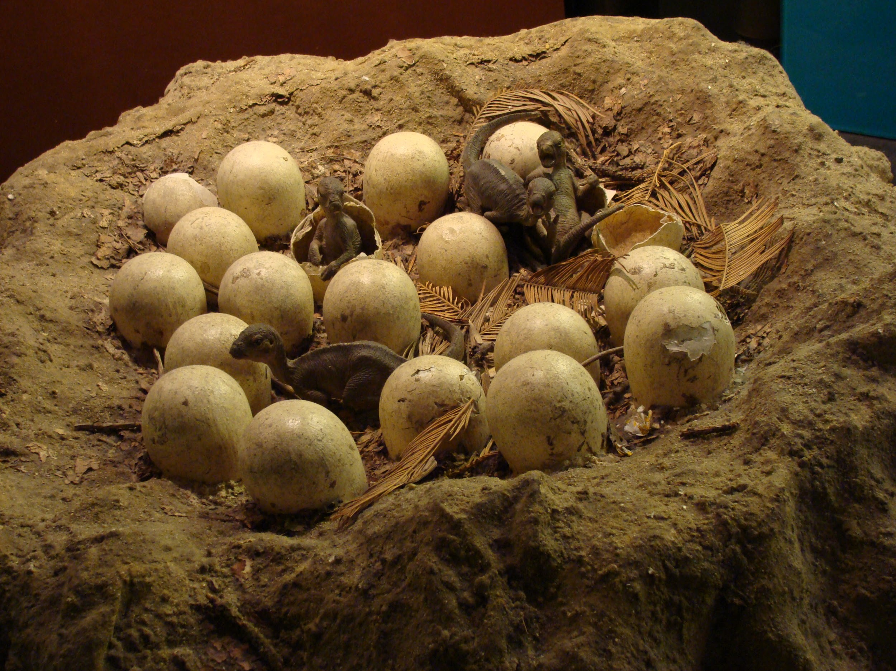
Bird Nests
Notes:
Dinos have long been thought to be the ancestors of dinosaurs
Share many of the same skeletal features, feathers, and nesting patterns.
They died out 65.5 million years ago, yet open-aired dino nests closely resemble modern-day nests source

Slide 3
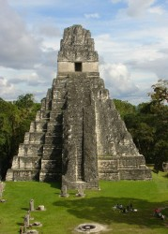
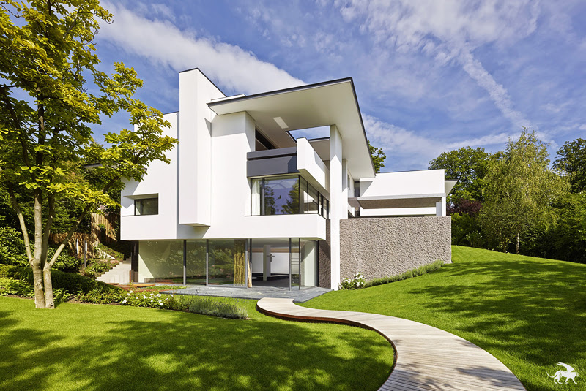
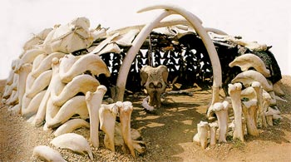
Human Shelters
Notes:
Mammoth Bone Dwellings
In ukraine, 4 huts made of a total of 149 bones
Covered in dried animal hides
Constructed about 15,000 years ago source
Maya architecture
Oldest sites are from the 1 century AD
Very tall, multi-level elevated platforms, massive step-pyramids, monumental stairways
Decorated with intricate, cultural iconography, most of it related to Mayan religion source
Contemporary architecture
Complex plumbing, electricity, heating, and even internet systems
Largely consist of decorative aspects not essential to survival, order, or function
As evident in especially the last photo, humans have continued to develop architecture even though it’s no longer a necessity to do so
Though they could have stopped advancing architecture, they sought out more opportunities. Unlike other animals that only change when their environment changes and they are forced to change as well, humans actively seek out opportunities to change, and even create the opportunities themselves.

Slide 4
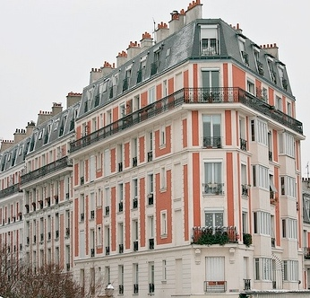
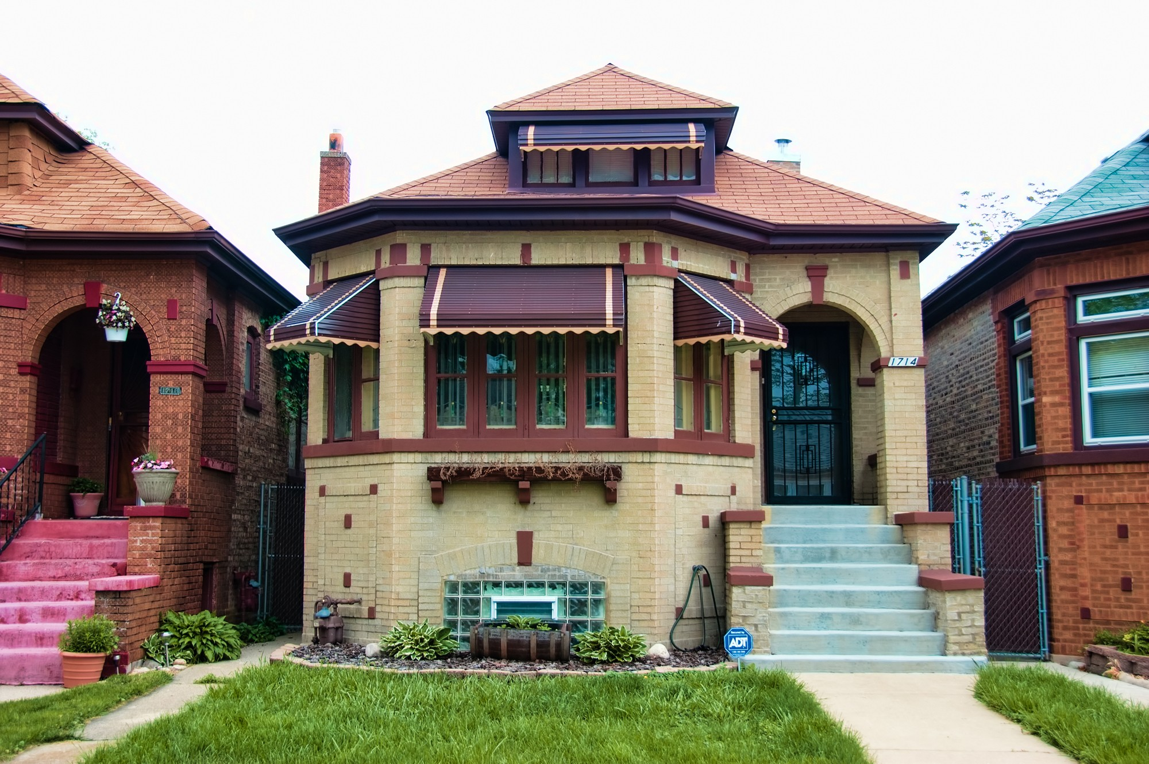
Variety in Modern Architecture
Notes:
While I was gathering images and info for the previous two slides I started thinking about architecture as an art form
Building on the idea that humans have continued to develop shelter beyond the point of necessity
Around the world, different groups of people advance their architecture and design in different ways
Humans have not only transcended the fundamental need of shelter, but have developed their shelters enough to make building homes an art form, with different styles specific to individual cultures

