Slide 1
What does it mean to be human?
Jasmin Chadha

Slide 2
Being a human means having more advanced physical ability and higher cognitive function.

Slide 3
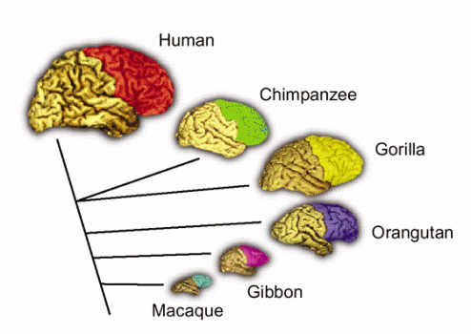
Brain Size/Function
The human brain is considerably more advanced than most other animal brains.
Notes:
Human brains are unusual in that they have high cognitive function because of the size proportions of their many different parts. The frontal lobe of the human brain is relatively larger than the frontal lobes of other animal brains, which allows humans to have a more developed personality and communication.

Slide 4
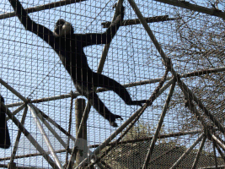
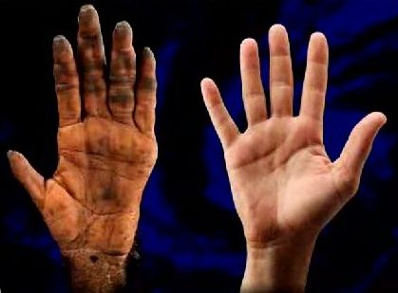
Opposable Thumbs...
Similar to other animals/primates, humans have opposable thumbs.
Notes:
However, humans have been able to grasp and utilize the thumb in other ways because of a smaller distance between the thumb and four fingers on the hand of a human. While chimpanzees can swing from branches and grasp with their fingers, humans use their thumbs to grasp more objects.

Slide 5
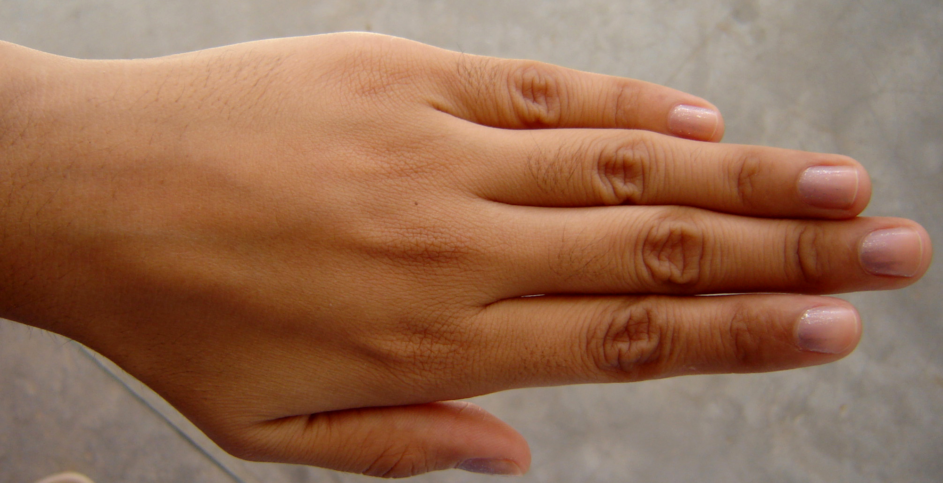
Hands
Because of their opposable thumbs, humans are able to use their hands in ways that are different from other species.
Notes:
Humans have had the ability to create tools- from complex machines such as dishwashers, to simple spears for killing animals in the wild. While animals such as chimpanzees have been observed to use sticks as tools to collect bugs as food, humans can create bows and arrows, and construct entire skyscrapers.

Slide 6
Knee Function...
Human knees are the only ones that are able to fully extend.
Notes:
This is an example of how humans have the unique function of upright walking because of various aspects of their body. The human knee is an important part of the reason why humans are able to walk upright.

Slide 7
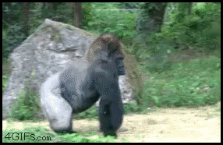
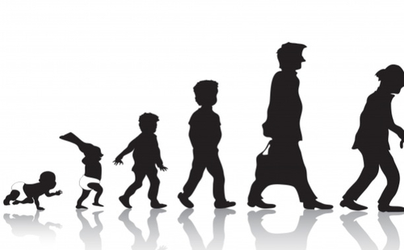
Upright Walking/Childhood Development
Humans are the only animals who are structured to be bipedal and walk upright as their main mode of locomotion. They outgrow walking on all fours as a child.
Notes:
While other animals, such as the gorilla below, have the ability to walk upright occasionally, humans are the only animals who are structures to be bipedal and walk upright as their main mode of locomotion. Apes, which are closely related to humans, still rely heavily on walking on knuckles and hands, while the humans grow out of this after a developmental stage as a young child. It takes human babies about 9-12 months until they take a few steps, which is a long time until they can be completely mobile. In comparison, a gorilla takes about 3-4 months to be able to walk on all fours, and they do so for the rest of their lives, while humans only walk on all fours for a small amount of time.

Slide 8
Overall, humans are unique because of their frontal lobe and higher brain function, along with the physical characteristics that are similar but more advanced than other animals!

