Slide 1
What Makes Us Human?
By Laura Pickert

Slide 2
Intro
Neurologically, how are we different than animals?

Slide 3
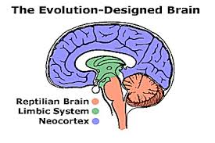
What our brains share With other animals
http://www.wisdompage.com/FlawsPix/Brain.gif

Slide 4
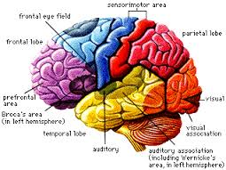
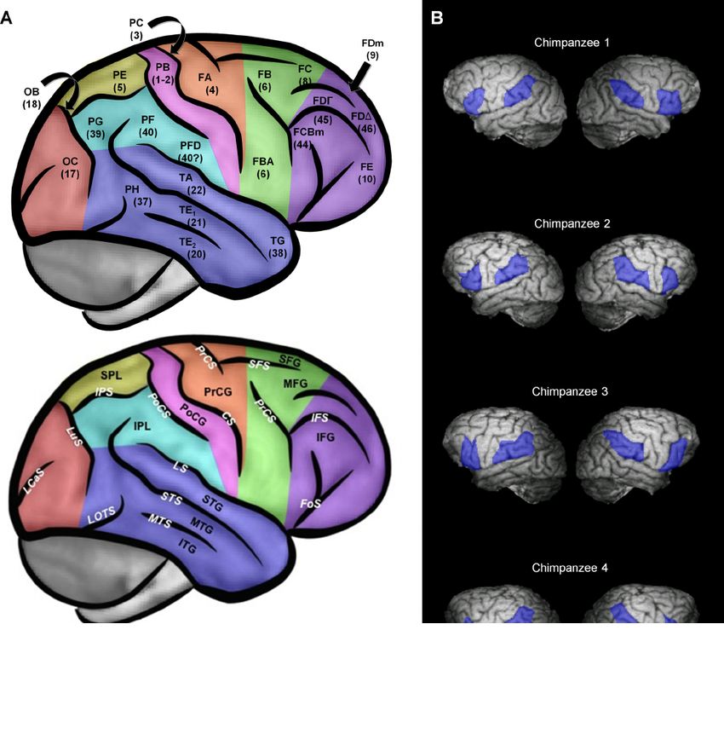
What Makes Us Unique
http://cms.boloji.com/articlephotos/The%20Human%20Brain1.gif https://www.researchgate.net/figure/256201668_fig3_Figure-3-Chimpanzee-cortical-anatomy-and-ROIs-Left-hemispheres-appear-on-the-left-A

Slide 5
Conclusion
+Speech
+Capacity for Communication

