Slide 1
What does it mean to be a human?
Lindsay Opie
Period 5

Slide 2
-Higher levels of cognitive functioning
-Humans are social animals
-human brain structures enable us to develop language, respond to stimuli, and perform motor abilities that animal counterparts are not capable of

Slide 3
PARTS OF THE BRAIN:
A CRASH COURSE
Getting to know the structures and functions before analyzing their importance

Slide 4
THE CEREBRAL CORTEX AND ITS FUNCTIONS
Frontal Lobe: involved in speaking and muscles movements, making plans and judgements
Motor Cortex: controls body movement, body parts with more intricate movements have larger surface area, back of frontal lobe
Parietal Lobe: Intakes sensory information for touch and body position
Sensory Cortex: negotiates and processes information about sensations, front of parietal lobe
Temporal Lobe: controls hearing and listening, holds functioning to process speaking words, receive auditory information from the opposite ear
Occipital Lobe: visual processing, receive information from the opposite visual field

Slide 5
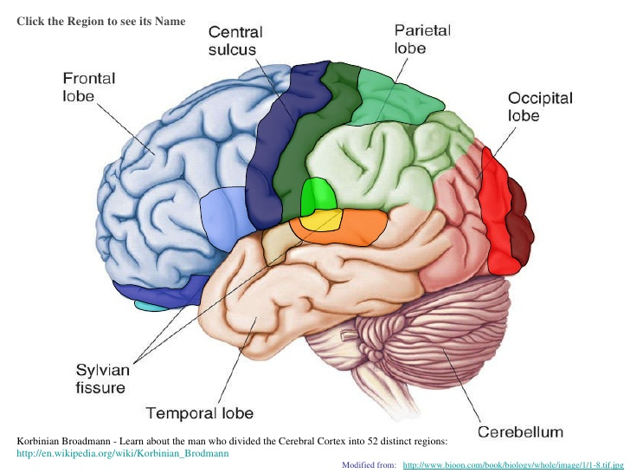
Exterior view of cerebral cortex of brain

Slide 6
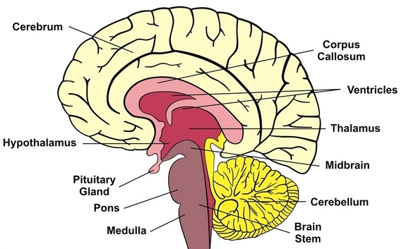
THE CEREBRUM AND ASSOCIATED BEHAVIORS
HIGHER FUNCTIONS
Cerebrum: consciousness, intellect, memory, and language. Surface layer is known as the cerebral cortex
Cerebellum: posture, coordination, and balance
Corpus callosum: communication between brain hemispheres
Amygdala: linked to emotion, temperament, mood, and “flight or fight’” response
SURVIVAL RELATED
Brainstem: controls heartbeat, blood pressure, body temperature, and breathing rate
Pons: coordinates movement
Medulla: controls heartbeat and breathing
Thalamus: the brain’s sensory switchboard
Hypothalamus: governs eating, drinking, and body temperature, and the endocrine system (hormones)

Slide 7
BRAIN BREAK!

Slide 8
COMPARISON TO OTHER ANIMALS
TWO MAIN POINTS:
A similarity between human brains and other animals is the part known as the brainstem. Animals have brainstems that are proportional to their size. The brainstem is responsible for controlling automatic survival functions, which is all some animals or organisms are capable of doing.
The parts of the brain associated with higher cognitive thinking are very large in the human brain, while they are small or non-existent in brains of other animals. This demonstrates, biologically, why human traits such as personality, thinking, planning, and decision making are characterized as uniquely human.

Slide 9
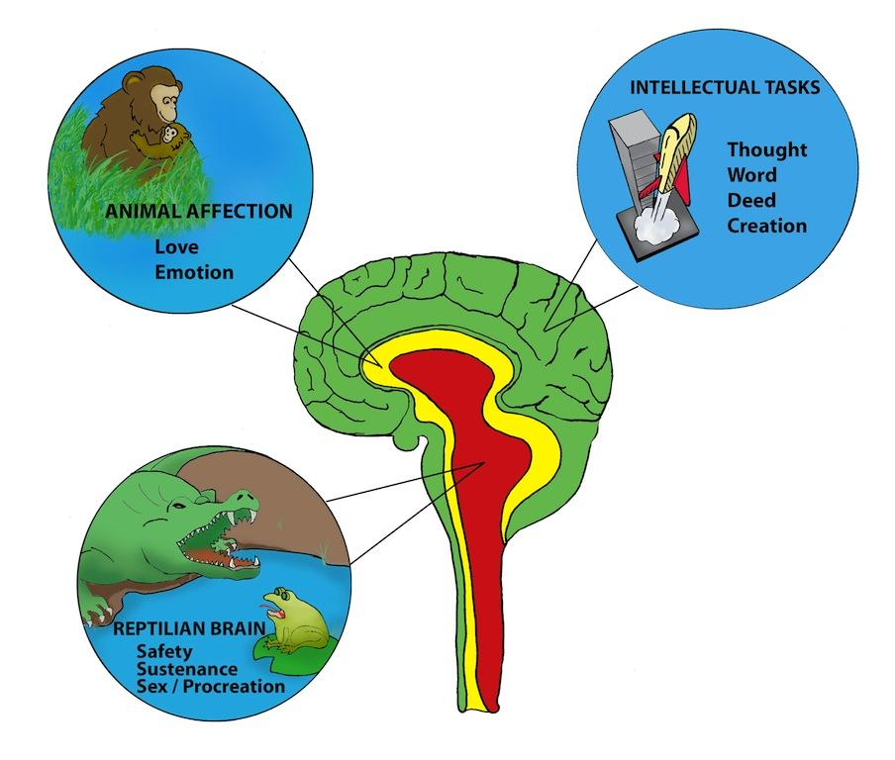
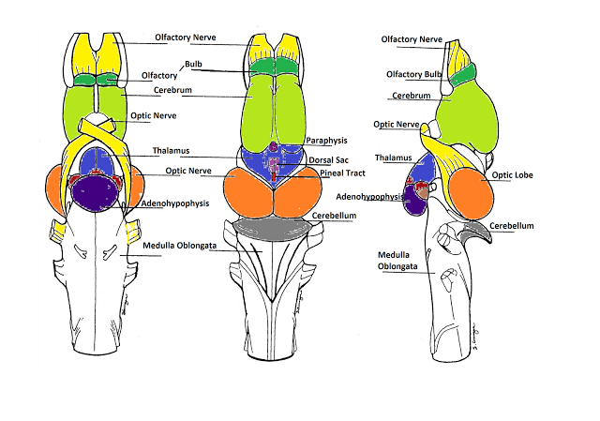
THE BRAINSTEM - SURVIVAL FOR ALL
-the brainstem in present in the brains of every animal (see reptile brain diagram below).
-the regulation of survival functions is a necessary component of every animal’s brain
-human behavior is linked to our more advanced brain structures.

Slide 10
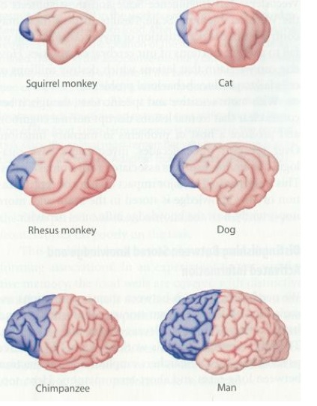
DEVELOPED AND LARGE FRONTAL LOBE - UNIQUELY HUMAN
-larger frontal lobe → more neurons dedicated to high thinking, planning, and personality
-these brain areas are associated with these high cognitive traits, a biological component that makes humans unique.

Slide 11
CHILDHOOD: LEARNING and LANGUAGE
In order to perform these high functioning behaviors, humans need an extended childhood to foster brain development.
Language: infants develop language in the babbling stage (occurs up to 2 months of age)
Learning: moral and social development are developed in children when they develop schemas
Language and learning are two distinctly human behaviors that develop during an extended childhood.

Slide 12
Many of the behaviors we attribute as essential to being human, like communication through a developed language, as well as moral and planned decision making, are results of human biological and social advantages that are developed during an extended childhood.

