Slide 1
What is so special about humans?
Mairead Gergeni … Period 5

Slide 2
Behavioral Characteristics
Can laugh without physical stimulation
Capable of moral reasoning
Have religions
Uses fire and tools

Slide 3
Mental Characteristics
Capable of cooperating and sharing
Capable of feeling guilt
Have theory of mind
Understand cause-and-effect

Slide 4
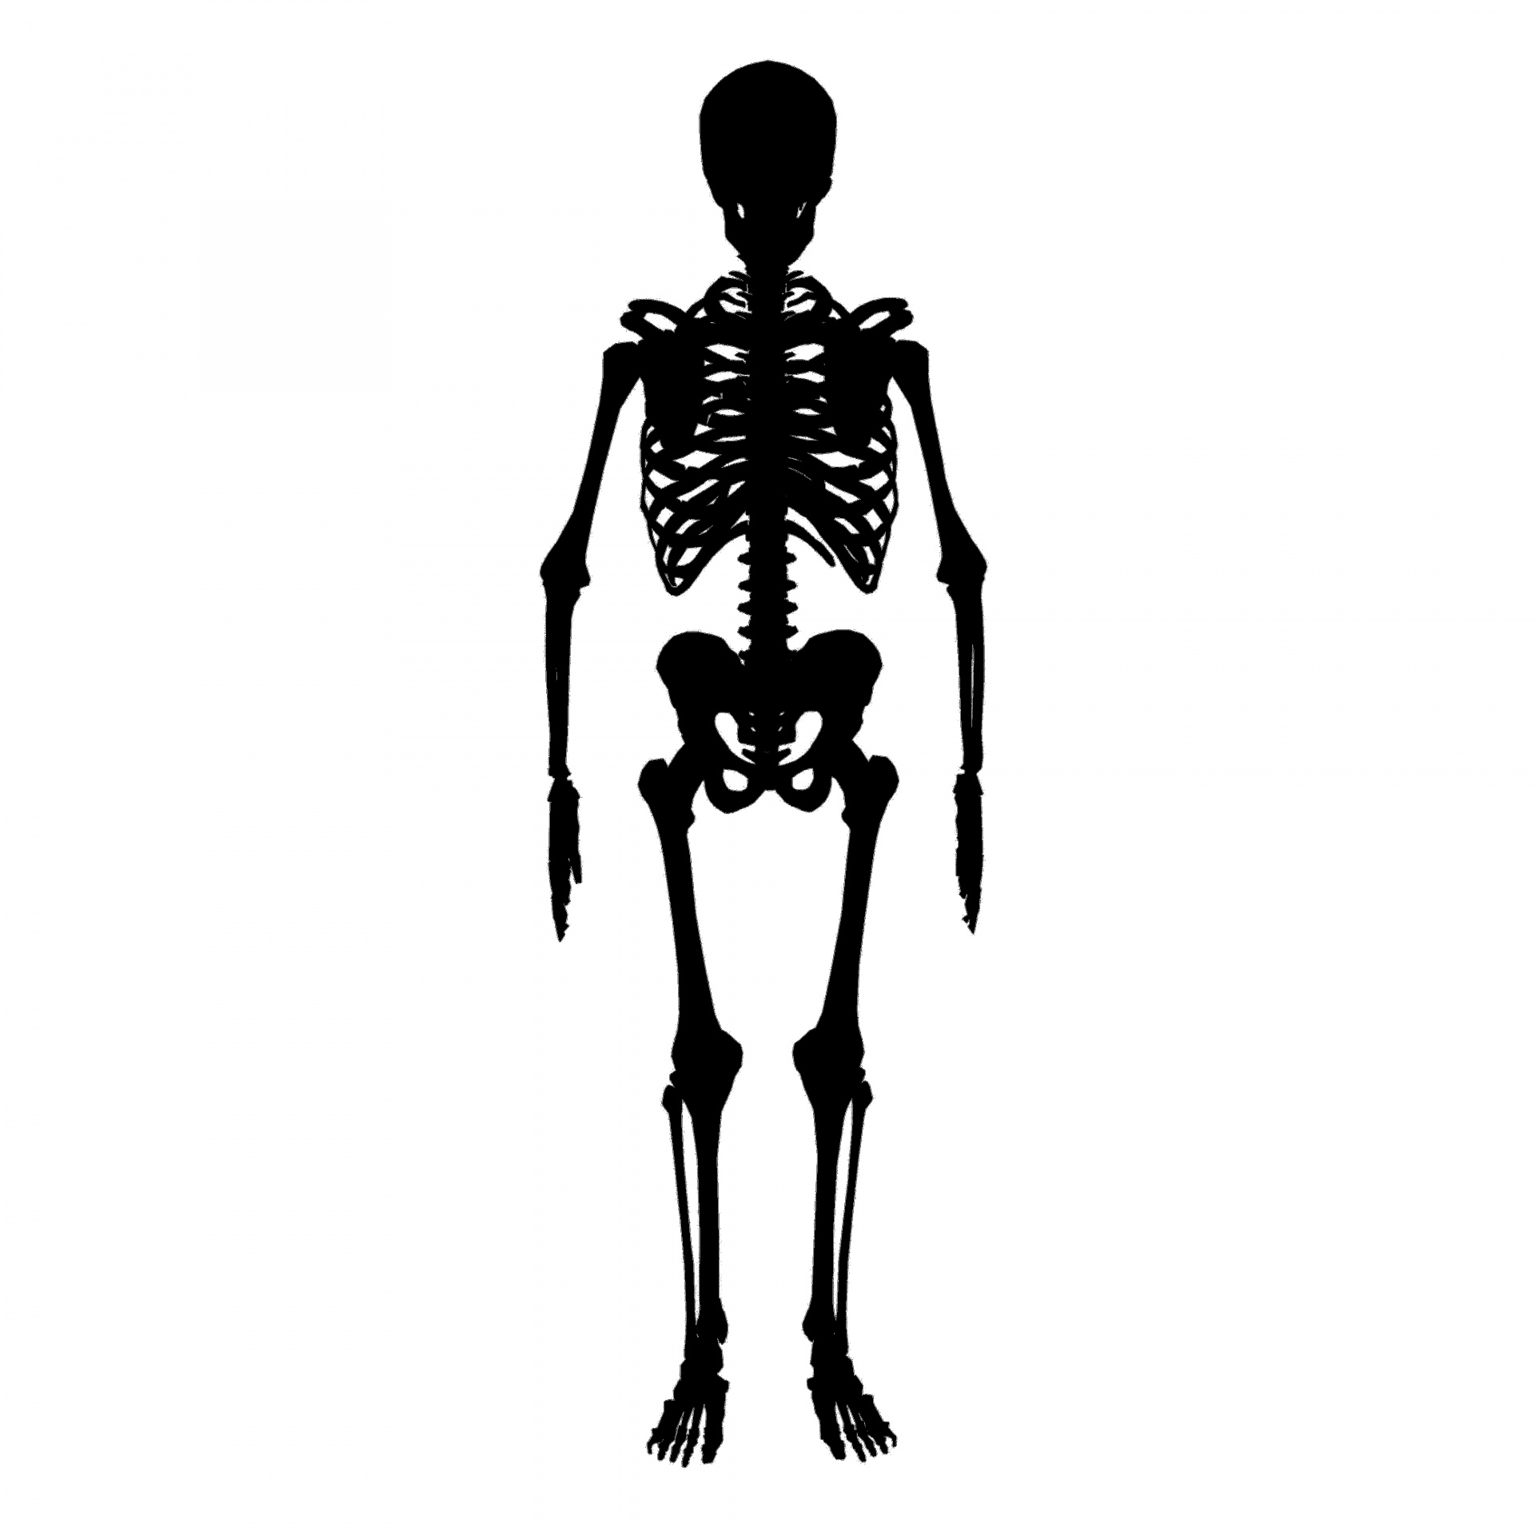
Physical Characteristics
Largest glutei maximi in relation to size
Spine has special curves to aid walking
Very wrinkled brain

