Slide 1
What Makes Humans Different?
Mia Bahr

Slide 2
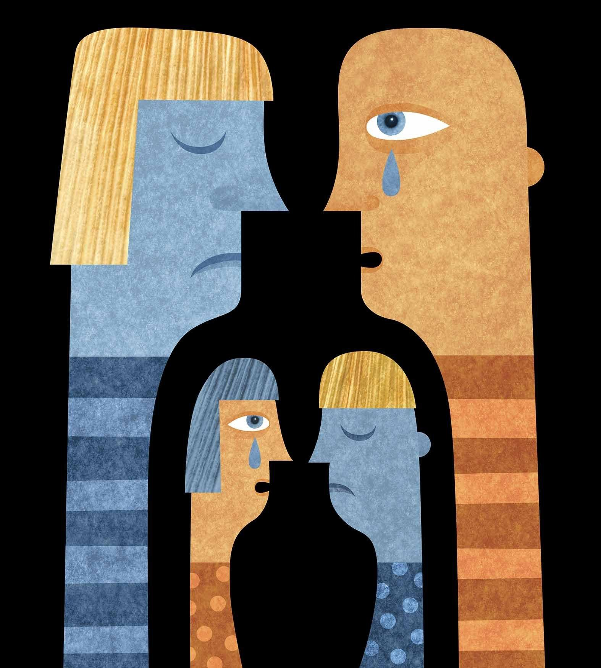
Development
Humans have a longer dependency on parents/adults
Mike Tomasello, Anthropologist
Kindness and empathy
Self-Consciousness

Slide 3
Prosocial: The ability to identify and be moved by others’ experiences

Slide 4
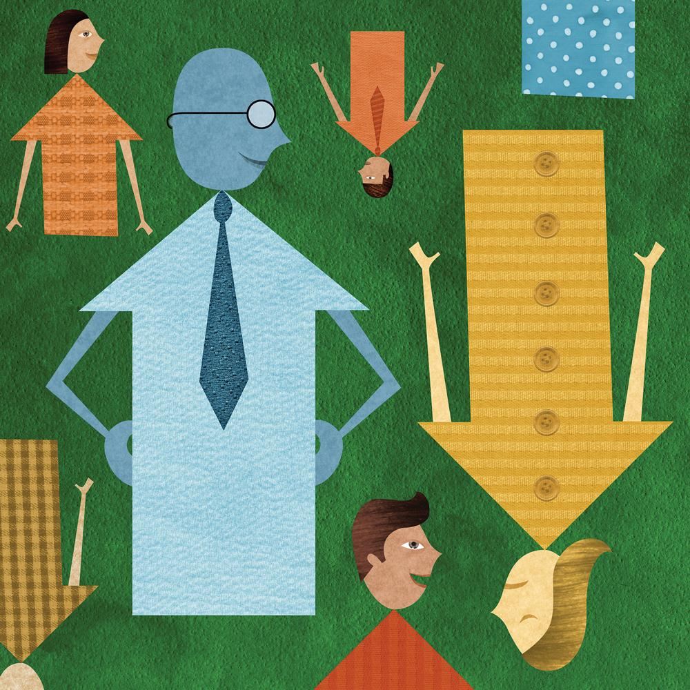
Prosocial
Nancy Eisenhower
Childhood shapes human nature
Complexity cannot be fully understood
Philanthropy

Slide 5
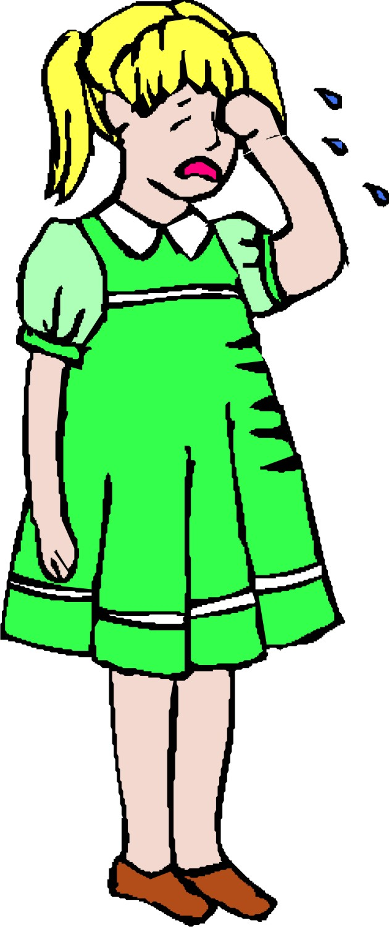
?

Slide 6
Prosocial: The ability to identify and be moved by others’ experiences

Slide 7
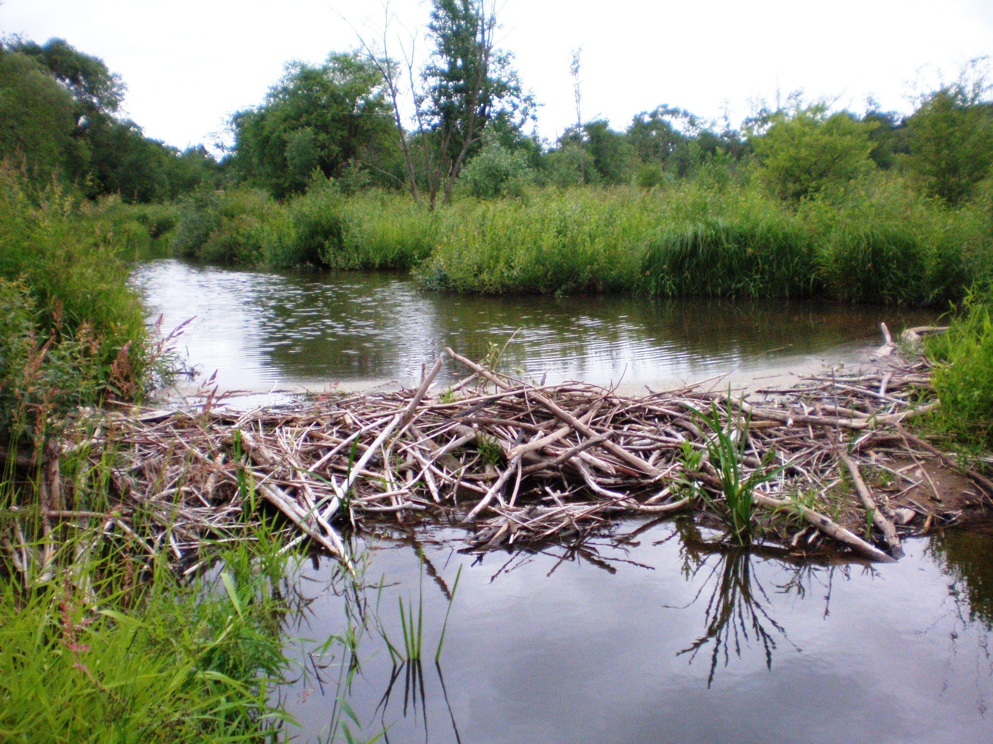

Slide 8
Difference
Natural Materials
Manual
Serves bare minimum purpose for survival
Man-made materials
Manual, but not by hand, impossible
Goes above and beyond for aesthetic and structural satisfaction

Slide 9
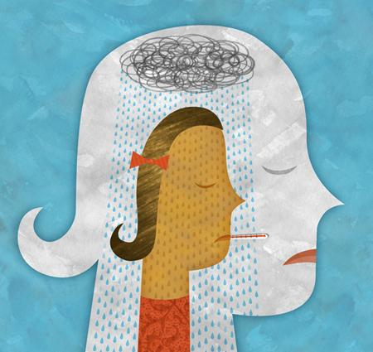
Compensation
We as humans are unique because we have the ability to sense what flaws are, for ourselves and others, and because of our physical advancements, we can compensate like no other animal can.
It is not a matter of brain power or intelligence, but rather emotional competence that we are able to be unique.

Slide 10
Sources
http://www.bbc.com/future/story/20150706-the-small-list-of-things-that-make-humans-unique
http://www.livescience.com/15689-evolution-human-special-species.html
http://well.blogs.nytimes.com/2012/12/10/understanding-how-children-develop-empathy/?_r=0
http://www.npr.org/programs/ted-radio-hour/485704159/what-makes-us-us

