Slide 1
What It Means To Be Human

Slide 2
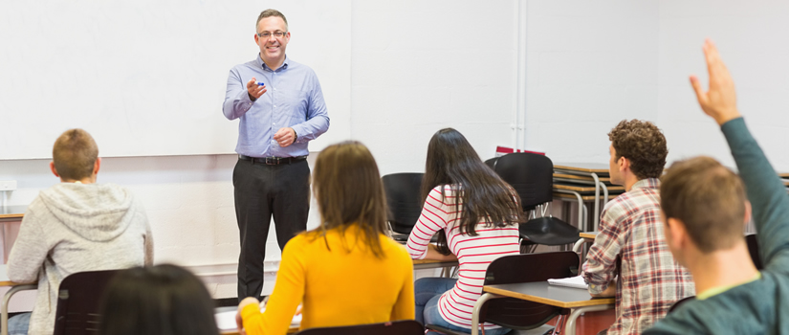
Ability to survive and adapt in different situation coupled with the ability to learn from each other

Slide 3
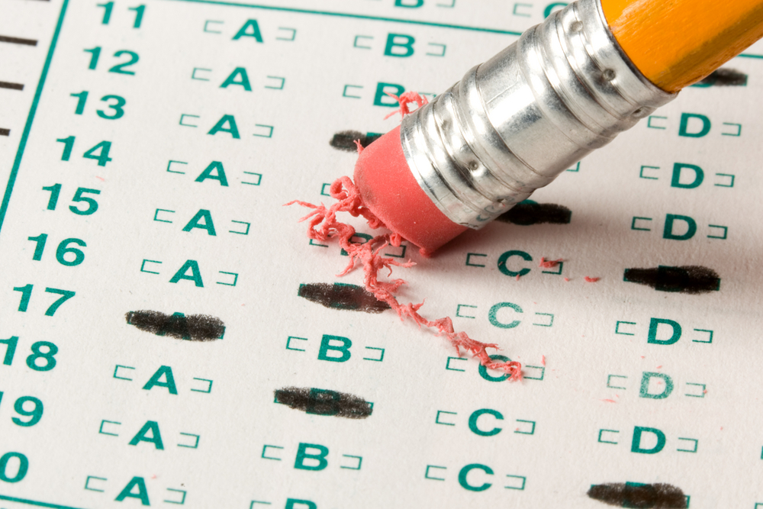
Society

Slide 4
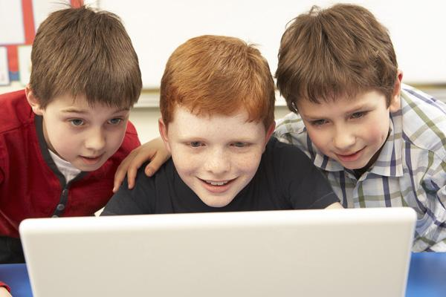
Learning From Each Other

Slide 5
Feral Children: Oxana Malaya

Slide 6
https://www.youtube.com/watch?v=93HymGXC_wM

Slide 7
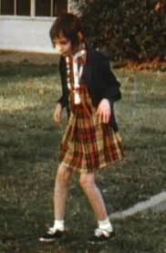
Genie

