Slide 1
What Does It Mean to be Human

Slide 2
What Makes Us Human
Unique DNA
Unique Hand structure allowing for grip
Consistently biopedal
HIgher brain function

Slide 3
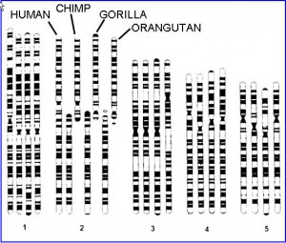
Humans have a unique DNA sequence

Slide 4
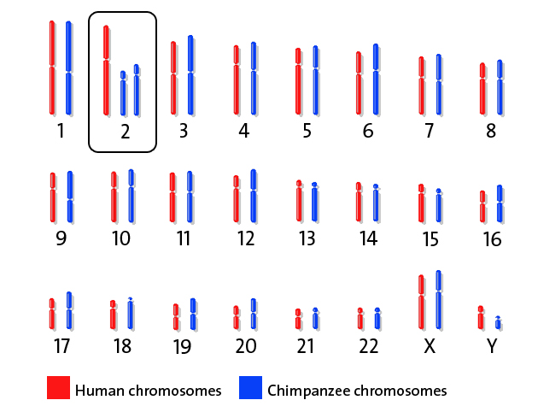
How human chromosomes compare to chimps

Slide 5
Gene Summarity between us
Another human? | 100% - All humans have the same genes, but some of these genes contain sequence differences that make each person unique.
A chimpanzee? | 98% - Chimpanzees are the closest living species to humans.
A mouse? | 92% - All mammals are quite similar genetically.
A fruit fly? | 44% - Studies of fruit flies have shown how shared genes govern the growth and structure of both insects and mammals.
Yeast? | 26% - Yeasts are single-celled organisms, but they have many housekeeping genes that are the same as the genes in humans, such as those that enable energy to be derived from the breakdown of sugars.
A weed (thale cress)? | 18% - Plants have many metabolic differences from humans. For example, they use sunlight to convert carbon dioxide gas to sugars. But they also have similarities in their housekeeping genes.

Slide 6
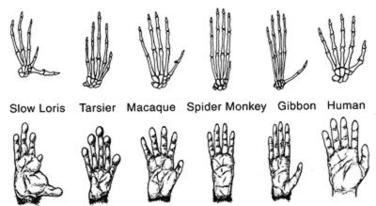
How hand structure compares

Slide 7
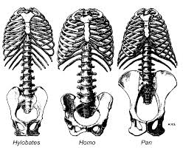
How Pelvic Structure Compares

Slide 8
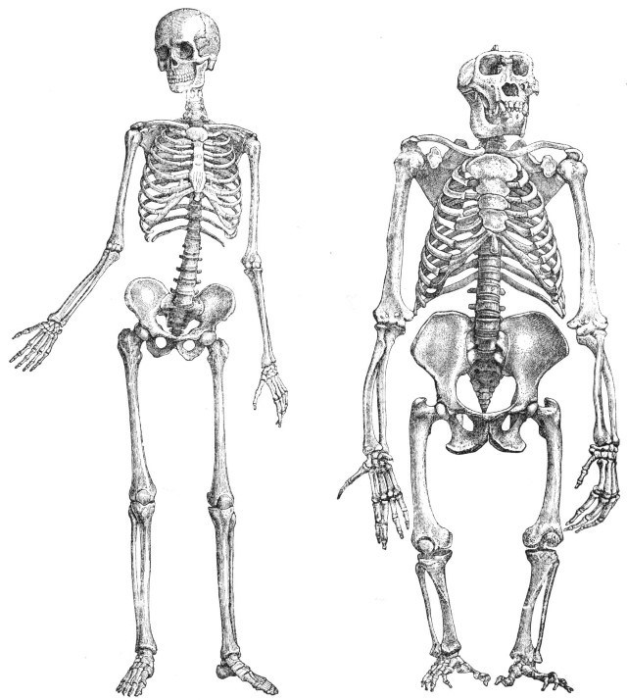
Consistently biopedial

Slide 9
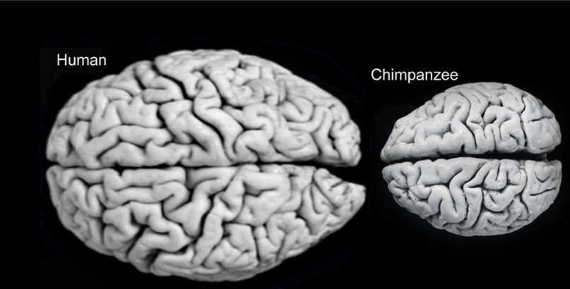
Brain Size and Cortical Space

Slide 10
Functions of Different Areas of the Brain

Slide 11
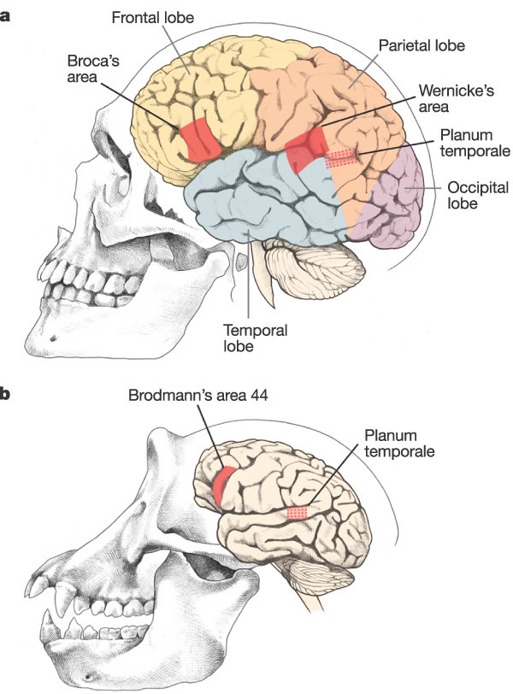
Language

Slide 12
Conclusion
Now that I have defined what it is that makes humans unique I challenge you to define what creates differences among humans

