Slide 1
What makes humans unique?
By
Trinity Thomas

Slide 2
Preliminary Research
Internet Surfing
BBC Future.com
PhilosophyNow.org
Neuroanthropology.net
Trip to the Library
The Origins of Humankind
and a lot more

Slide 3
Human Attributes
We can be really selfish :(
Jealousy
Reward & Punishment
Grief
Justice

Slide 4
Jealousy
Animals merely appear jealous
Psychologists at the University of California
The dogs were less jealous of the jack-o'-lanterns
But 40 percent showed aggression when their owners started talking to the jack-o'-lanterns
“These dogs seemed like they were trying to draw their owners away from the stuffed animal indicates that they're feeling something very similar to human jealousy” psychologist Christine Harris
Laurie Santos (director of the Canine Cognition Center at Yale University) "We think, 'If my husband is talking to another woman, maybe he's cheating.' "

Slide 5
Reward and Punishment
Family dynamic
Mama Bear in the literal sense

Slide 6
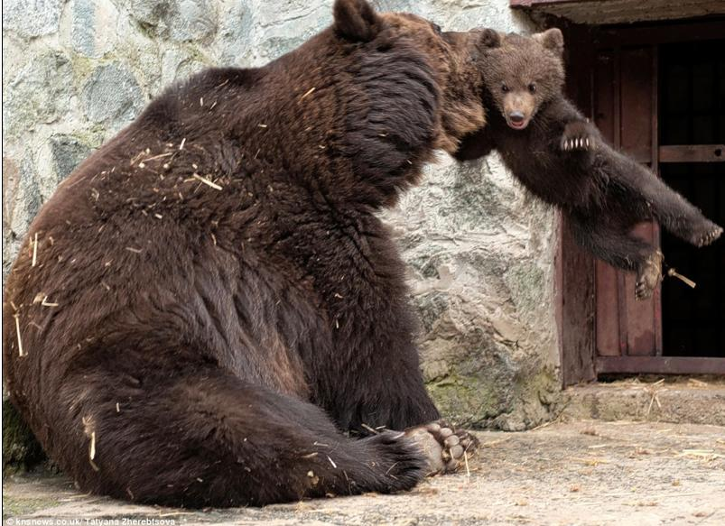

Slide 7
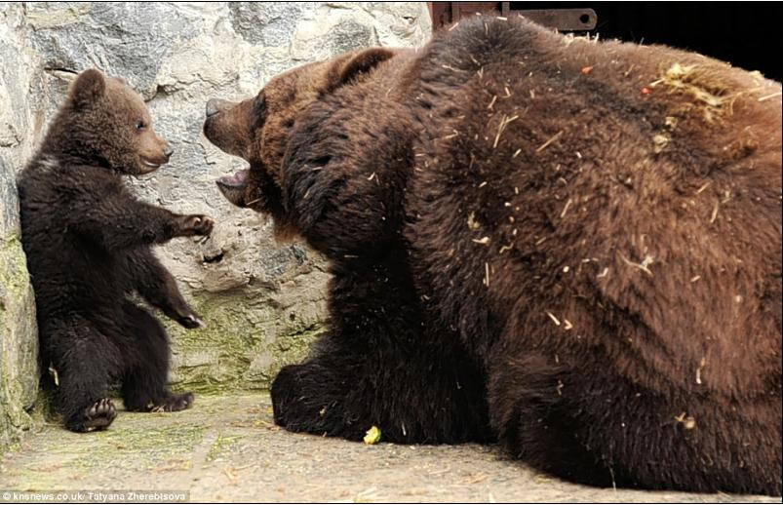

Slide 8
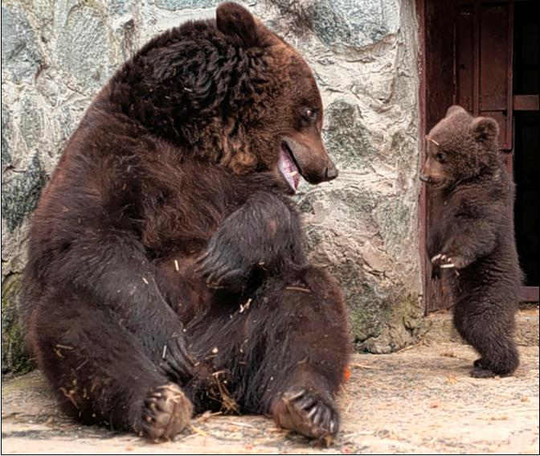

Slide 9
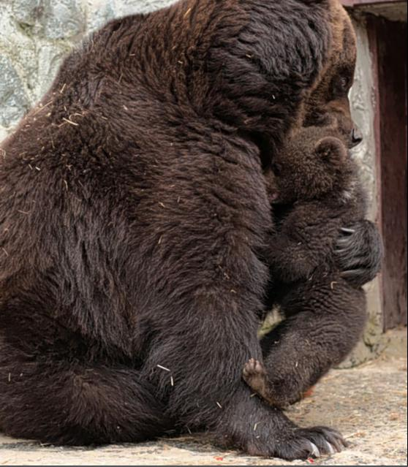

Slide 10
Grief
Sanaga-Yong Chimpanzee Rescue Centre Cameroon
“Dorothy :( <3”
Monkey Funeral

Slide 11
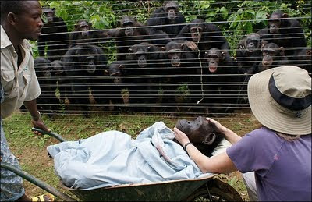

Slide 12
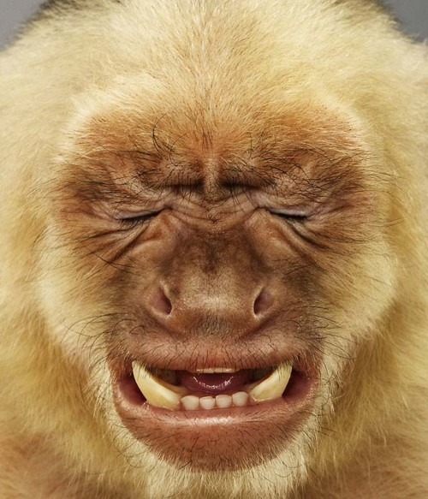
Justice
“Brosnan, along with lead author Megan van Wolkenten and Frans B. M. de Waal, both at Emory University in Georgia, trained 13 tufted capuchin monkeys (Cebus apella) at Emory's Yerkes National Primate Research Center to play a no-fair game.”
“When both monkeys received cucumber rewards, all was fine in primate land. But when one monkey handed over the granite stone and landed a grape, while monkey number two got a cucumber, madness ensued.”

Slide 13
In conclusion?!?
…Everything is evolving...right now...

Slide 14
Works Cited
"Innate Tendencies." From Human Nature. Stephen Gislason, n.d. Web. 20 Oct. 2016.
http://www.bbc.com/future/story/20150706-the-small-list-of-things-that-make-humans-unique
http://www.npr.org/sections/health-shots/2014/07/23/334454122/does-your-dog-feel-jealous-or-is-that-a-purely-human-flaw
https://philosophynow.org/issues/69/What_Makes_Human_Beings_Unique
https://chipublib.bibliocommons.com/item/show/8992522081_not_so_different
http://sparethekids.com/2012/03/what-a-mama-bear-can-teach-humans-about-disciplining-children/

